Slide 1
TSO Programs and Service Projects Area Workshop Presentation

Slide 2
“Reset Your Chapter’s Compass in New Directions Through Programs and Service Projects”

Slide 3
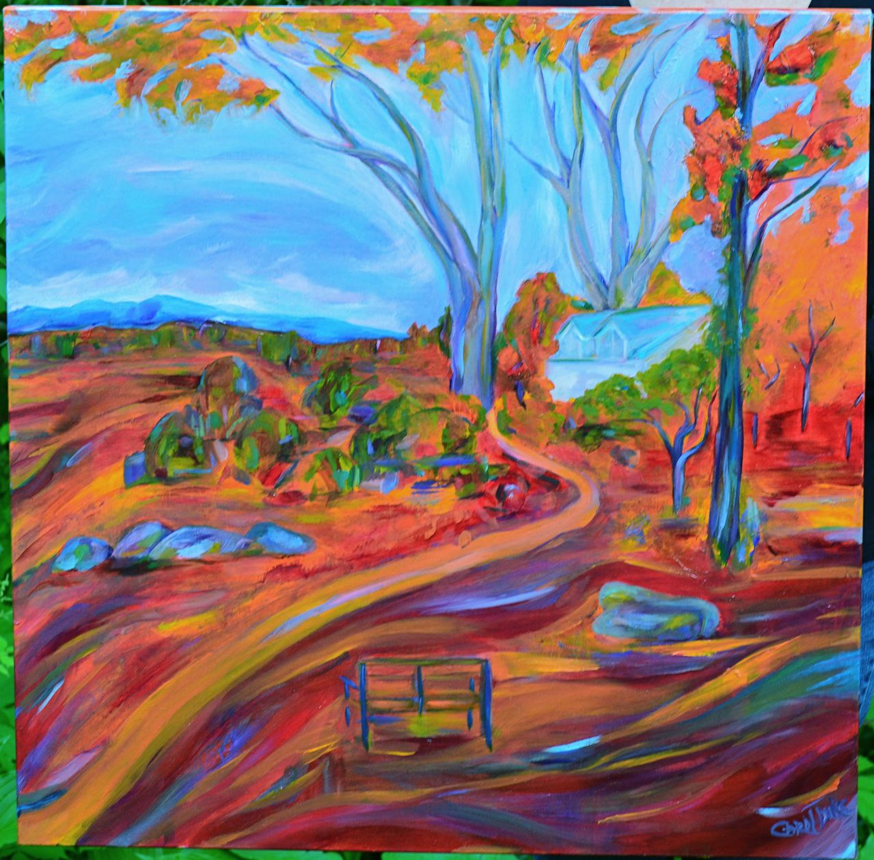
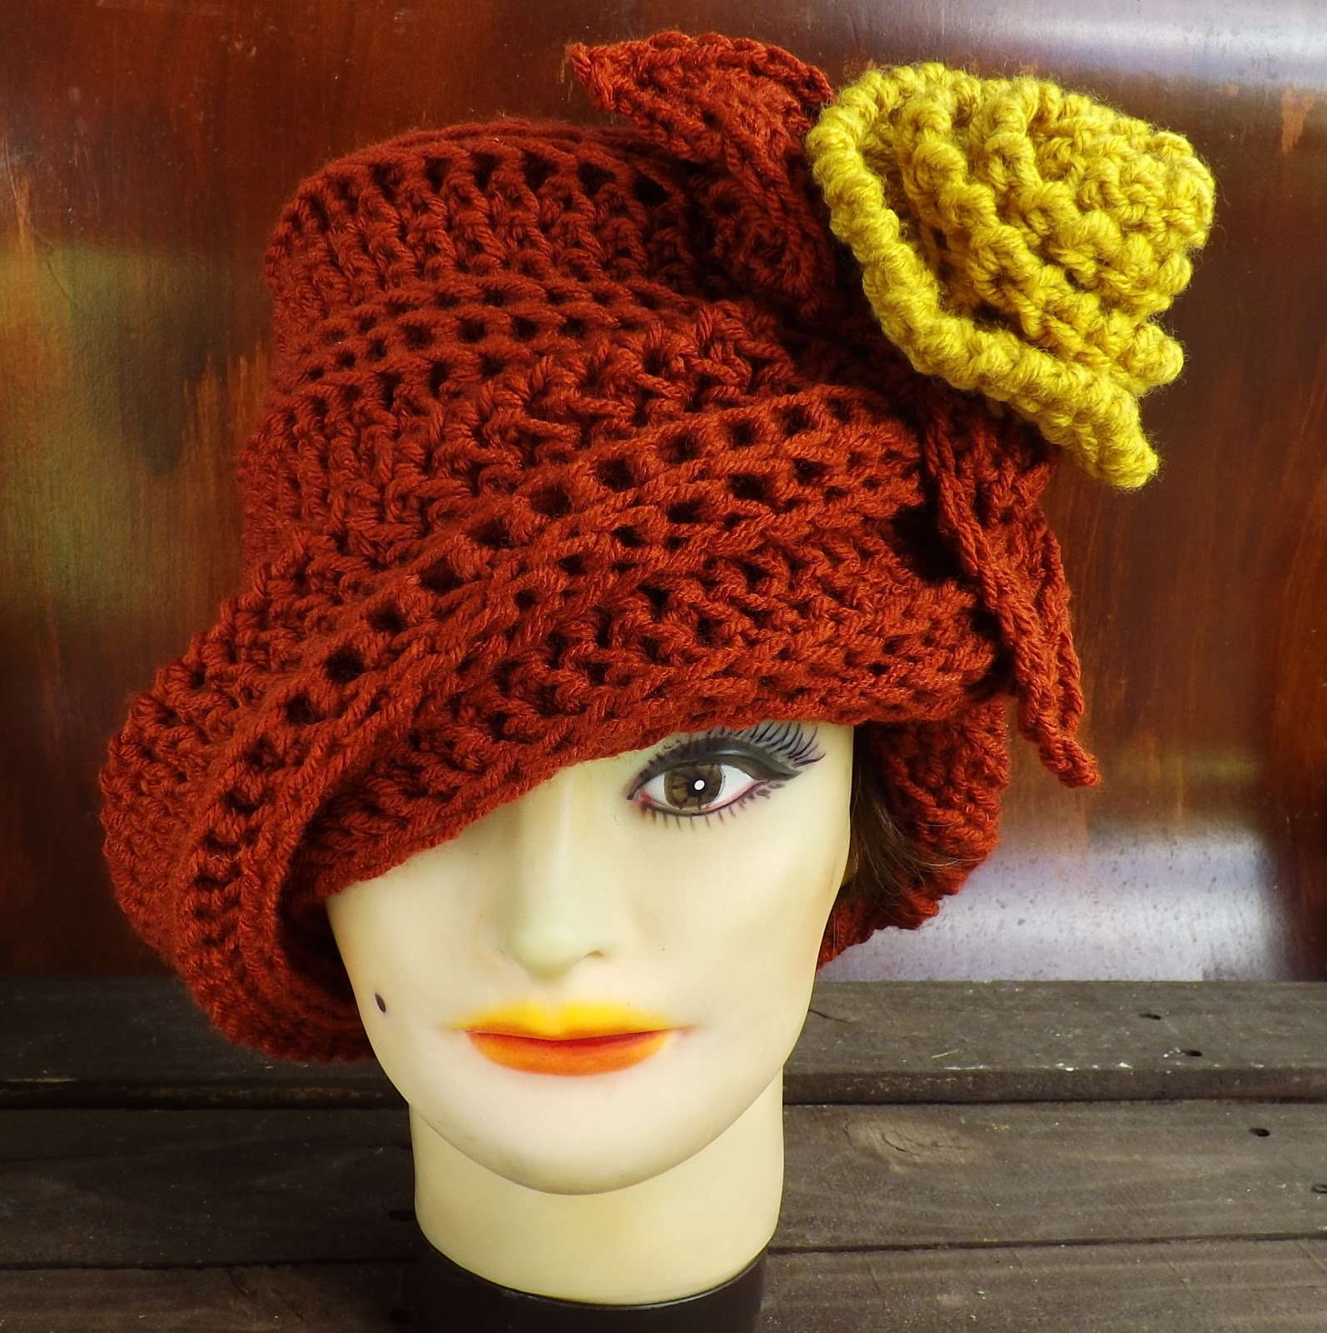
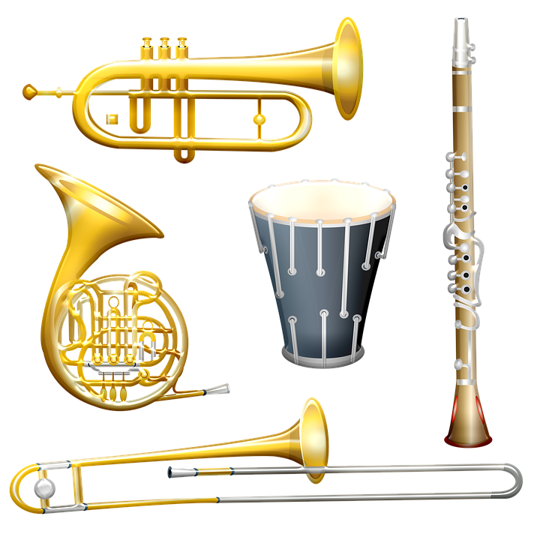
Group activity:

Slide 4
In thinking about the 3 previous pictures what category of programs would they fall into? A. Mental and emotional women’s health B. Community available places to visit C. Women in the arts

Slide 5
How does your Chapter plan programs? Gather topics of interest gathered from a survey? Review program topics from previous year Will a project be generated from program presentation?

Slide 6
Chapter Planning Meeting
Chapter Programs and Service Projects Committee meets to plan programs for year.

Slide 7
Community speaker
Invite a community non-profit to come talk to chapter and present purpose's and needs.

Slide 8
Can a project become a program ?

Slide 9
Identify needs

Slide 10
Collect school supplies mid year for teachers

Slide 11
Chapter Recognitions

Slide 12
Honoring Outstanding Member
Does your chapter award an achievement award?
Recognize members who have 5-10-25-50+ years in DKG
Celebrate events with members

Slide 13
Invite another chapter to have a meeting or fund raising event with your chapter (in person or zoom)

Slide 14
Attend DKG events and share with chapter
Area Workshops
State Convention
International Convention

Slide 15
Service Projects ideas

Slide 16
Making goody bags for teachers

Slide 17
Collecting Educational Items to share

Slide 18
Making items of need identified in community based programs

Slide 19
Where can you find ideas for programs and projects?
Go to the following websites
www.dkg.org (Programs and Projects)
www.astef.org (Project ideas)
www.dkgtexas.org (Programs and Service Projects)
Check out available grants for projects
www.astef.org (Alpha State Texas Educational Foundation)
www.dkg.org (DKG International Educator Foundation)

Slide 20
Please contact Lynda Anderson for additional information tsoprogramsprojectsdkg@gmail.com

