Slide 1
Brenda Lozano
brendaklozano@gmail.com
281-224-7312
Martha Lynn Lewis
marthalynnlewis@msn.com
713-829-4954

Slide 2
The Red Folder
Brenda Lozano and Martha Lynn Lewis
Lambda Alpha

Slide 3
Why was it needed?

Slide 4
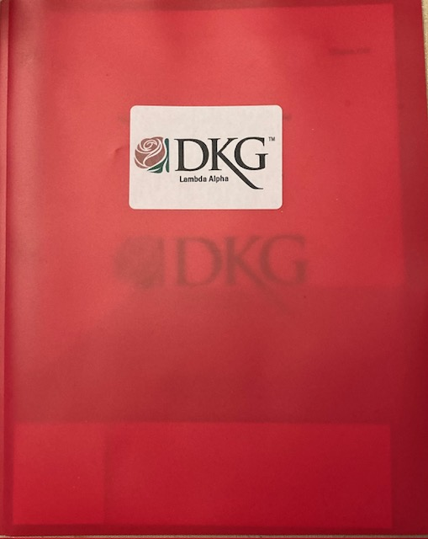
Red Folder itself
Plastic or paper
with pockets
Label

Slide 5
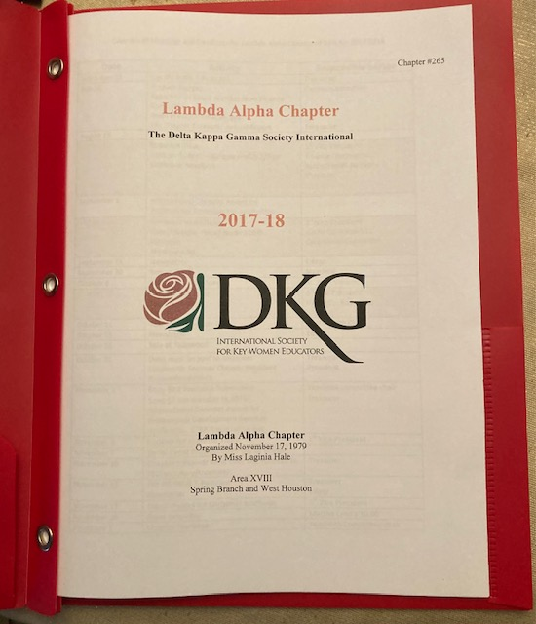
Cover sheet
Name
Year
Chapter #
When organized
By whom
Area
Geographic description of area

Slide 6
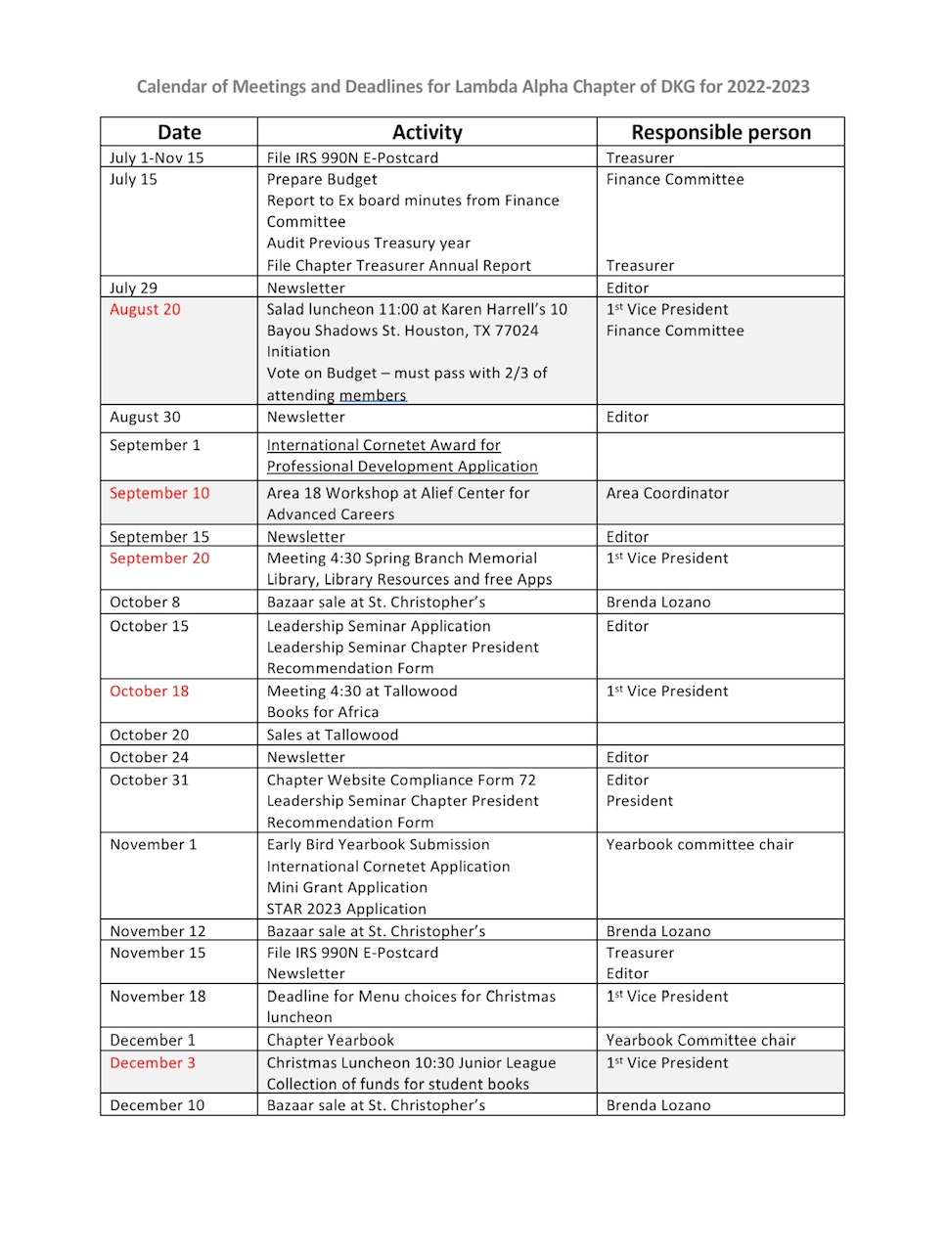
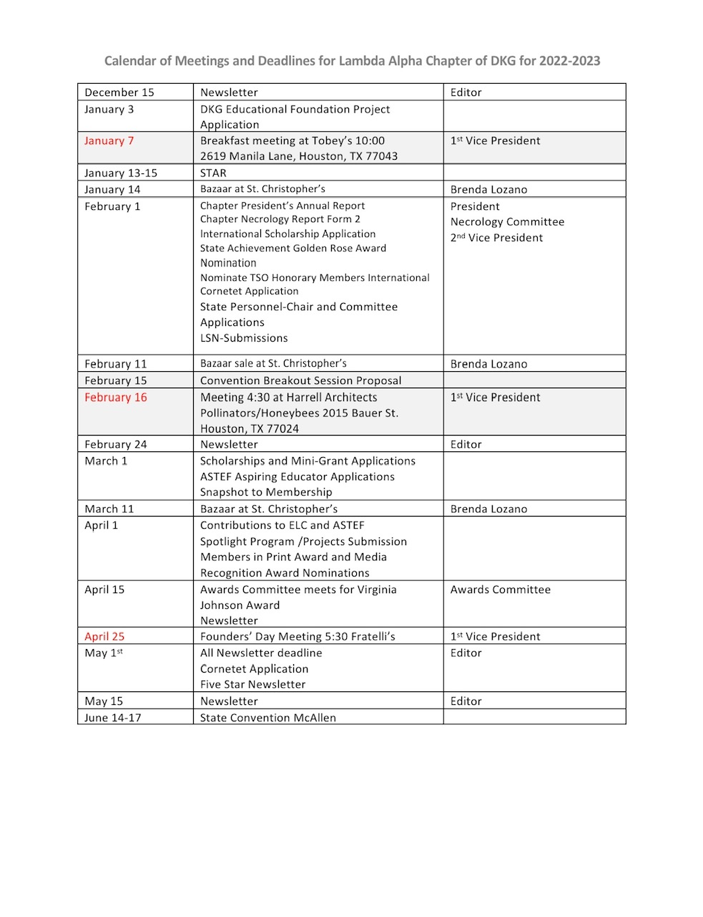
Deadlines
International
State
Chapter
Also lists person responsible
Individual folders could be personalized with their responsibilities highlighted
Meetings in Red

Slide 7
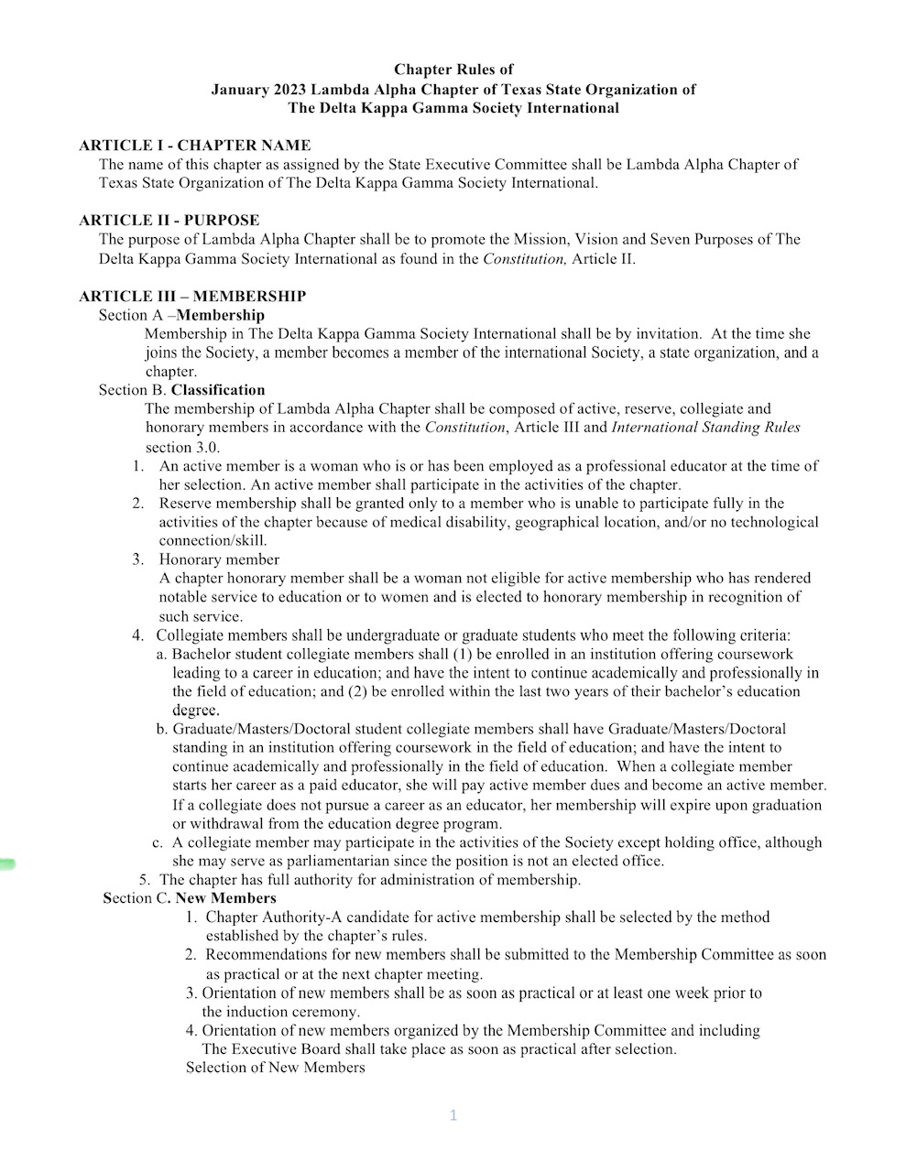
Chapter Rules
It is important for all members to have these and not just for the Executive Committee.

Slide 8
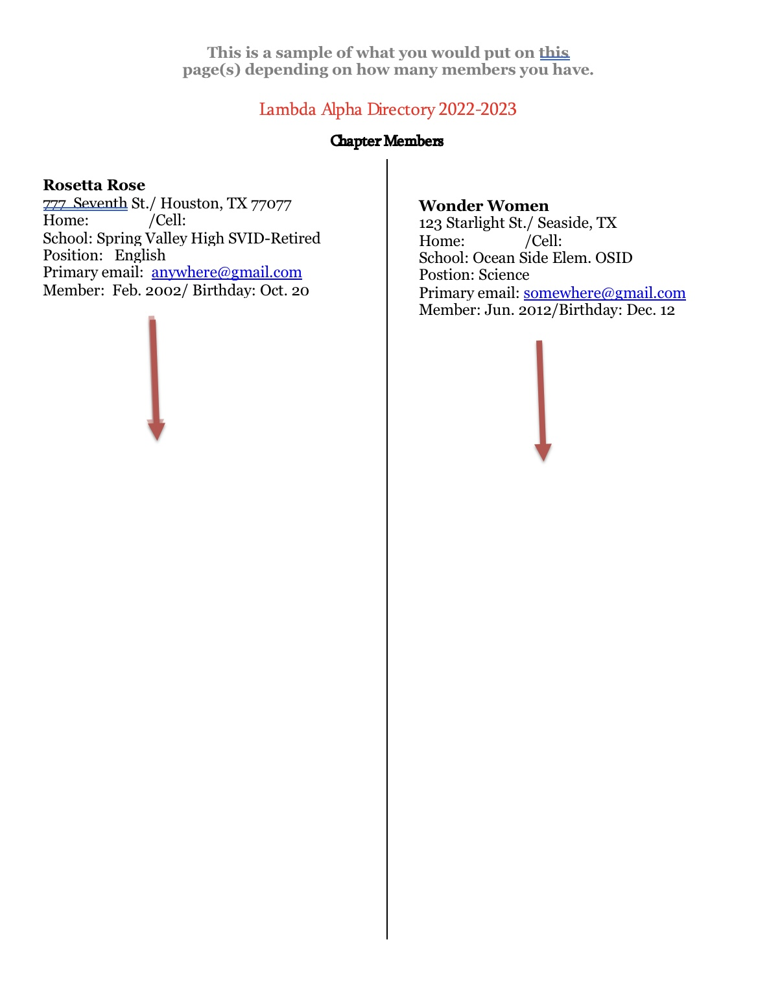
Directory
Print labels for new members so they can be added easily to directory
Name, address, phone number, school, position, primary email, other email, Induction date, birthday

Slide 9
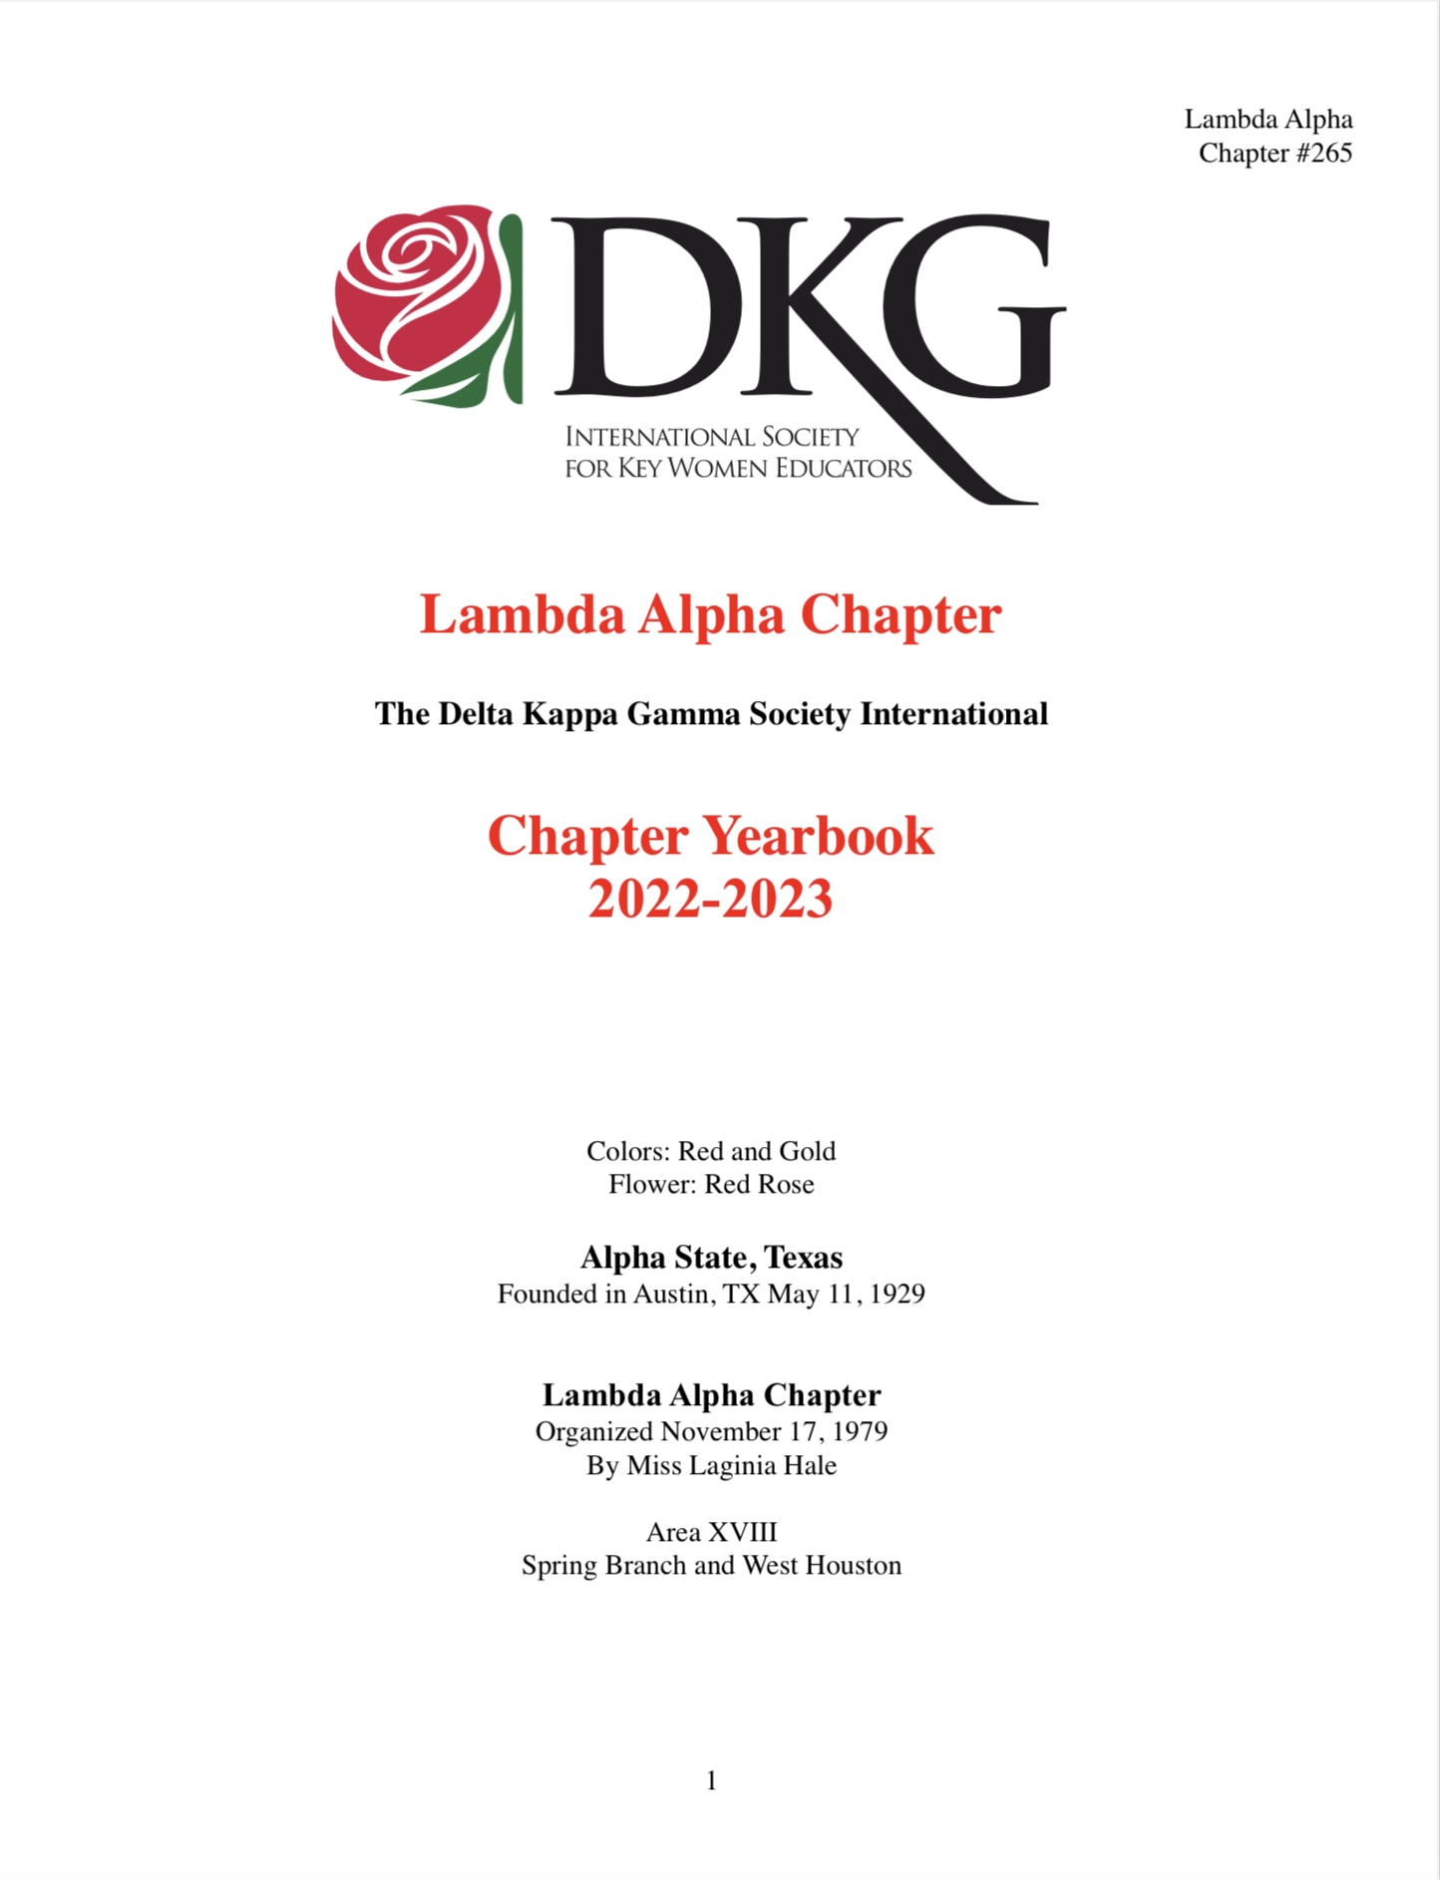
Pockets are good for:
Yearbook
List of committees
Sign in sheets
Treasurer’s reports
Agendas
Budget
Newsletters
Flyers
Vouchers
Song

Slide 10
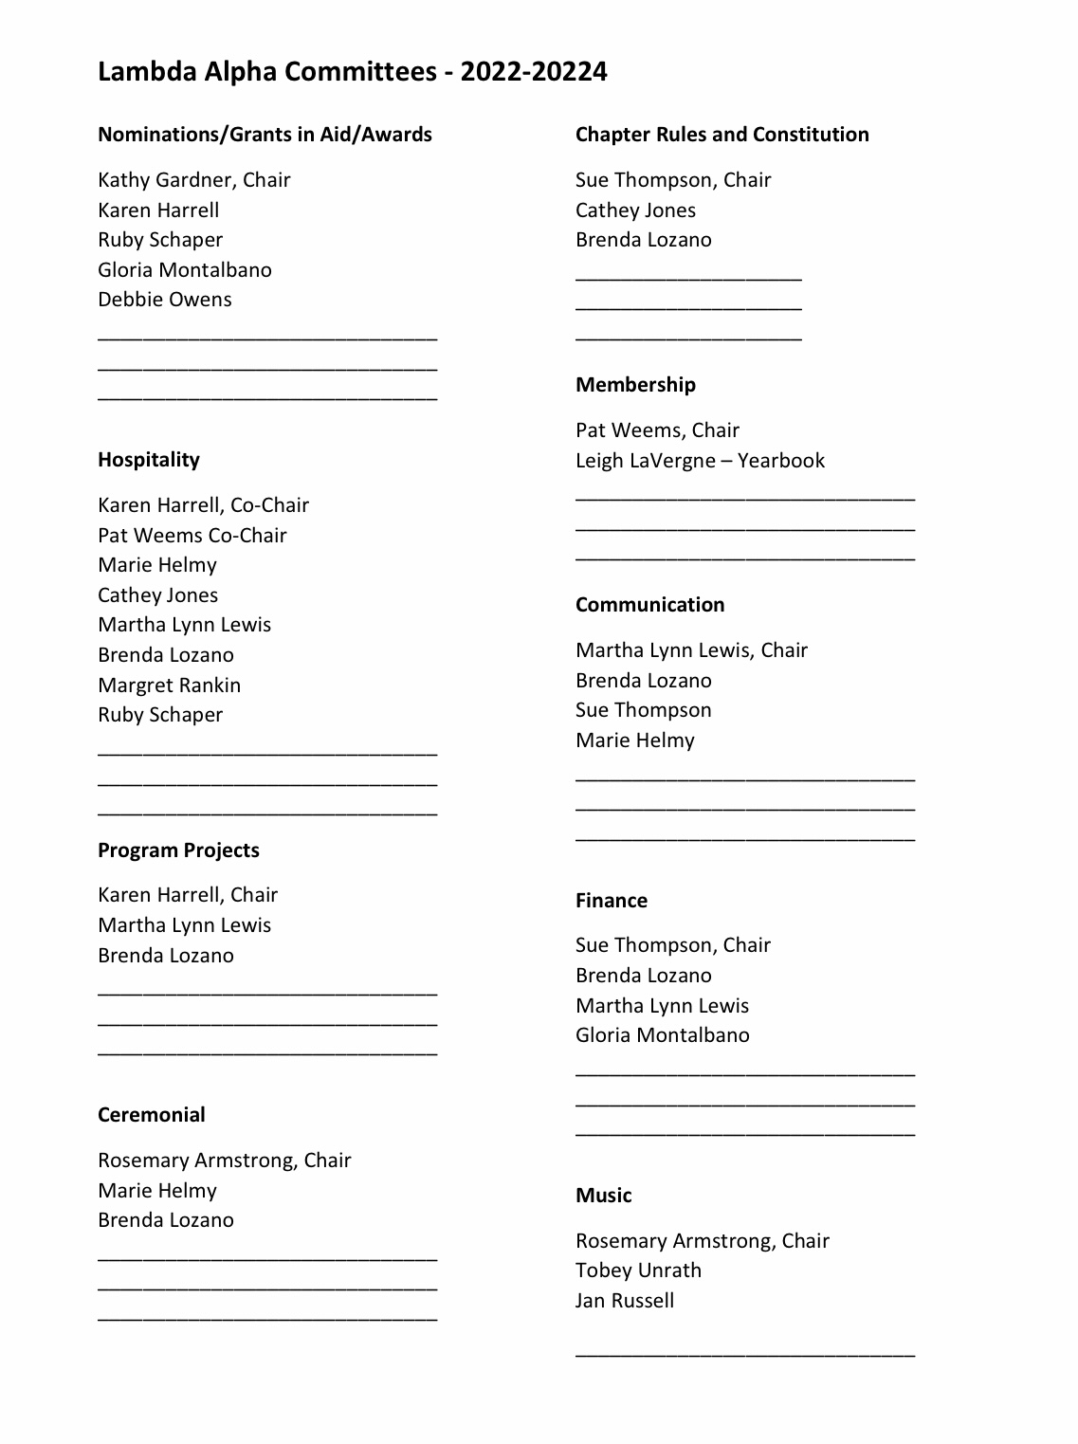
Pockets are good for:
Yearbook
List of committees
Sign in sheets
Treasurer’s reports
Agendas
Budget
Newsletters
Vouchers
Song

Slide 11
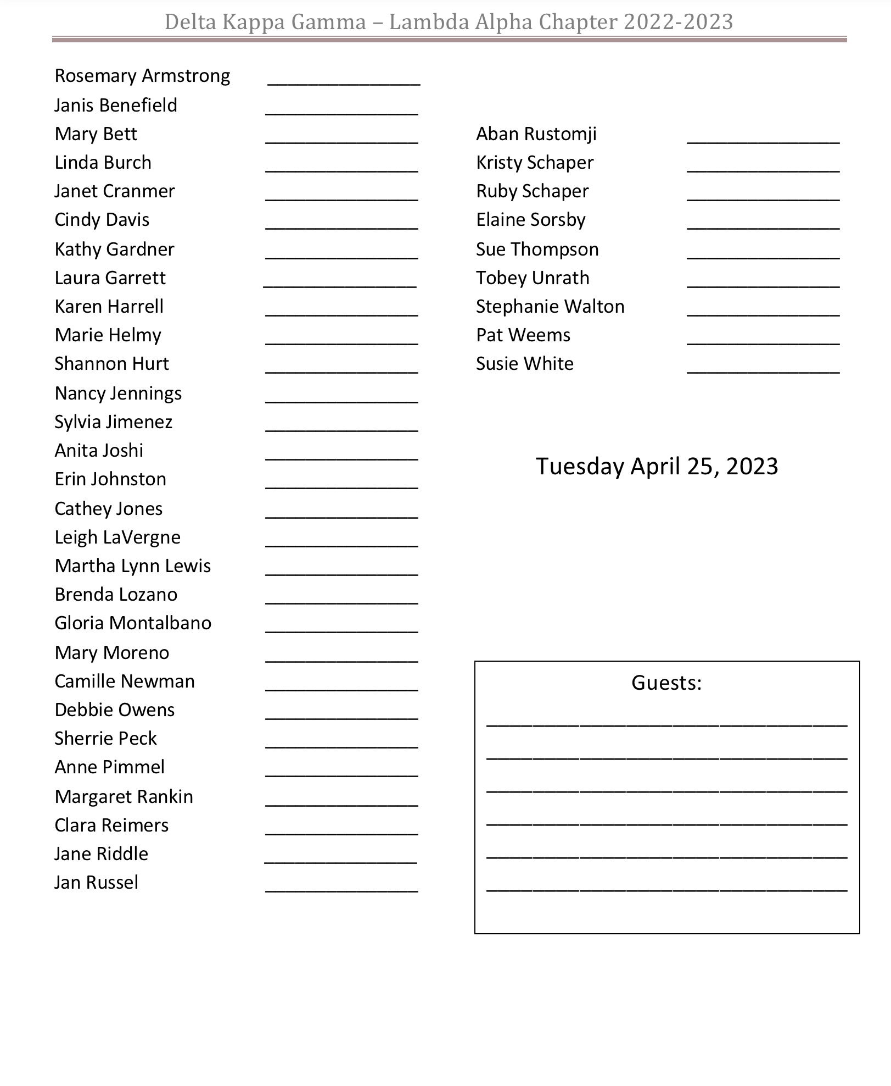
Pockets are good for:
Yearbook
List of committees
Sign in sheets
Treasurer’s reports
Agendas
Budget
Newsletters
Vouchers
Song

Slide 12
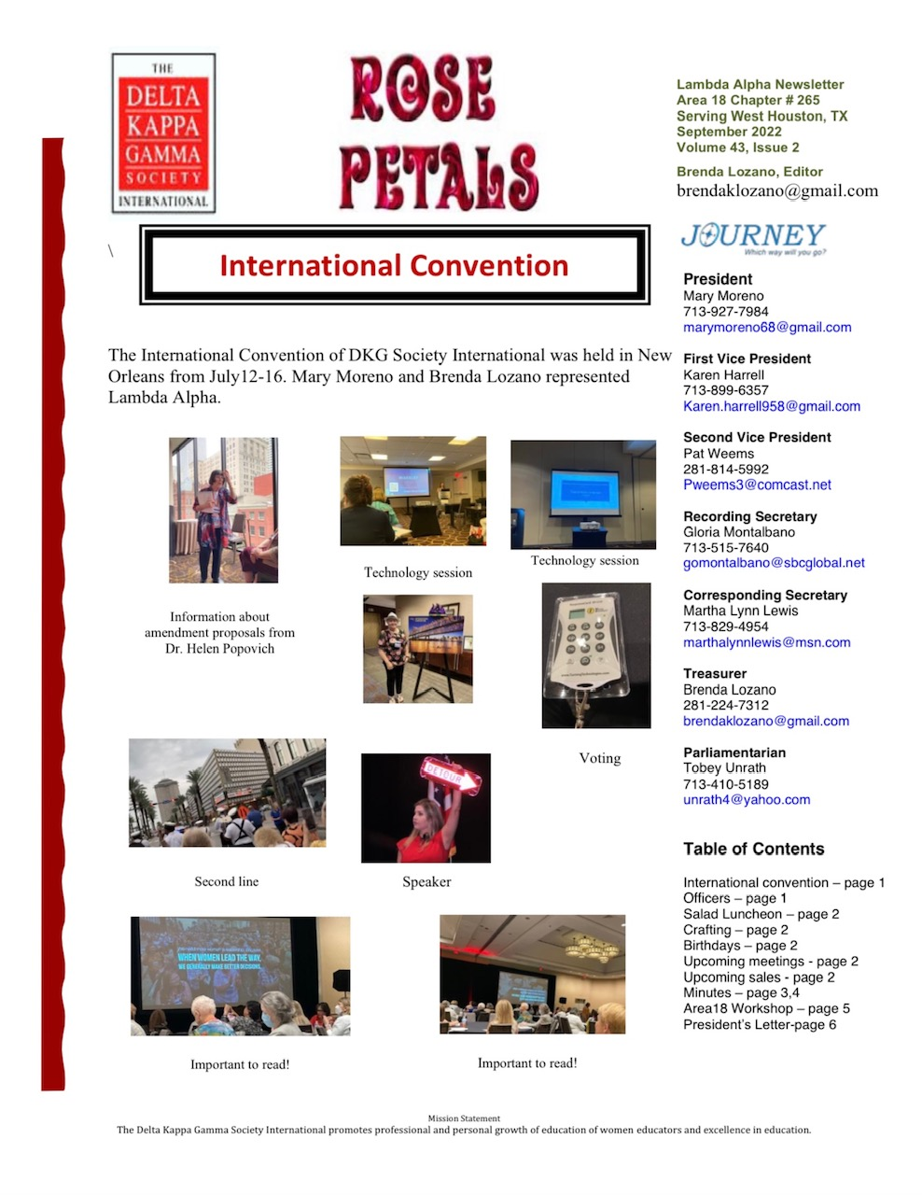
Pockets are good for:
Yearbook
List of committees
Sign in sheets
Treasurer’s reports
Agendas
Budget
Newsletters
Vouchers
Song

Slide 13
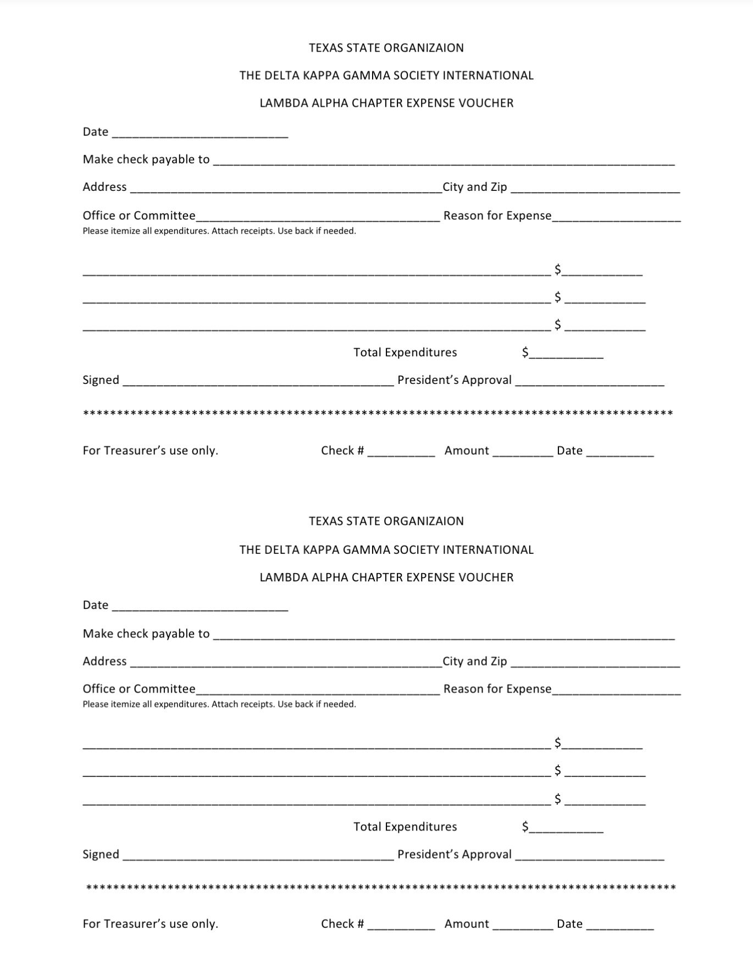
Pockets are good for:
Yearbook
List of committees
Sign in sheets
Treasurer’s reports
Agendas
Budget
Newsletters
Vouchers
Song

Slide 14
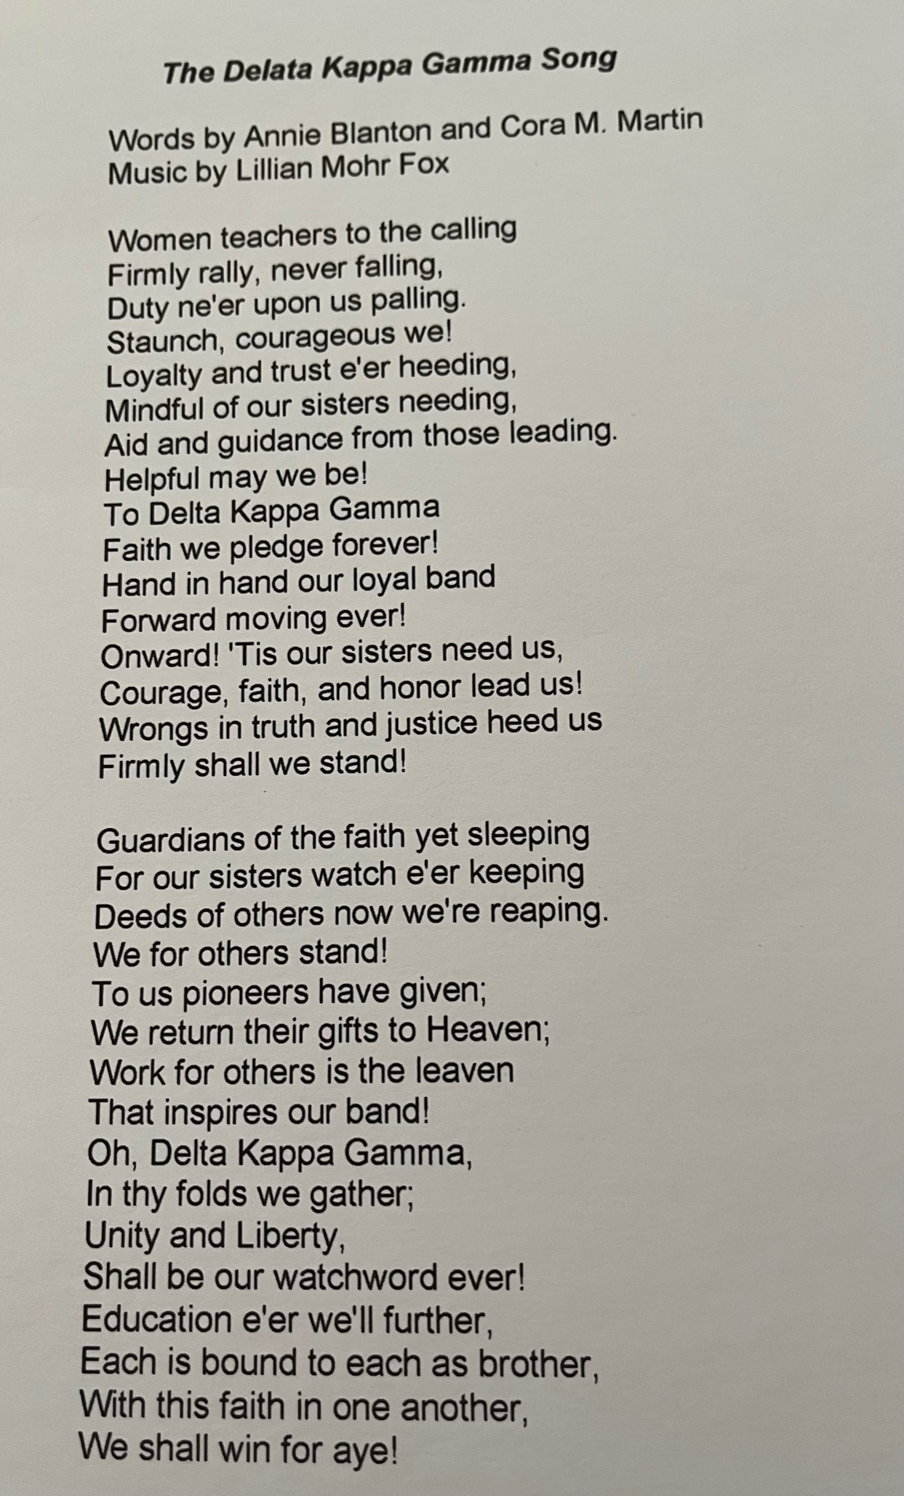
Pockets are good for:
Yearbook
List of committees
Sign in sheets
Treasurer’s reports
Agendas
Budget
Newsletters
Vouchers
Song

Slide 15
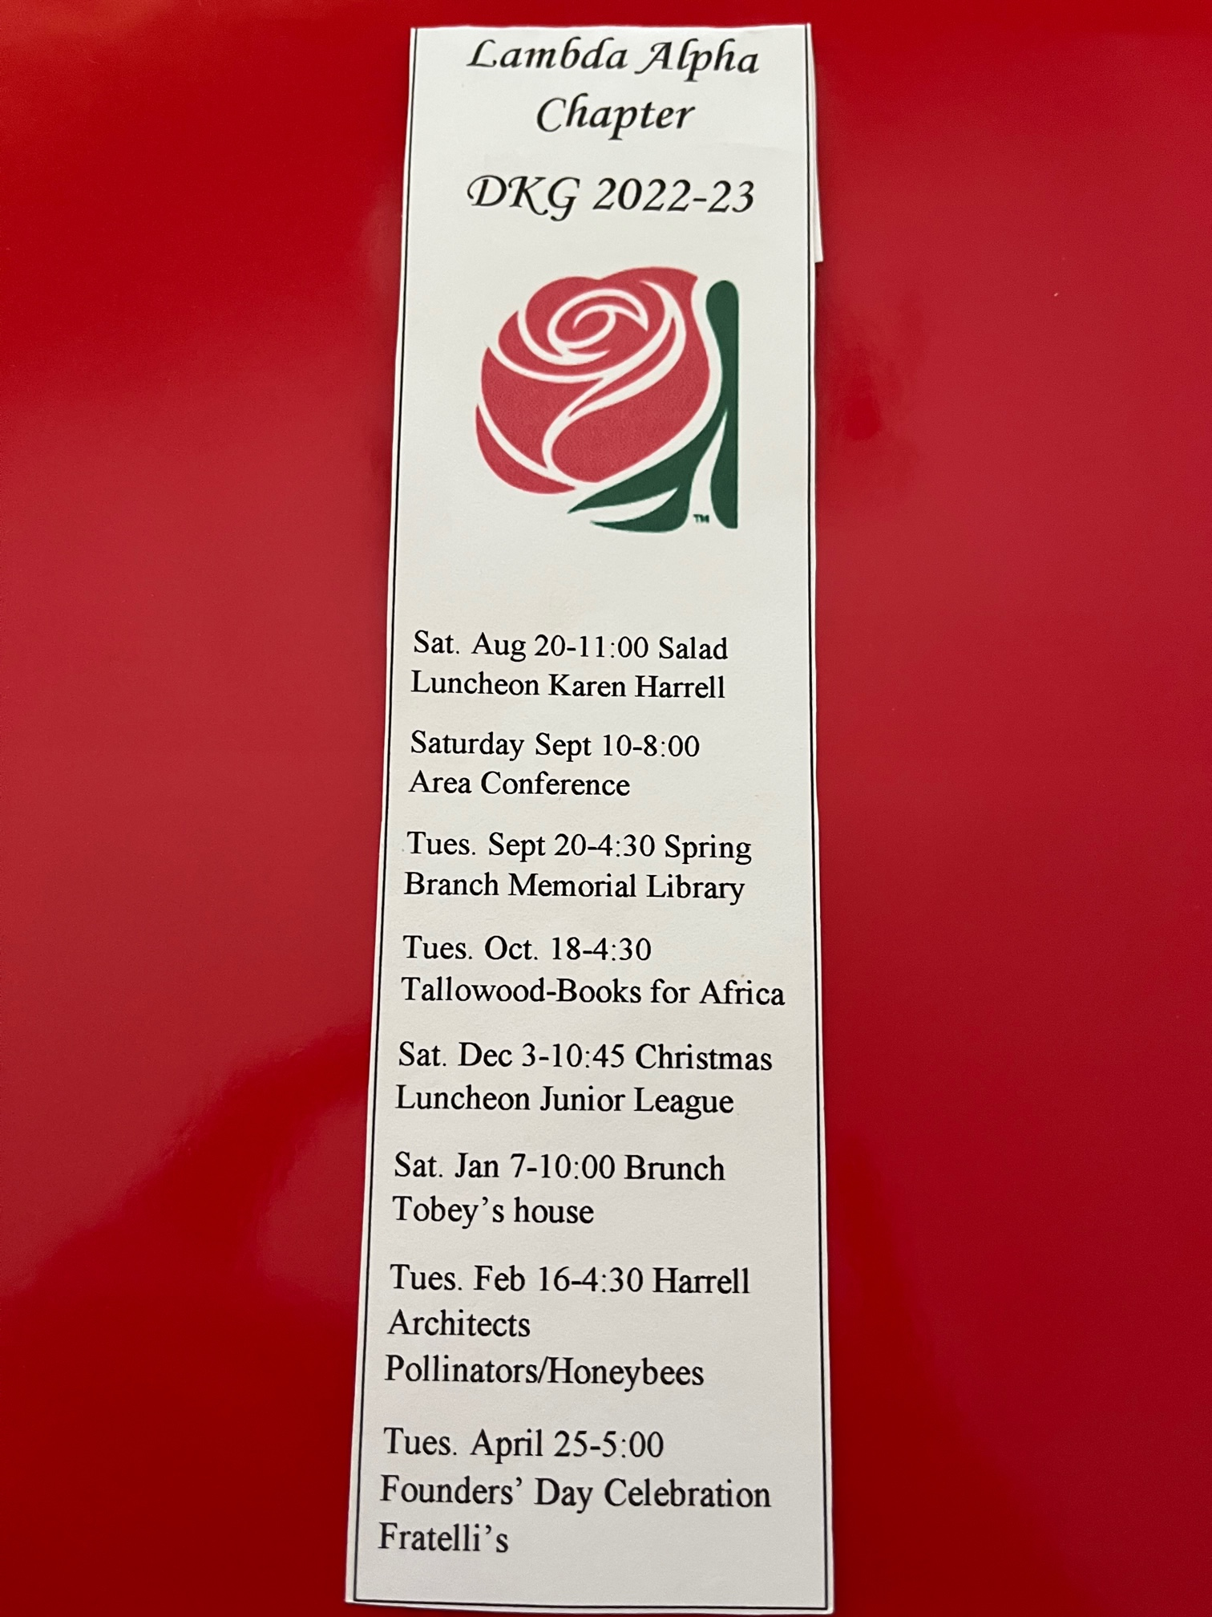
Bookmarks
Have magnets to use as bookmark or can go on refrigerator or other metal spot
Easy reference for dates
Good talking point when friends are over

Slide 16
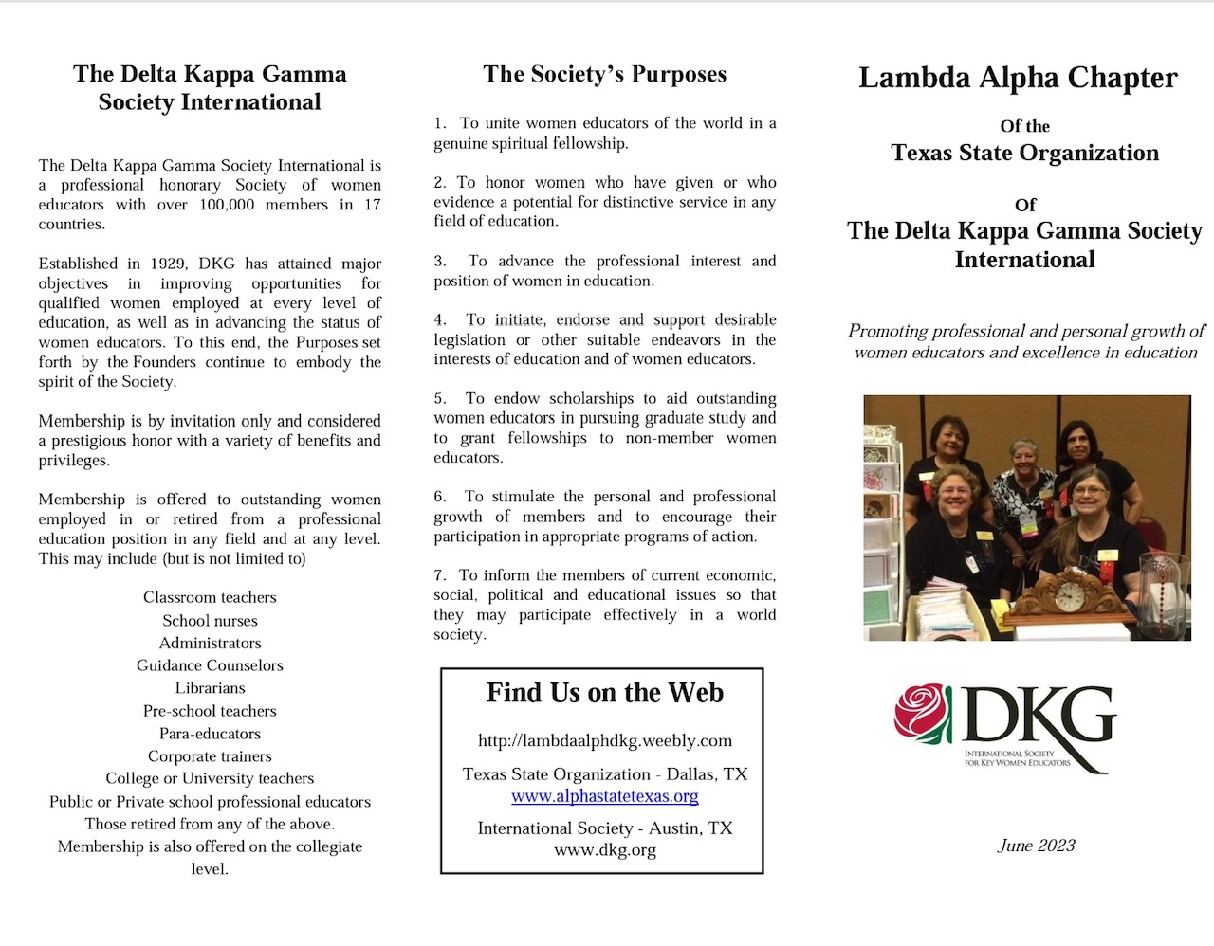
Flyer

Slide 17
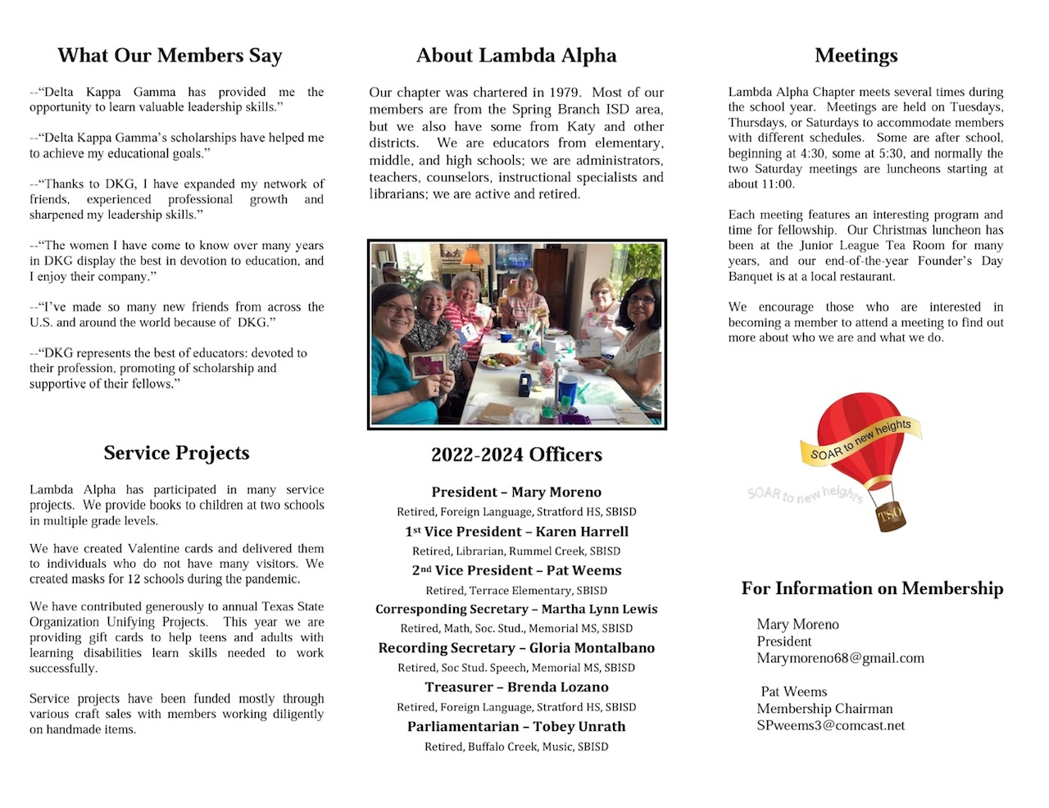
Flyer

Slide 18
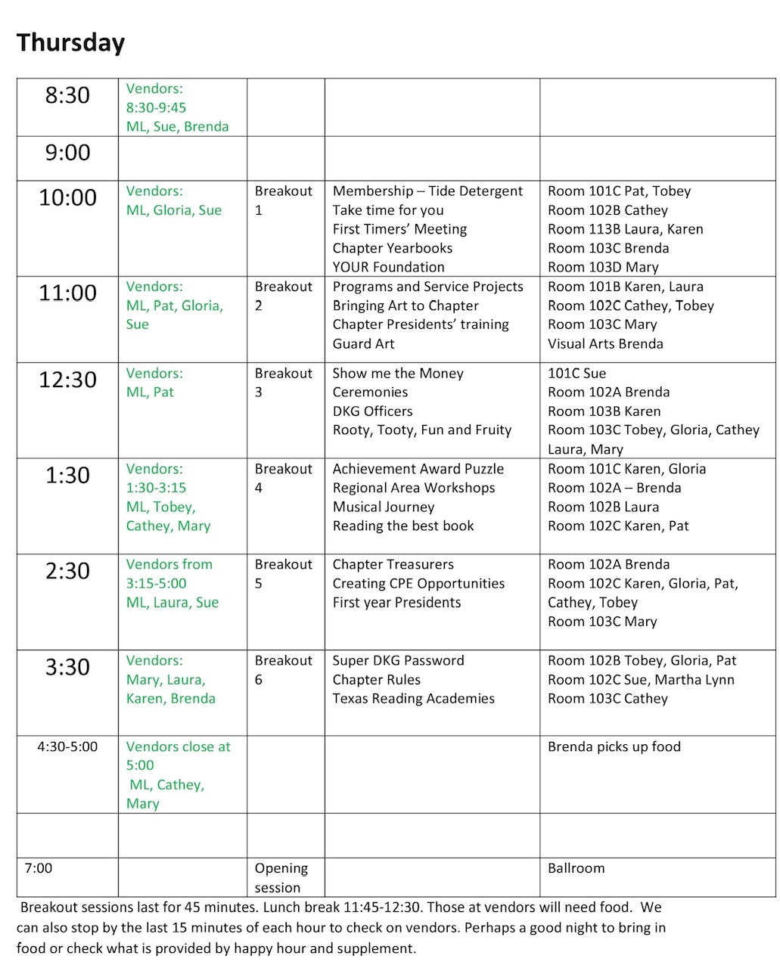
Conference schedule
Lists time
Name of session
Room of session
Who is going
Who is manning vendor’s table
Additional notes at bottom

Slide 19
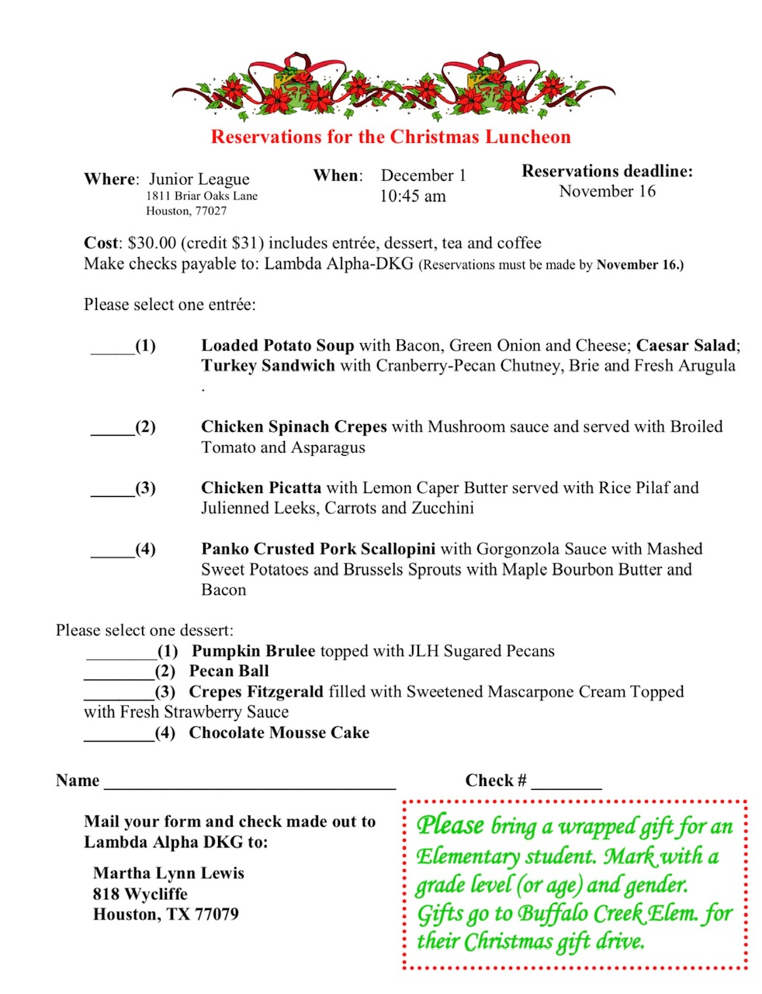
Christmas luncheon at the Junior League

Slide 20
Christmas Luncheon Spreadsheets
One is done alpha, one for entrée, one for dessert
Electronic copies are given to the Junior League and then printed copies to the servers

Slide 21
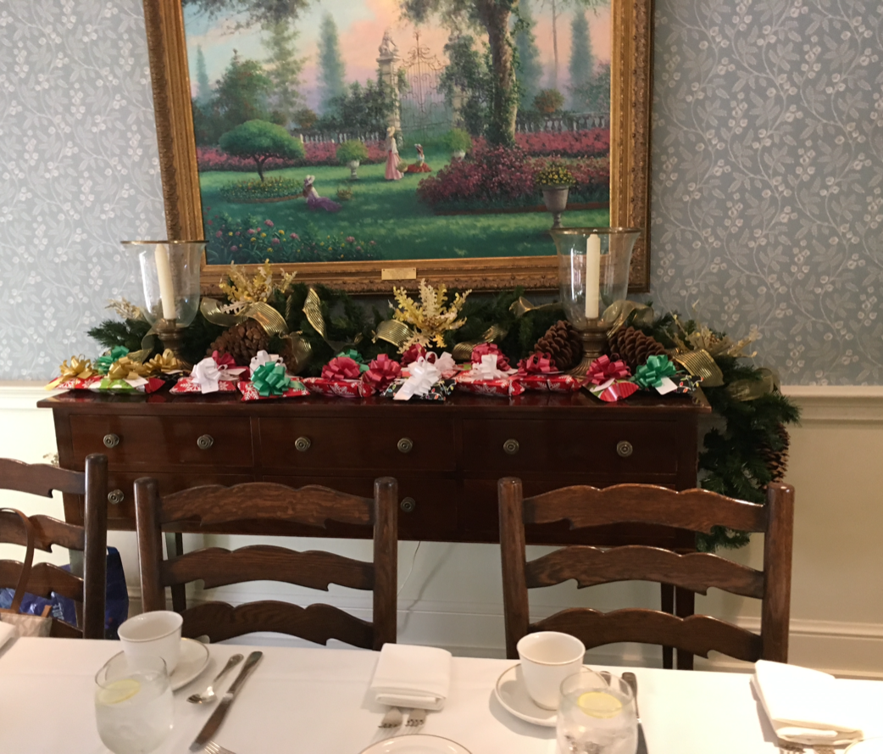
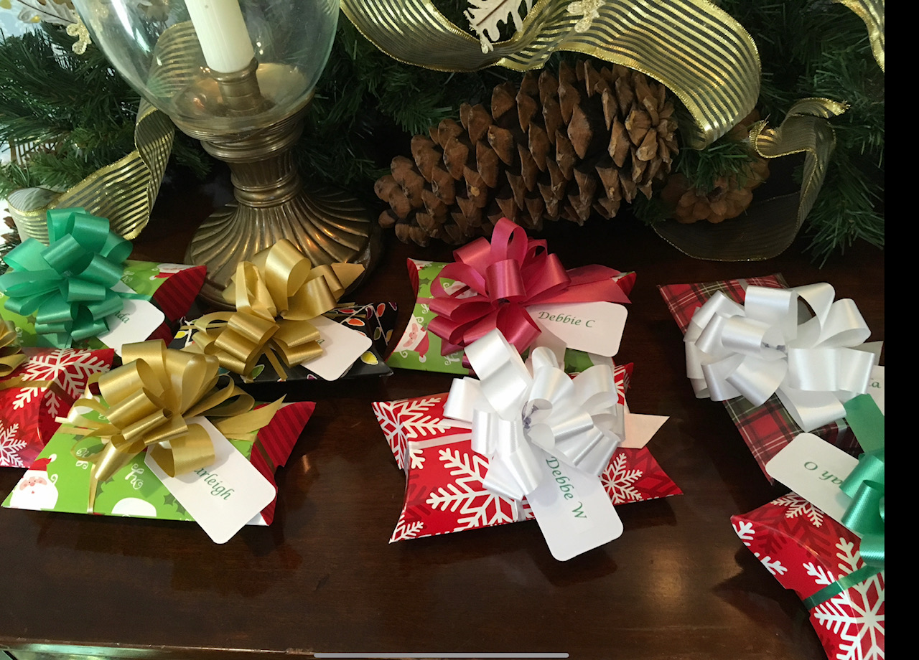
Favors – box indicates entrée and ribbon indicates dessert

Slide 22
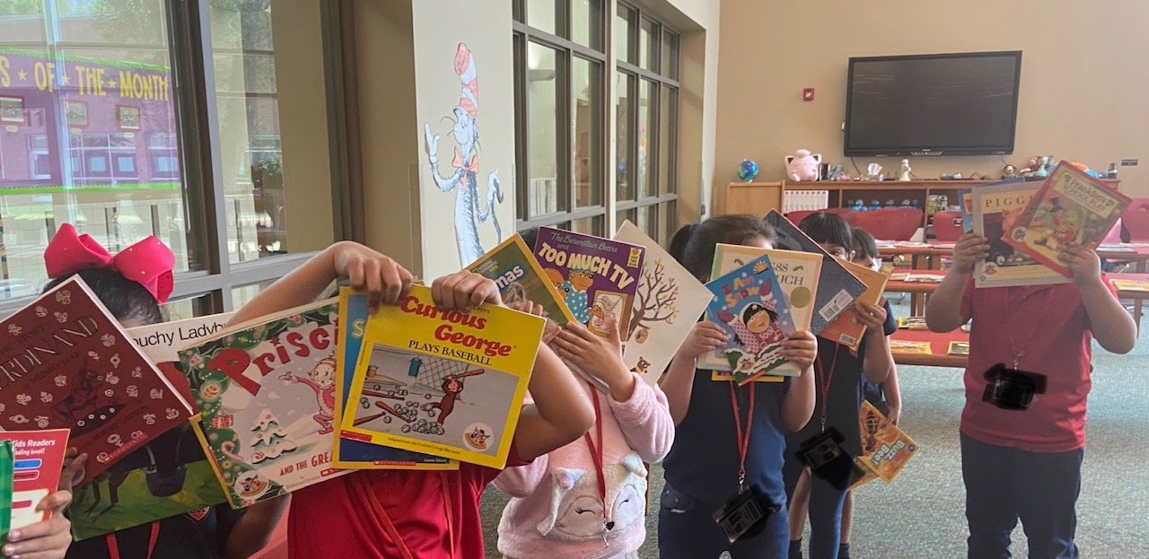
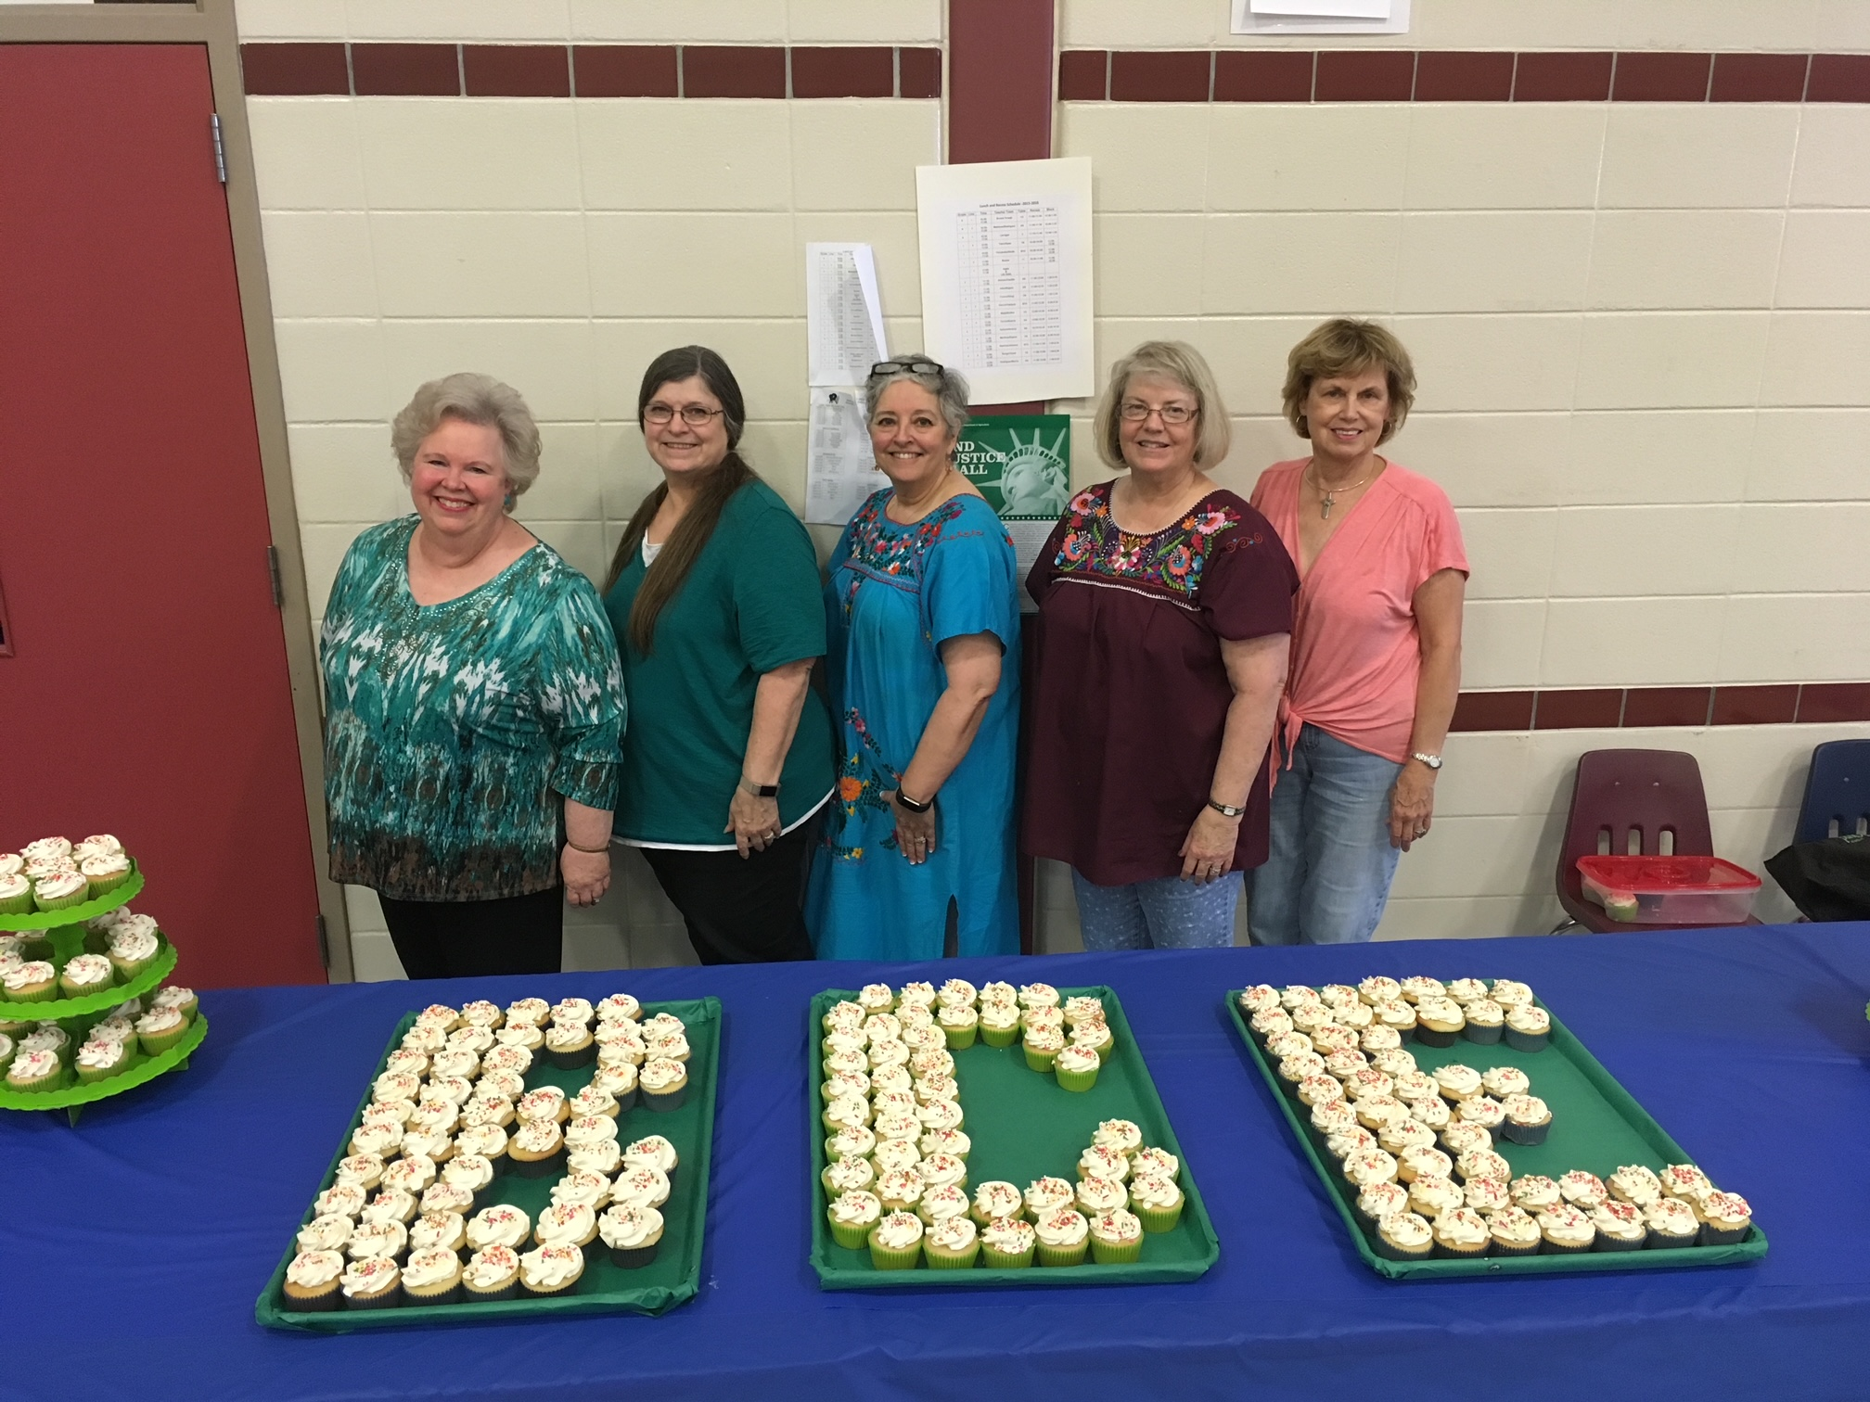
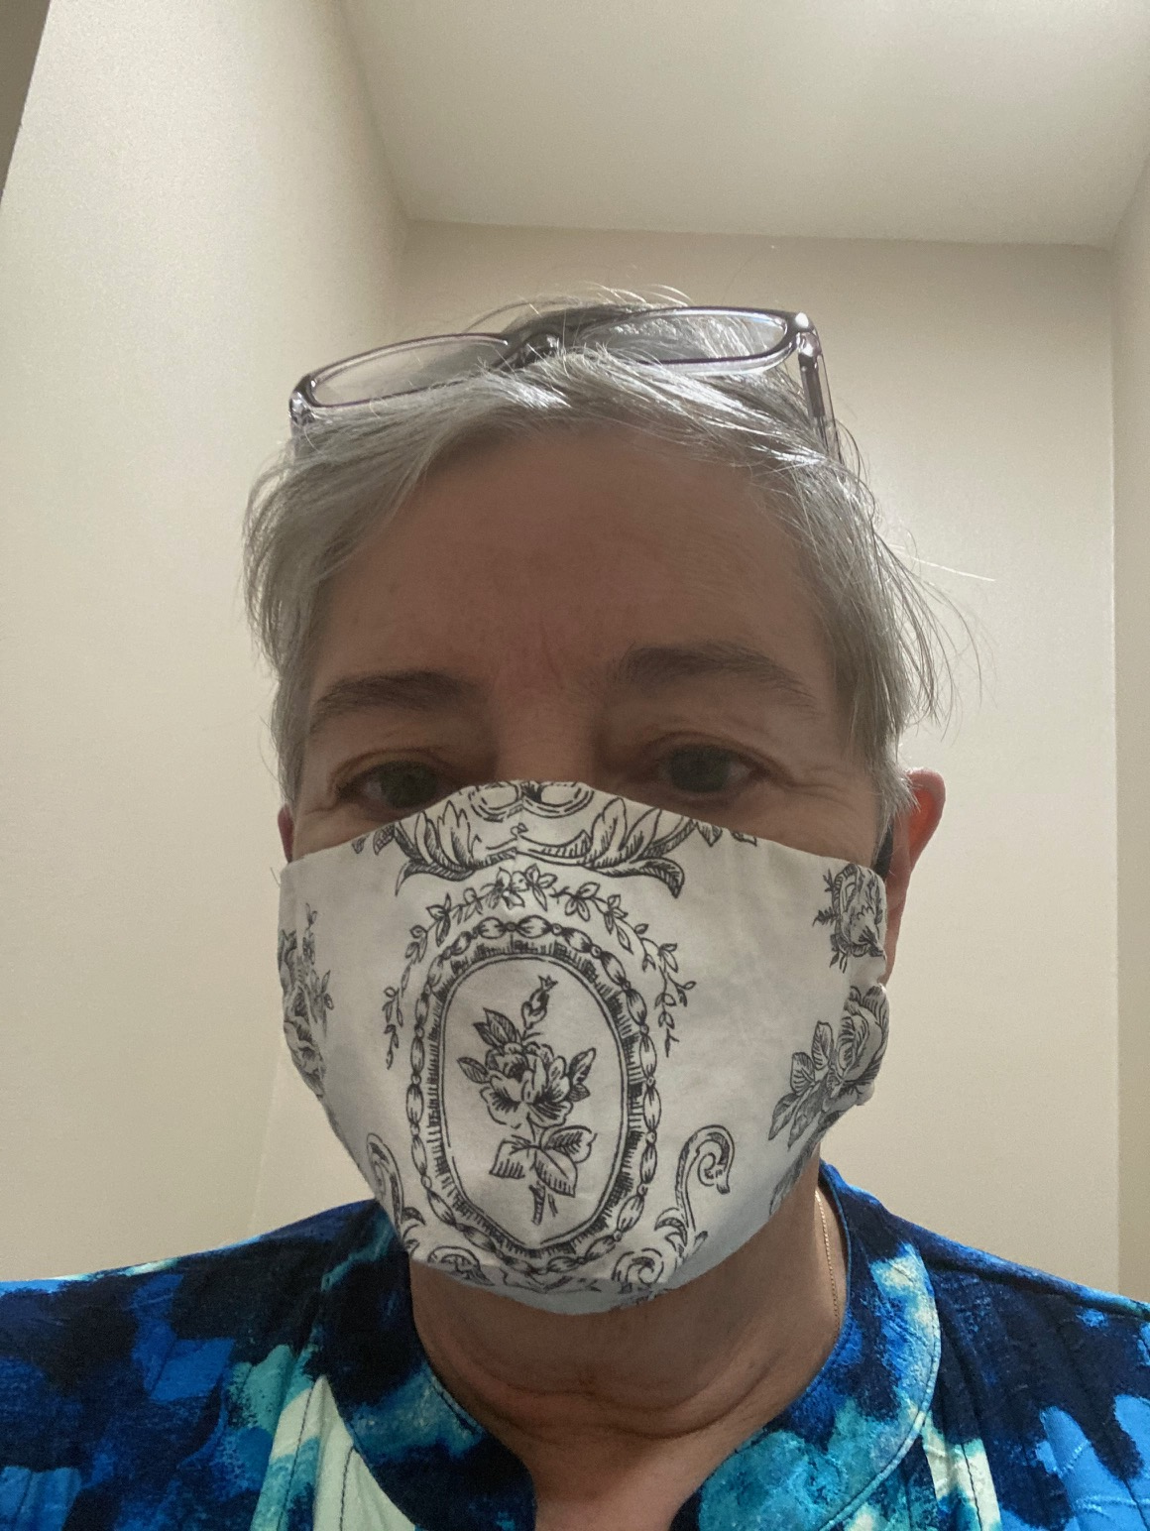
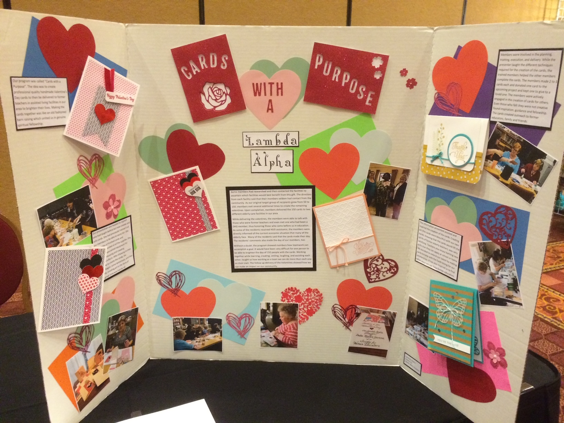
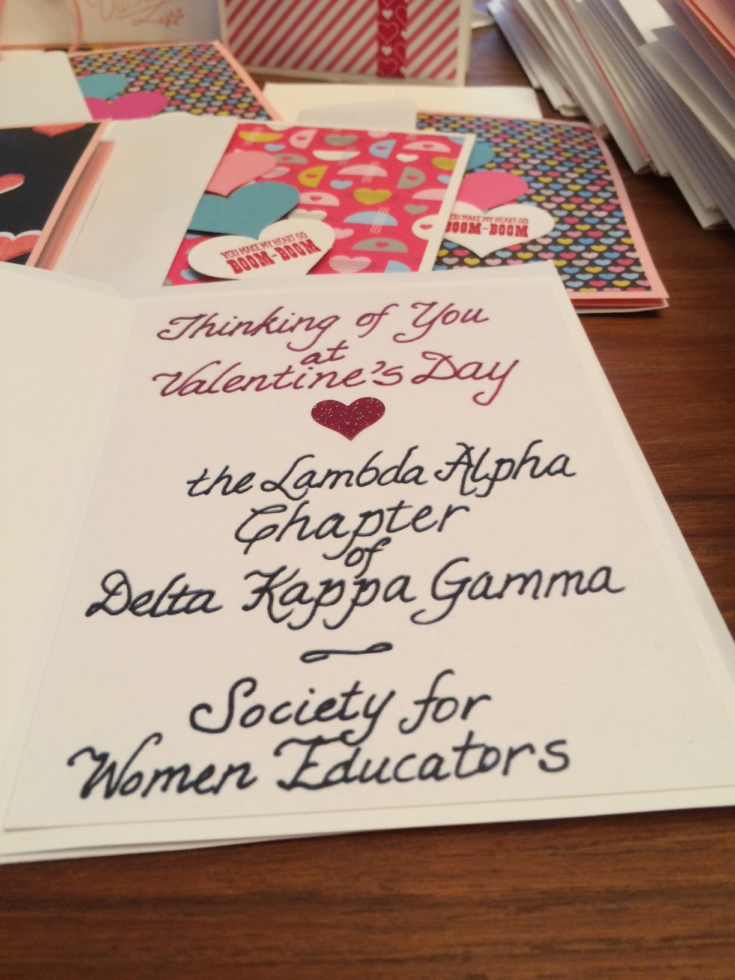
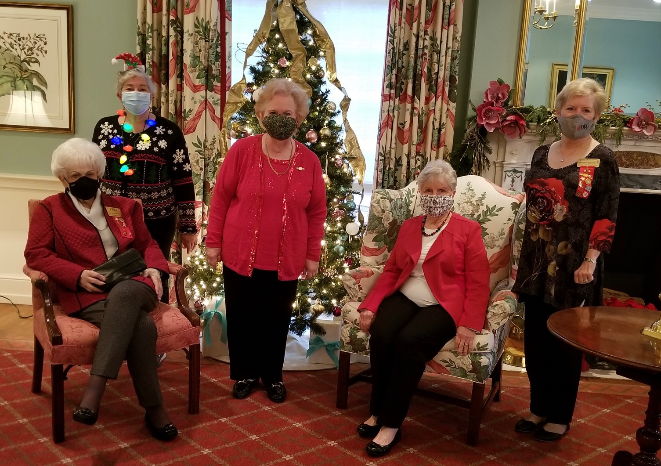
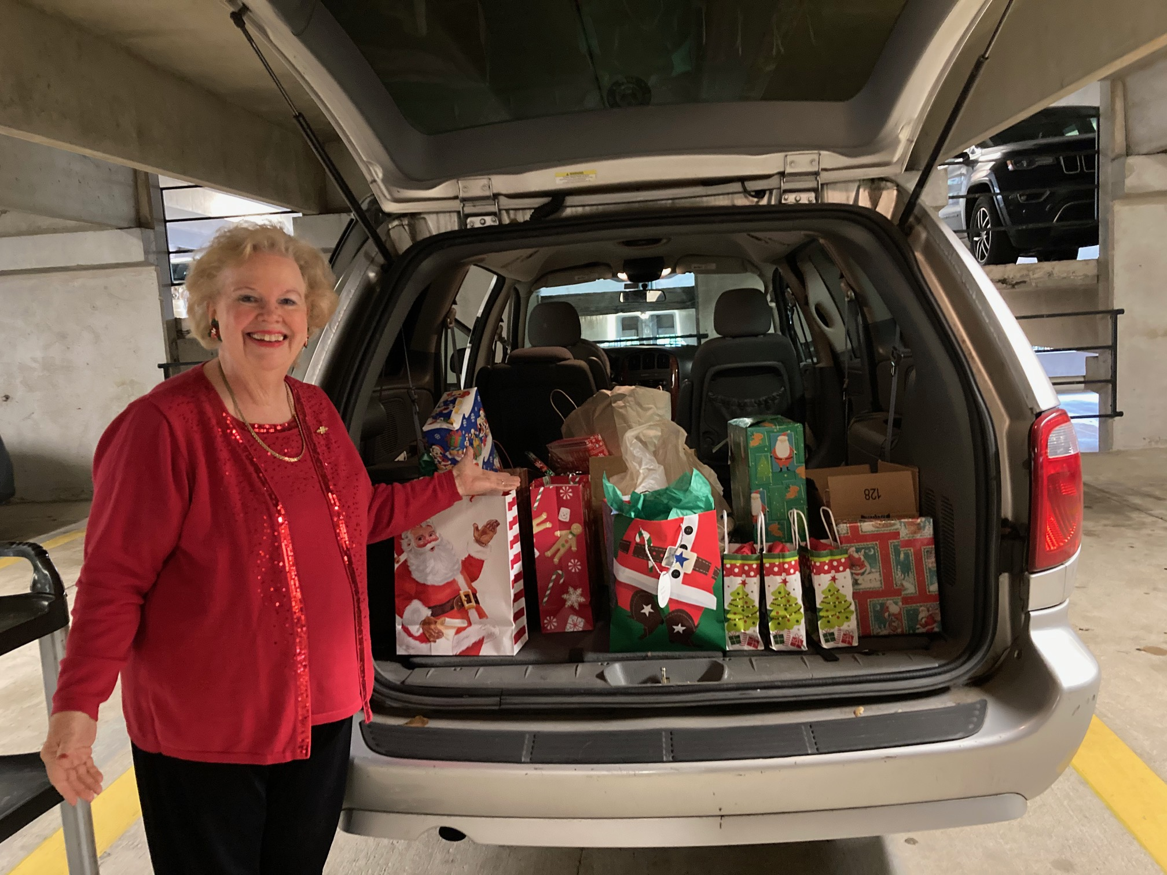
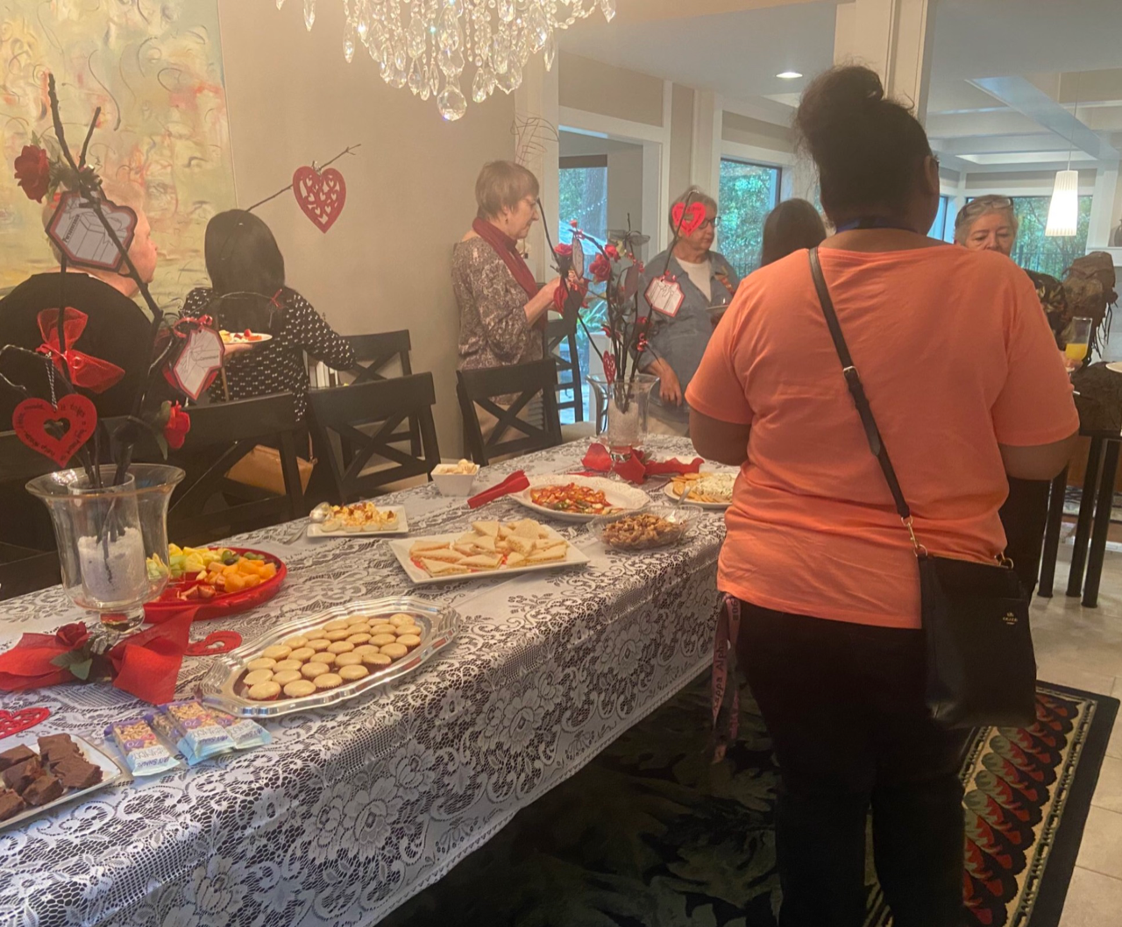
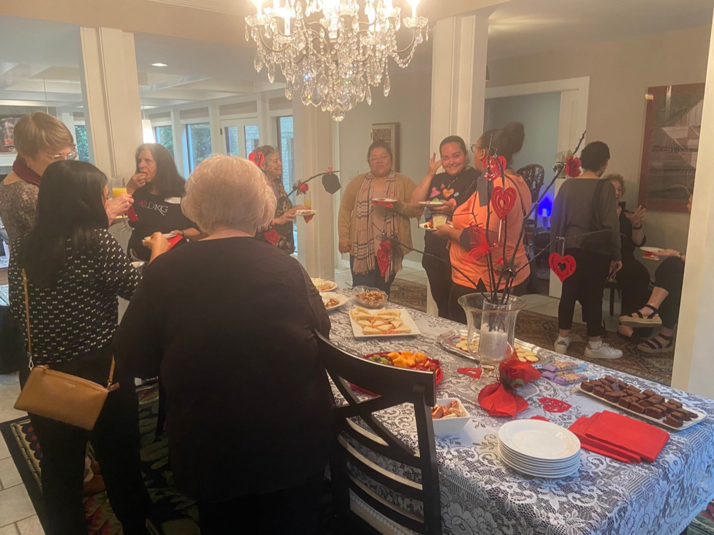
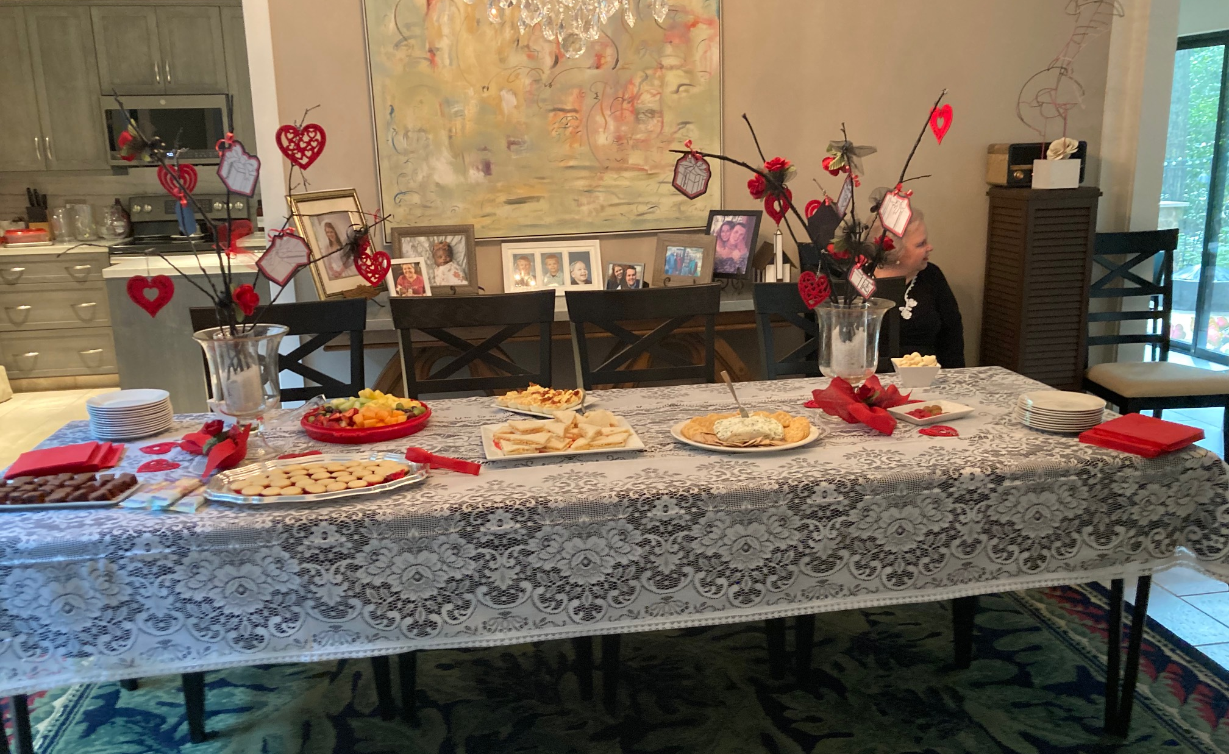
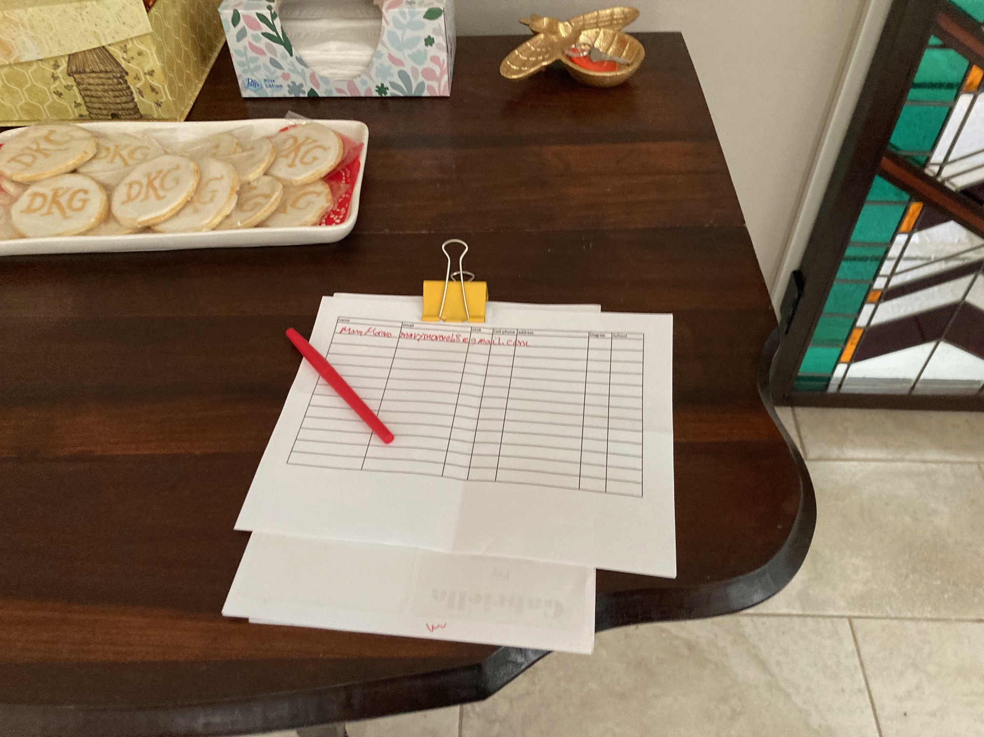
Projects
Books for students – labels
cards for Elderly
Cookies and or cupcakes for schools
Teacher of the year reception
Masks
Grant in aid
Teacher goodies
Money to food pantry
Donations for anti trafficking
Epson salt in pill bottles

Slide 23
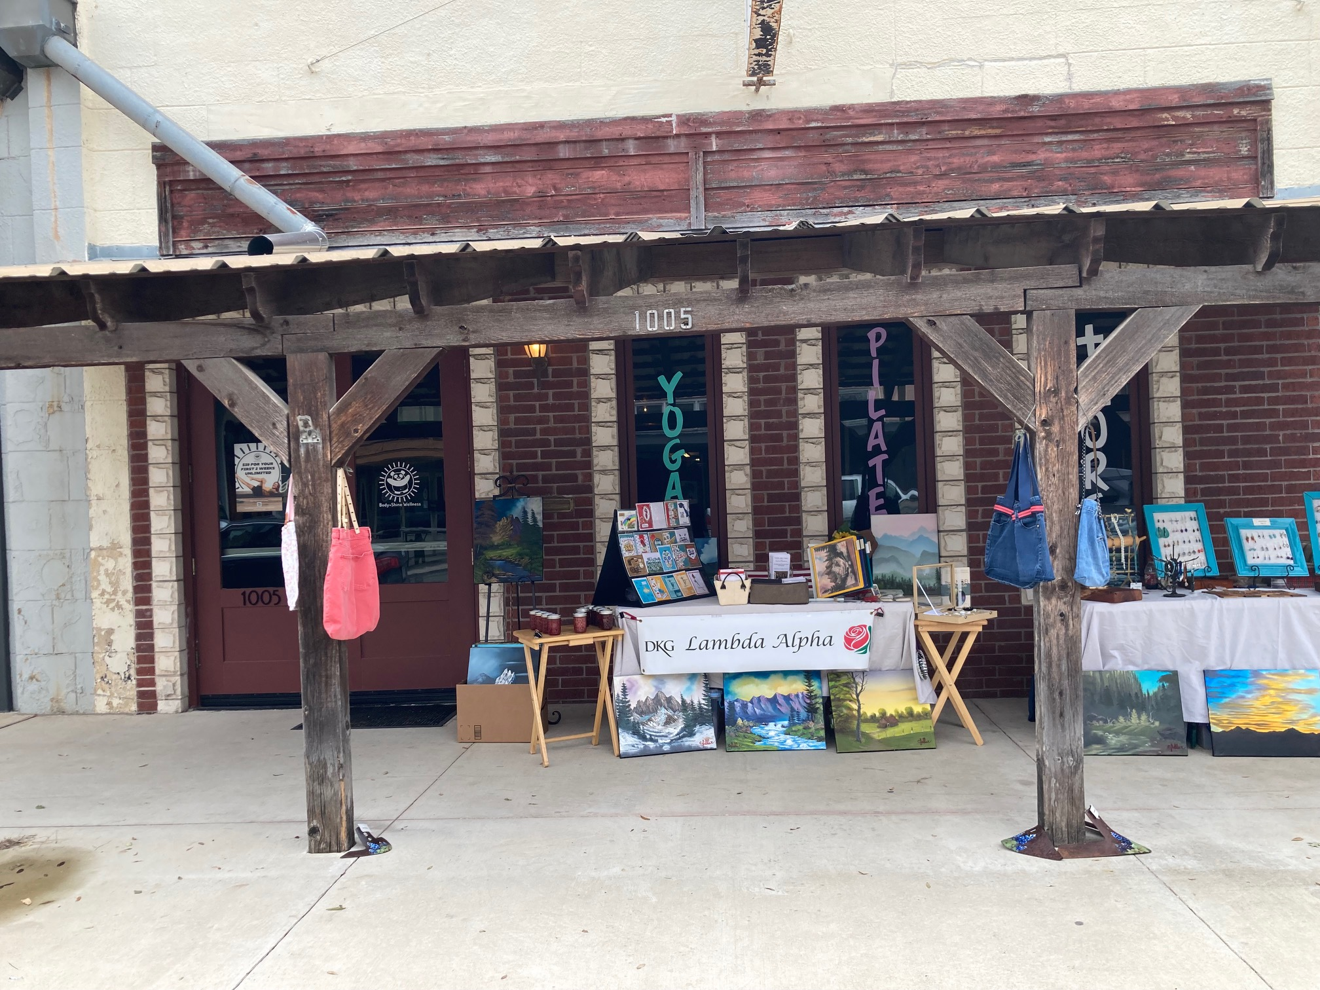
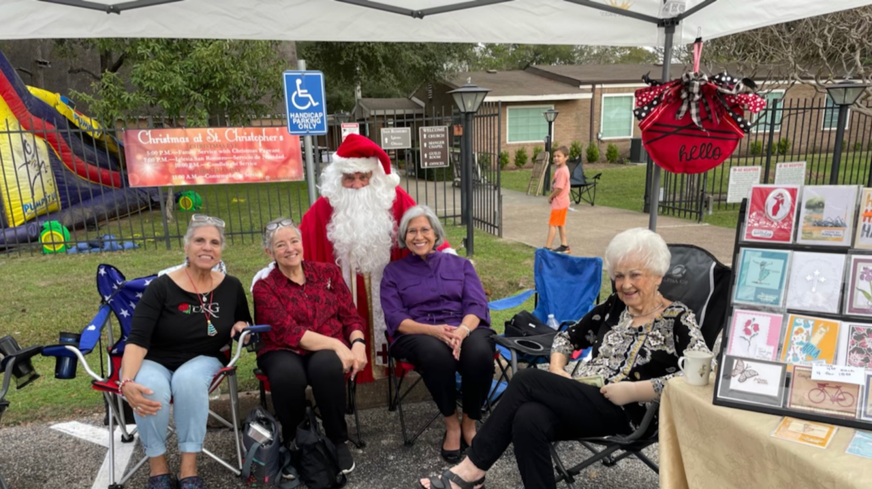
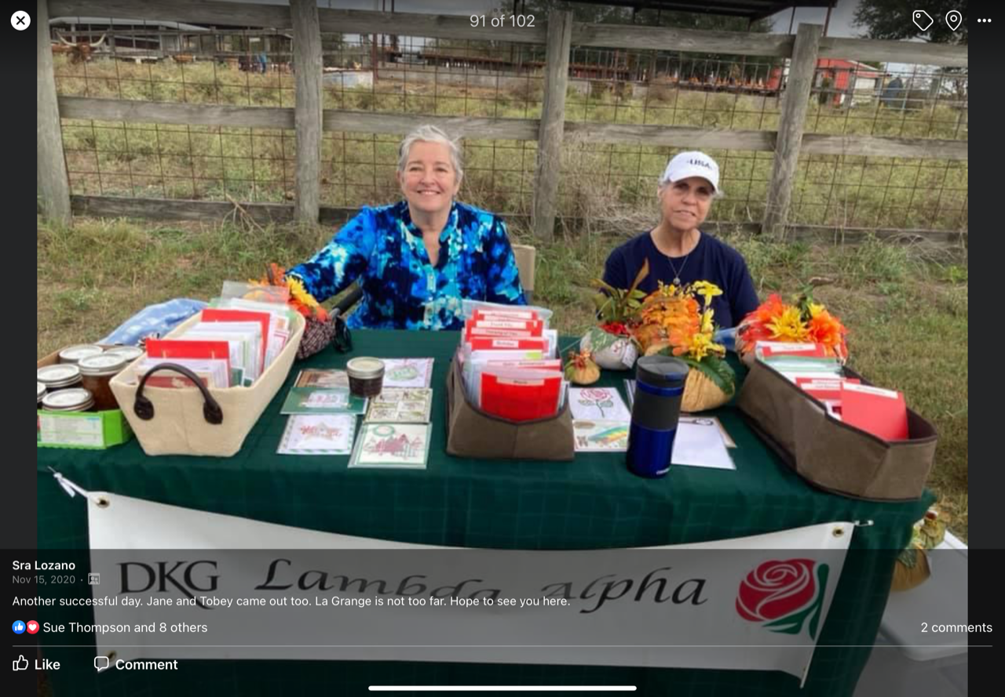
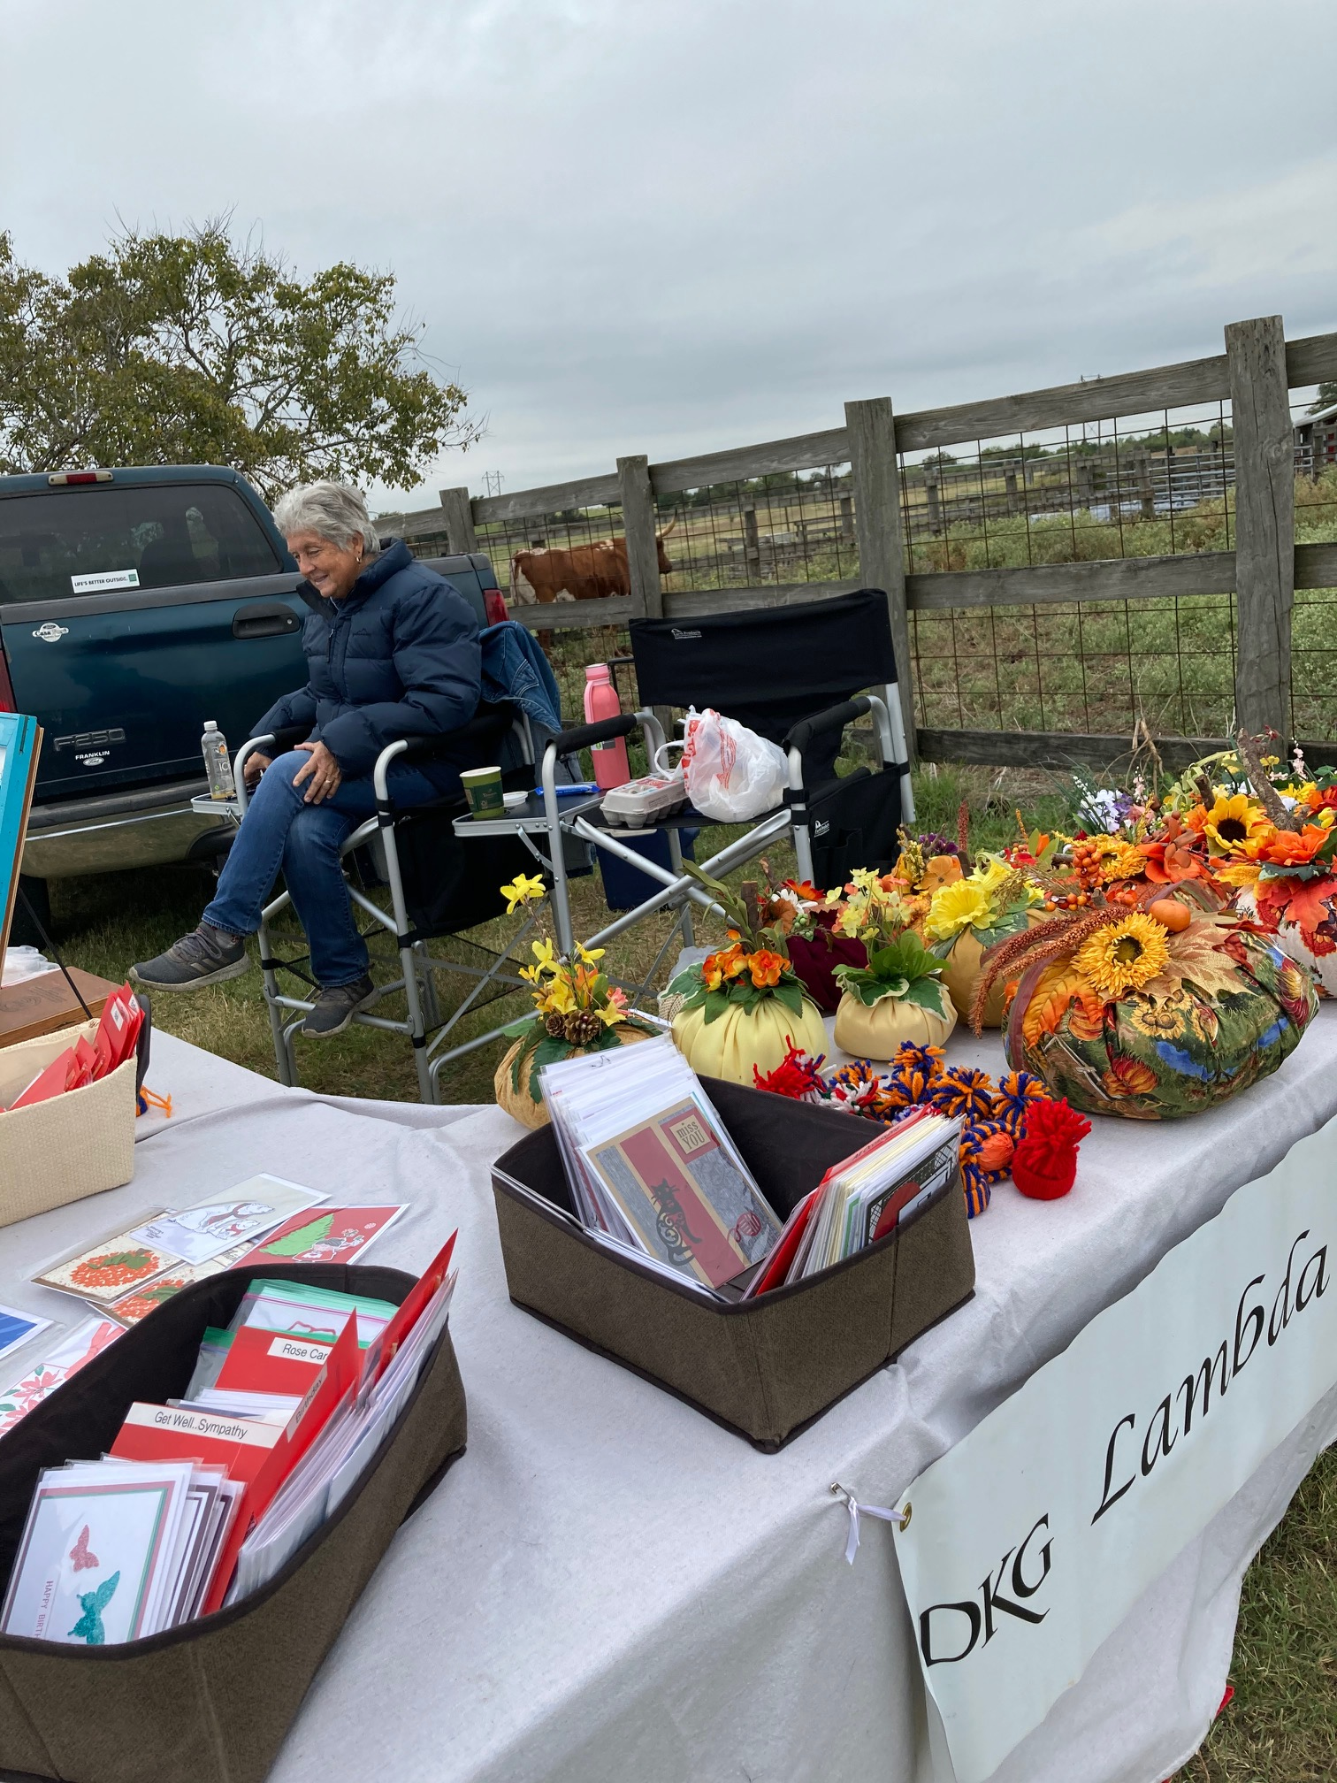
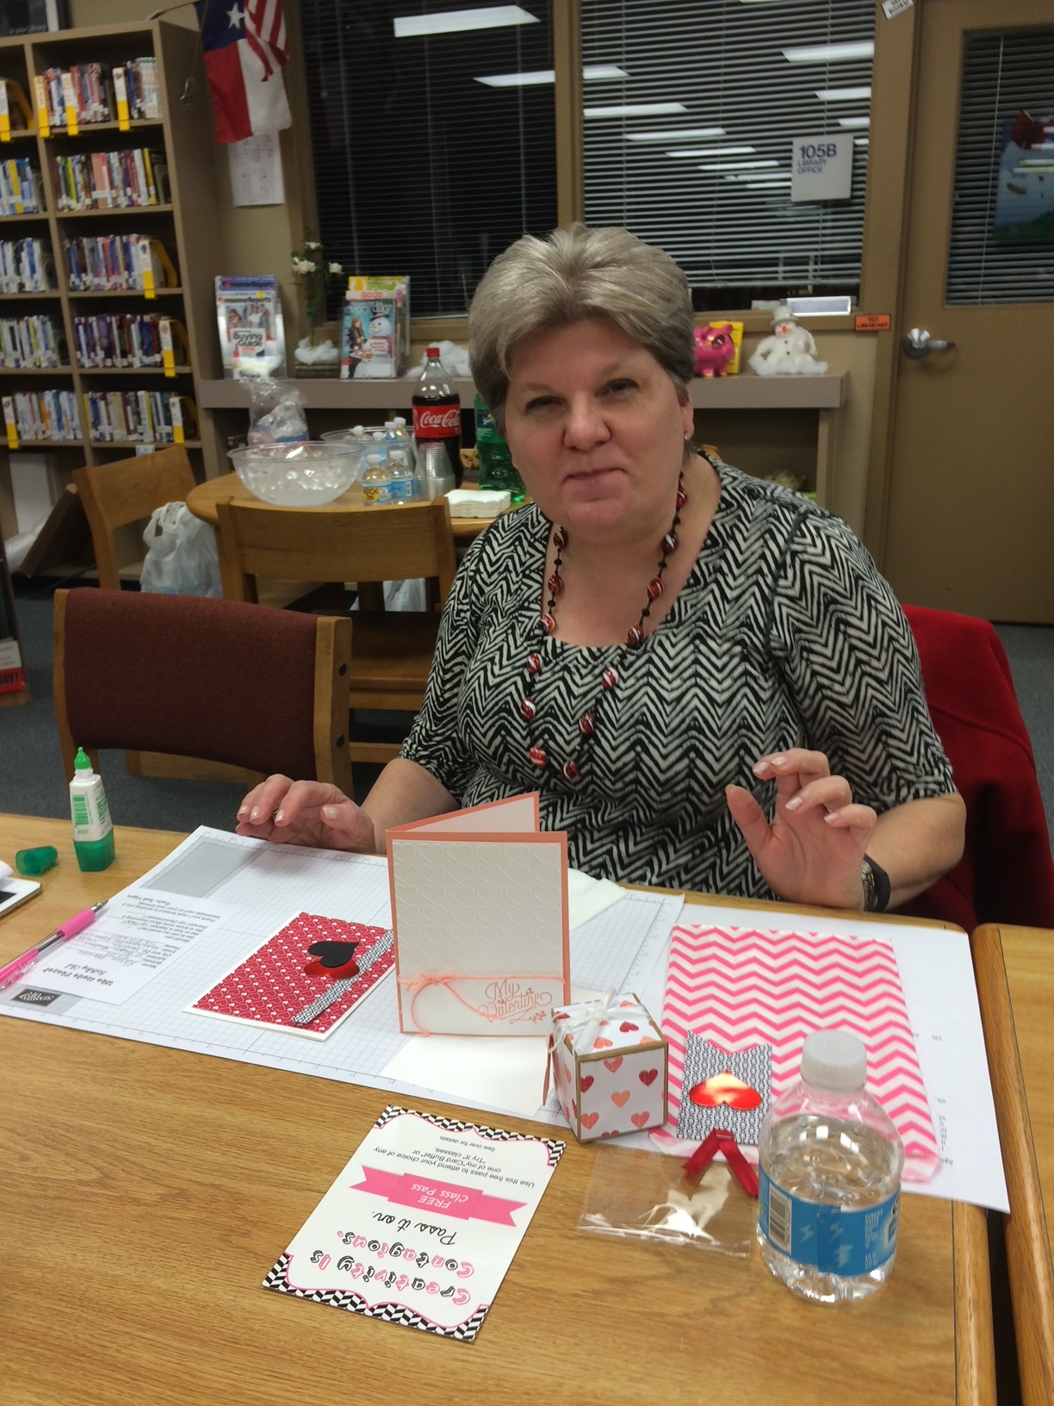
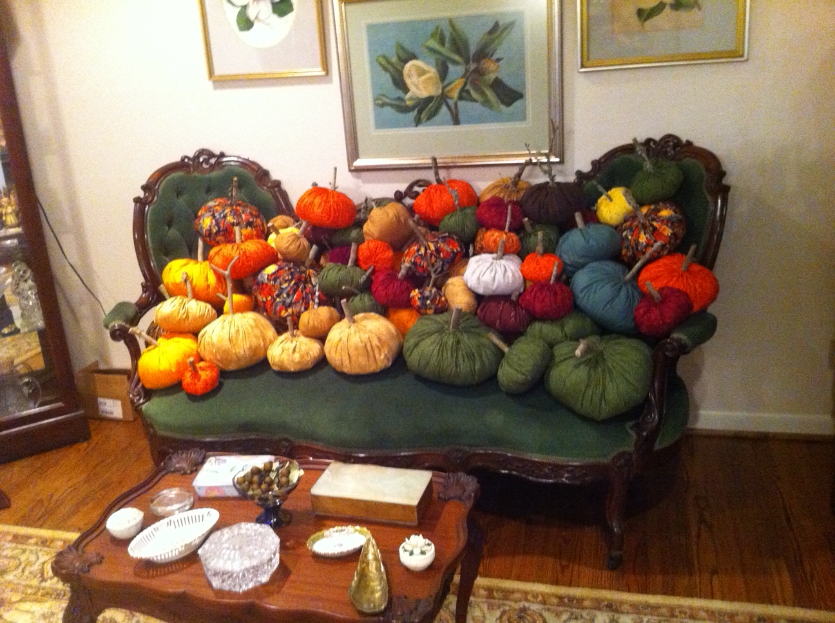
Money making ideas
Silent auction
Cards
Sales at St. Christopher, Bastrop, and La Grange
Commissioned Christmas gifts
Commissioned baked goods
Pumpkins
Metal art
Ceramic art
Blue jean purses
Paintings
Kits
Use of square

