Slide 1
Security: How safe are you?
Debbi Ball
TSO Webmaster
dkgtexas@gmail.com

Slide 2
Social Media
Facebook
YouTube
WhatsApp
Instagram
TikTok
Snapchat
Pinterest
Reddit
LinkedIn
Twitter

Slide 3
Did you know?
4.65 Billion Users

Slide 4
The new word
Sharenting

Slide 5
What to do
Ask
Always ask permission
Give
Always give permission
Check
Check publication policies
Check
Check with photographers

Slide 6
More safety tips
Check social media privacy setting
Tell friend and family
Check your Friends list
Turn off metadata and geotagging
Don’t include personal data
No nude or semi-nude photos

Slide 7
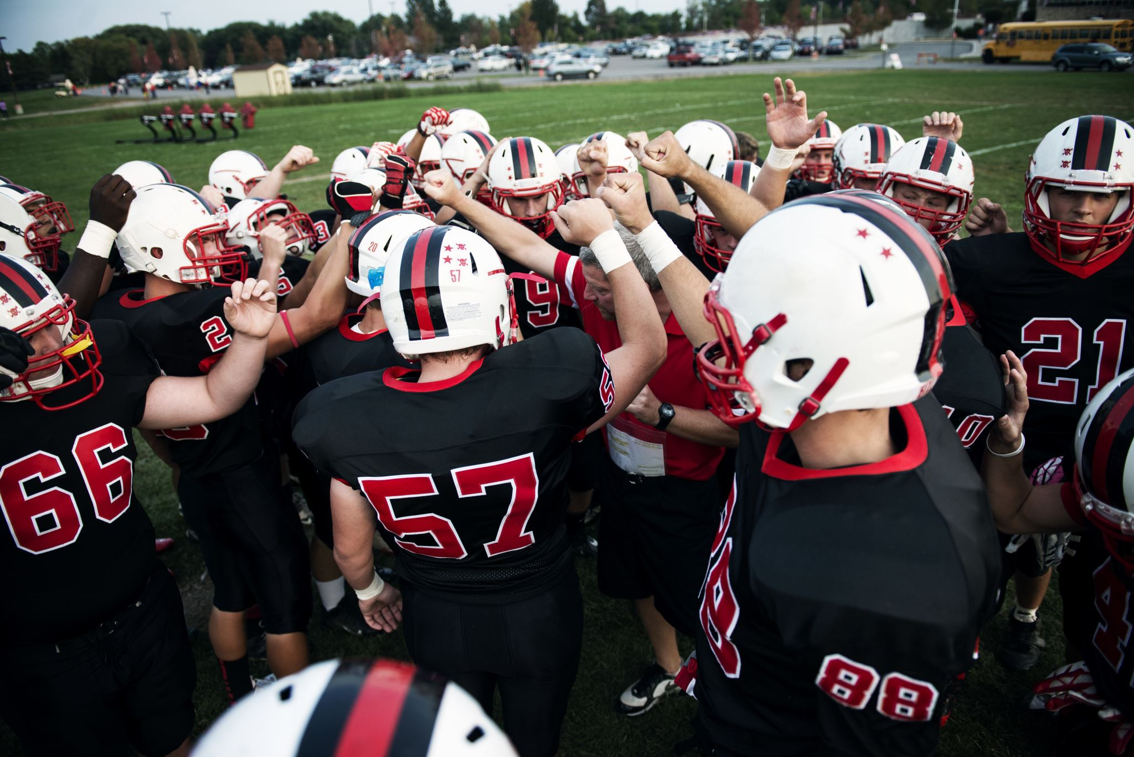
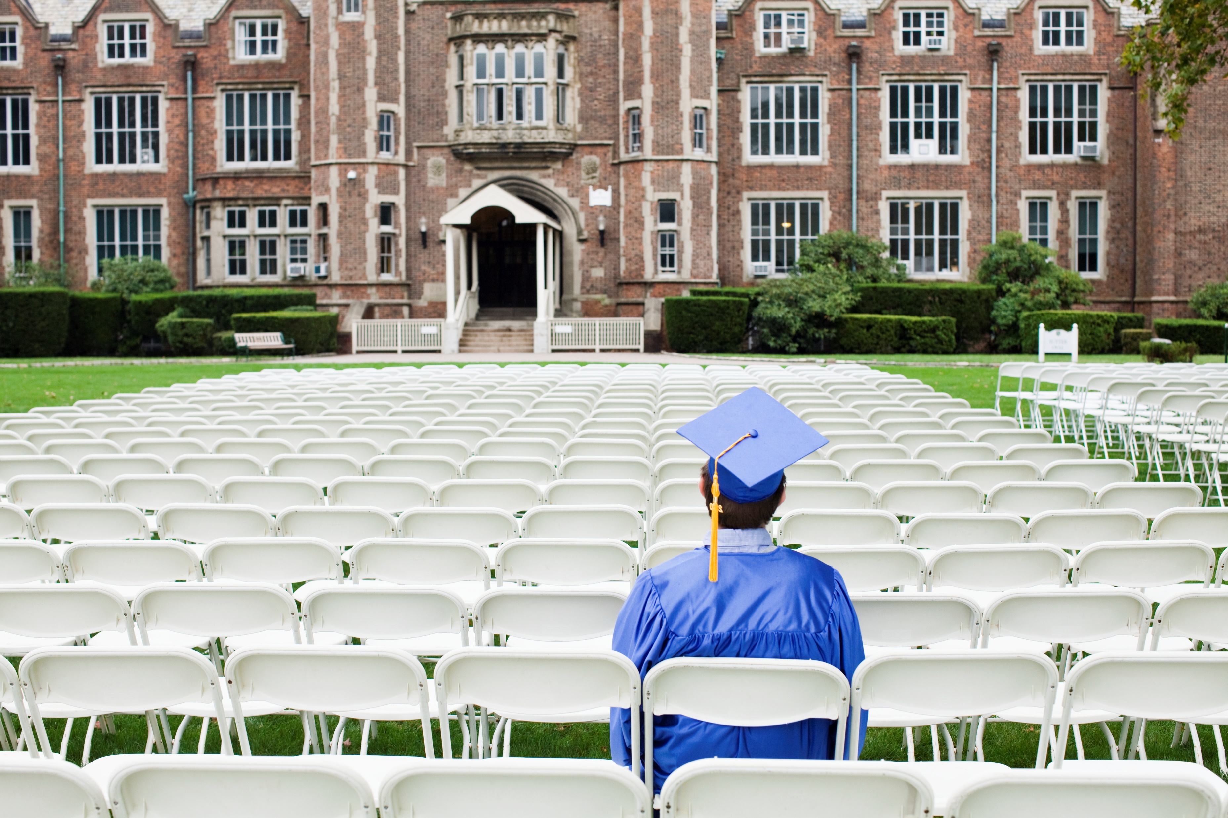
More tips

Slide 8
Safe alternatives

Slide 9
Threats
Social Engineering
Phishing
Malware
Brand Impersonation
Catfishing

Slide 10
Steps to Security
Enable MFA (Multi-factor Authentication
Individual passwords

Slide 11
Password Managers

Slide 12
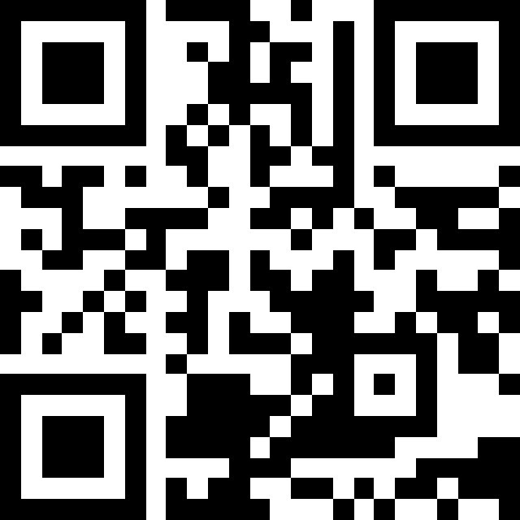
Steps to Security
Enable MFA (Multi-factor Authentication
Individual passwords
Update security settings
Review connections
Monitor security risks
Learn about phishing
Look for spoofs
Source

Slide 13
Your Chapter
Photos
Dates
Locations

Slide 14
Digital Footprint
Permanent
Reputation
Employment
Misinterpretation
Spread
Exploit

Slide 15
Be Aware

