Slide 1
Necrology Tips
Robyn Rucker, Necrology Chair
and
the Necrology Committee
Area Workshops 2022

Slide 2
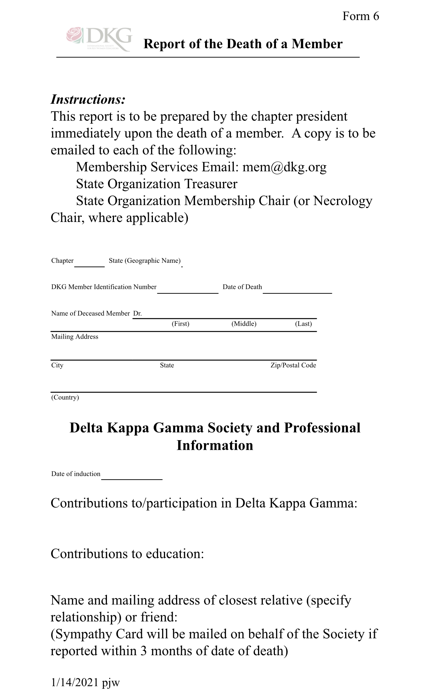
Who do I send the Form 6 to:
Robyn Rucker – Necrology Chair
rucker.tsonecrologychair.2123@gmail.com
Deborah Thomas – TSO Treasurer
tsotreas@gmail.com
International DKG Membership Services
mem@dkg.org

Slide 3
How to Fill Out Form 6
* Before you fill out the Form 6, please make sure that the deceased member is good standing.
Name of current chapter and state (Texas)
DKG Member’s number
Date of Member’s Death
Name of the deceased member (First, Middle, and Last Name) – make sure you indicate if the deceased was a Dr.
Mailing Address at time of death (Mailing Address, City, State, Zip Code, Country (USA))

Slide 4
How to Fill Out Form 6
Delta Kappa Gamma Society and Professional Information – Please check your chapter archives for this information.
Date of Induction – when did the deceased become a DKG Member
Contributions to/participation in Delta Kappa Gamma – what did the deceased member do at the chapter, state, and international level?
Contributions to education – what were her teaching assignments, honors, and awards

Slide 5
How to Fill Out Form 6
* Where to send a sympathy card
Please share the name and mailing address (specify relationship) – family member or friend

Slide 6
State Necrology Chairman & Committee
• Form 6 is received, and date of receipt is recorded.
• State membership list is checked to confirm status of membership at date of death; International is contacted if necessary.
• Information from Form 6 is recorded, and Form 6 is filed for future use.
• A DKG condolence card is sent to the family member or friend listed on the Form 6 .
• Member’s name is added to the TSO Book of Memories.
• Member’s name is added to the list for publication in the Lone Star News.
• Names of the deceased are sent to International Chairman.
• Ceremony of Life and Remembrance is planned and conducted during the annual TSO Convention.
• Names are printed in the program booklet and read at the service. The information is gathered by the Necrology Chairman from Form 6 .
• Book of Memories is displayed at the Ceremony of Remembrance

Slide 7
Ways Chapters May Honor Their Deceased Sisters
• Hold a memorial service at a meeting.
• Use the TSO website to find ceremonial ideals
http://www.dkgtexas.org/ necrology -committee.html
• Ceremony at the funeral service (found on the Texas DKG website or Ceremonies book).
• Members take roses to the family or the service.
• Members wear their pins at the funeral or memorial service.
• Give a contribution to the Society fund or a charity in her name.
• Enter the name into a chapter Book of Memories.
• Look into honoring the member with a plaque.

Slide 8
Necrology Committee
Chair
Robyn Rucker Kappa Theta Area 16 rucker.tsonecrologychair.2123@gmail.com
Committee Members
Katherine Bunce Kappa Pi Area 1 somatt225gmail.com
Janette Musachia Beta Eta Area 3 jmmusachia@gmail.com
Gretchen Dupnik Gamma Omicron Area 4 gdupnik@sbcglobal.net
Precious Chavis Coleman Lambda Beta Area 6 pmcaka@yahoo.com
Dianne McCorcle Theta Alpha Area 9 mmccorcle@gmail.com
Pam Cook Epsilon Nu Area 10 pamcook2012@yahoo.com
Kay Geiger Alpha Kappa Area 12 kgeiger@suddenlink.net
Kimberly Best Lambda Xi Area 13 kimberlyannbest1@gmail.com
Anita Patton Zeta Xi Area 14 apatton123@sbcglobal.net
Margie Nelson Rodriquez Theta Iota Area 15 margaret.nelson27@gmail.com
Nancy Vines Alpha Zeta Area 17 keyofq@yahoo.com
Shalan Inmon, ExOfficio Alpha Sigma Area 12 2123.tso.pres@gmail.com

