Slide 1
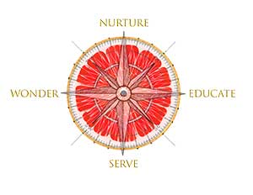
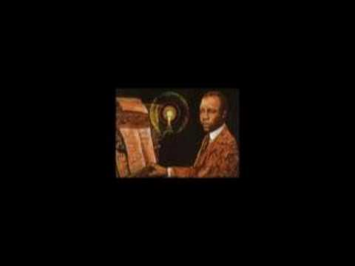
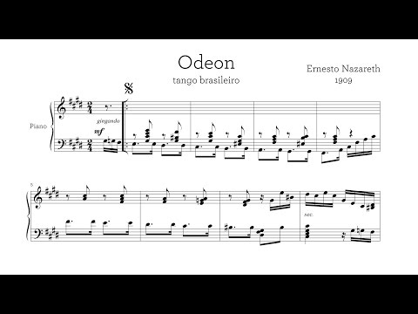
DKG McAllen 2023 Convention
Let Your Journey Be Fruitful!

Slide 2
A Musical Journey: Creation, Preservation, and Integrating Music Interrelationships and the Impact on Cognitive Functions

Slide 3
Questions? Dr. Cindy Kates cindy@cindykates.com www.CindyKates.com (409) 228-1998

Slide 4
Topics Covered
Public Domain
Copyright Laws
Publishing Process
Cognitive Relations
Group Activity
Notes:
(note - add more

Slide 5
Public Domain
What is it?
Anything that is not protected under Copyright Laws
Not protected by intellectual property laws (copyright, trademark, or patent laws)
Anything published on or before 1/1/1924 is in the Public domain
Government paperwork or images are also in the public domain
Why learn it?
There have been instances where teachers use music in football game half-time performances and were sued for it
To be safe when using information for lesson plans

Slide 6
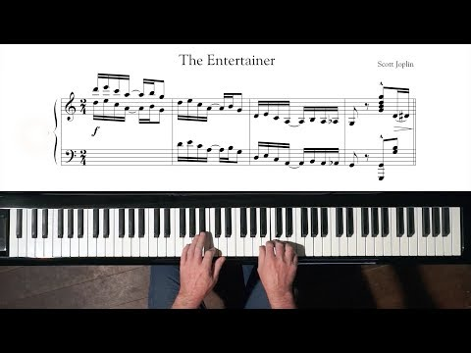
Public Domain
Questions that need to be asked before using the work:
Did a U.S. government employee within the scope of their job create the work
Is the author alive or dead? If the author has a died, what year did they die?
Is the work published? If so, what was the year of first publication?
Was the work first published with a copyright notice?
If the work was not published in or before 1977 then it has fallen in the public domain (hint 5 year to file)
The Majority of music up to 1925 is now available in the public domain
More than likely everything that belongs to Disney, still belongs to Disney
Was the copyright renewed ?
Notes:
What is in the public domain? (2020 Updated Public Domain Chart) (theartistsjd.com)

Slide 7
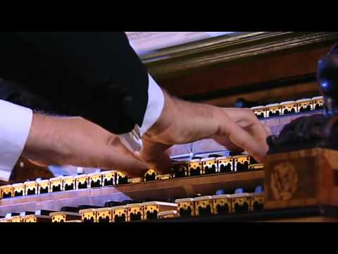
Copyright
What's the difference between Public Domain and Copyright Laws?
Public domain “refers to creative materials that are not protected by intellectual property laws such as copyright, trademark, or patent laws” (IIPTA) Anyone can have access and use the works without asking for permission or to use it because no one owns it.
Copyright is “a legal concept that grants authors and artists control over certain uses of their creations for defined periods of time. It limits who may copy, change, perform, or share those creations.” (Harvard Berkman)
Copyright Clause of the US Constitution states
“Congress may grant authors copyright protection for their works for a limited time in order to promote the progress of science and useful arts” (US. Constitution, Article 1, Section 8, Clause 8)” (Harvard Berkman)
Notes:
What I can use in my classroom?
Can I turn around and change the words to a song and sell it

Slide 8
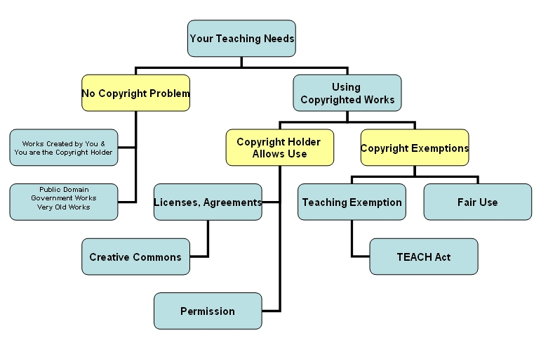
Notes:
https://library.uams.edu/assets/copyright/copyrightgoodhabitsmodule809_print.html

Slide 9
Fair Use
According to U.S. copywrite law – copyright infringements occur when music is used with permission. “It does not matter if you use one second or the entire song, using copyrighted materials without the consent or permission of the copyright owner, constitutes copyright infringement.”
Sampling – was a major issue in the past – do not use without permission.
There are exceptions –– but there is a fee to the owner and legal agreements - a mechanical license.

Slide 10
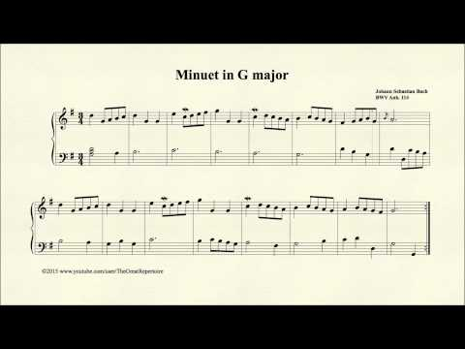
The TEACH Act
The “Technology, Education and Copyright Harmonization Act,” commonly known as the “TEACH Act,” was enacted by Congress on October 4, 2002. It is a full revision of Section 110(2) of the U.S. Copyright Act. Its provisions enable educators to use copyrighted materials for distance education, with certain restrictions.
Its primary purpose is to balance the needs of distance learners and educators with the rights of copyright holders. The TEACH Act applies to distance education that includes the participation of any enrolled student, on or off campus.
Notes:
In order for the use of copyrighted materials in distance education to qualify for the TEACH Act exemptions, the following criteria must be met:
• The institution must be an accredited, non-profit educational institution.
• The use must be part of mediated instructional activities.
• The use must be limited to a specific number of students enrolled in a specific class.
• The use must either be for ‘live’ or asynchronous class sessions.
• The use must not include the transmission of textbook materials, materials “typically purchased or acquired by students,” or works developed specifically for online uses.
• The institution must have developed and publicized its copyright policies, specifically informing students that course content may be covered by copyright, and include a notice of copyright on the online materials.
• The institution must implement some technological measures to ensure compliance with these policies, beyond merely assigning a password. Ensuring compliance through technological means may include user and location authentication through Internet Protocol (IP) checking, content timeouts, print-disabling, cut and paste disabling, etc.
What the TEACH Act does not allow
The new exemptions under the TEACH Act specifically do not extend to:
• Electronic reserves, coursepacks (electronic or paper) or interlibrary loan (ILL)
• Commercial document delivery
• Textbooks or other digital content provided under license from the author, publisher, aggregator or other entity
• Conversion of materials from analog to digital formats, except when the converted material is used solely for authorized transmissions and when a digital version of a work is unavailable or protected by technological measures
It is also important to note that the TEACH Act does not supersede fair use or existing digital license agreements.

Slide 11
Oops! And the Creative Commons License
Purchasing music – but violates trademarks etc.
CCL – terms of using, modifying and sharing works – without dealing with the creator for permission.

Slide 12
Publishing Process
How to publish Correctly?
Composer submits a manuscript to a publisher
Composer can also enter a contract with the publisher to submit a certain number of works in a determined amount of time or unsolicited
Editorial Department reviews and evaluates manuscripts on musical quality and feasibility
If a work meets these requirements, the Publication Committee further reviews and evaluates the work.
Any works that are not accepted are sent back to the composer.
The publisher’s Legal Department then secures the legal rights of the composer and publisher before reproducing and distributing the work.

Slide 13
Publishing Process
Publishing Cont.
A contract is signed between the composer and publisher.
The editor contacts the composer and discusses the composition in detail, working towards a finalized version to be printed.
Finally, the music is registered with the U.S. Copyright office and other similar organizations around the world.
Music Publishing is a partnership between the publisher and songwriter.
The Publisher acquires the copyrights, grant licenses, and collects the money.
The Songwriter writes the songs.

Slide 14
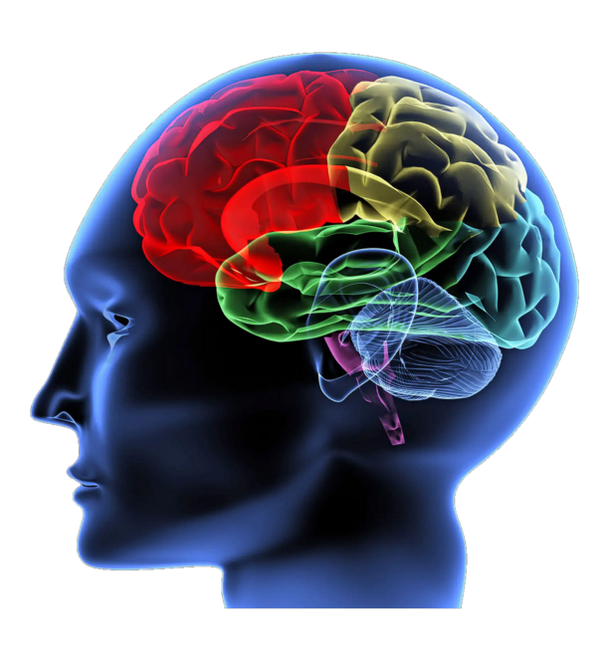
Cognitive Relation
What can music do?
Can motivate children to engage in learning activities
Piaget’s Theory:
At the ages 12 to adulthood, they develop logical, and problem solving skills that involve deductive reasoning
They being to think about “what if “ situations
In 2009 a study was conducted to see if the tempo of music altered a person’s reaction
Songs in major key made the individual happy
Songs in minor key made the individual sad
Rhythmic entertainment refines temporal processing and introducing of attention
This later can enhance an individual's reading skills and verbal memory

Slide 15
Elementary: | Middle: | High: | College:
Sonar - Echolocation, Animals that use it, Coloring sheet to show how sound waves bounce off of objects | Sonar - Sound Waves, How sound travels through water compared to sound travelling through solids or gasses, show video | Sonar - Sound waves extended, How to influence sounds underwater, influence of different frequencies underwater. Do a lab for hands on experience | Sonar - Mechanics of Sonar, how they function, reverse engineer a sonar device.
Teach frequency by playing music or hitting a bell | Play instruments to learn different frequencies | Learn about sound waves in comparison to other similar | The lesson plan to learn frequency for Engineering in college relates from frequency in Chemistry to general frequency in music.
Sound is emitted in the shape of waves. Welding glues things together. A suitable activity for this age group would be a coloring page of different wavelengths of sound. | Two metals can be bonded together using the same type of frequencies used in the broadcasting of radio and other forms of communication. This can be represented by a small worksheet. | Radio frequency welding is a form of welding that uses electromagnetic energy to bond the materials together. This frequency is also used in the broadcasting of music as well as many other forms of transmitters and communication devices. This can be done in a shop class. | Radio frequency welding is a form of welding that uses electromagnetic energy to bond the materials together. This frequency is also used in the broadcasting of music as well as many other forms of transmitters and communication devices. This can be done by a lab.
Math - Finding the time signature of different alternating measures within a small piece of music (fraction forms such as ¼,2/4,¾,4/4) | English - Relating music and types of music from different languages within the world. Such as spanish, french and other musics of different cultures. | Social Studies - The romantic era in world history is in the era of ~1800-1850s and it was known for its gothic lifestyle. Along with the expanse of industry in the United States, music also expanded to romanticism. | Science - Calculating the wavelengths, frequency, and amplitudes to draw detailed designs of diffraction patterns in different sound waves of music.
Draw an instrument of choice and describe what it sounds like | Make a project that includes pictures and sounds of the instrument of choice. | Research the instrument of choice and create a presentation of how and why it creates sound. | Choose an instrument and write a paper describing and explaining the types of notes and frequencies. Relate this to waves and vibration of sound and how it travels through the air. The paper must relate how the instrument produces sound and the science fundamentals of sound related to it.

Slide 16
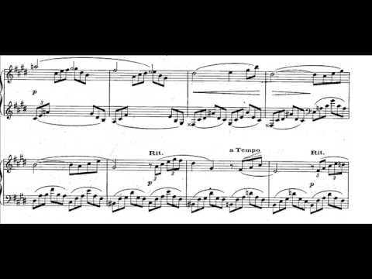
Activity
Title | Year Released | In the Public Domain; Yes or No?
Aladdin | 1992
A Nasa image of the moon | 2014
One Thousand and One Nights | 1706
“Rhapsody In Blue” by George Gershwin | 1957
“Steamboat Willie” by Walt Disney Animation Studios | 1928
Notes:
Determine if these titles are in the public domain by using their year that they came out in.

Slide 17
Activity
Title | Year Released | In the Public Domain; Yes or No?
Aladdin | 1992 | NO
A Nasa image of the moon | 2014
One Thousand and One Nights | 1706
“Rhapsody In Blue” by George Gershwin | 1957
“Steamboat Willie” by Walt Disney Animation Studios | 1928

Slide 18
Activity
Title | Year Released | In the Public Domain; Yes or No?
Aladdin | 1992 | NO
A Nasa image of the moon | 2014 | YES
One Thousand and One Nights | 1706
“Rhapsody In Blue” by George Gershwin | 1957
“Steamboat Willie” by Walt Disney Animation Studios | 1928

Slide 19
Activity
Title | Year Released | In the Public Domain; Yes or No?
Aladdin | 1992 | NO
A Nasa image of the moon | 2014 | YES
One Thousand and One Nights | 1706 | YES
“Rhapsody In Blue” by George Gershwin | 1957
“Steamboat Willie” by Walt Disney Animation Studios | 1928

Slide 20
Activity
Title | Year Released | In the Public Domain; Yes or No?
Aladdin | 1992 | NO
A Nasa image of the moon | 2014 | YES
One Thousand and One Nights | 1706 | YES
“Rhapsody In Blue” by George Gershwin | 1957 | YES
“Steamboat Willie” by Walt Disney Animation Studios | 1928

Slide 21
Activity
Title | Year Released | In the Public Domain; Yes or No?
Aladdin | 1992 | NO
A Nasa image of the moon | 2014 | YES
One Thousand and One Nights | 1706 | YES
“Rhapsody In Blue” by George Gershwin | 1957 | YES
“Steamboat Willie” by Walt Disney Animation Studios | 1928 | NO

Slide 22
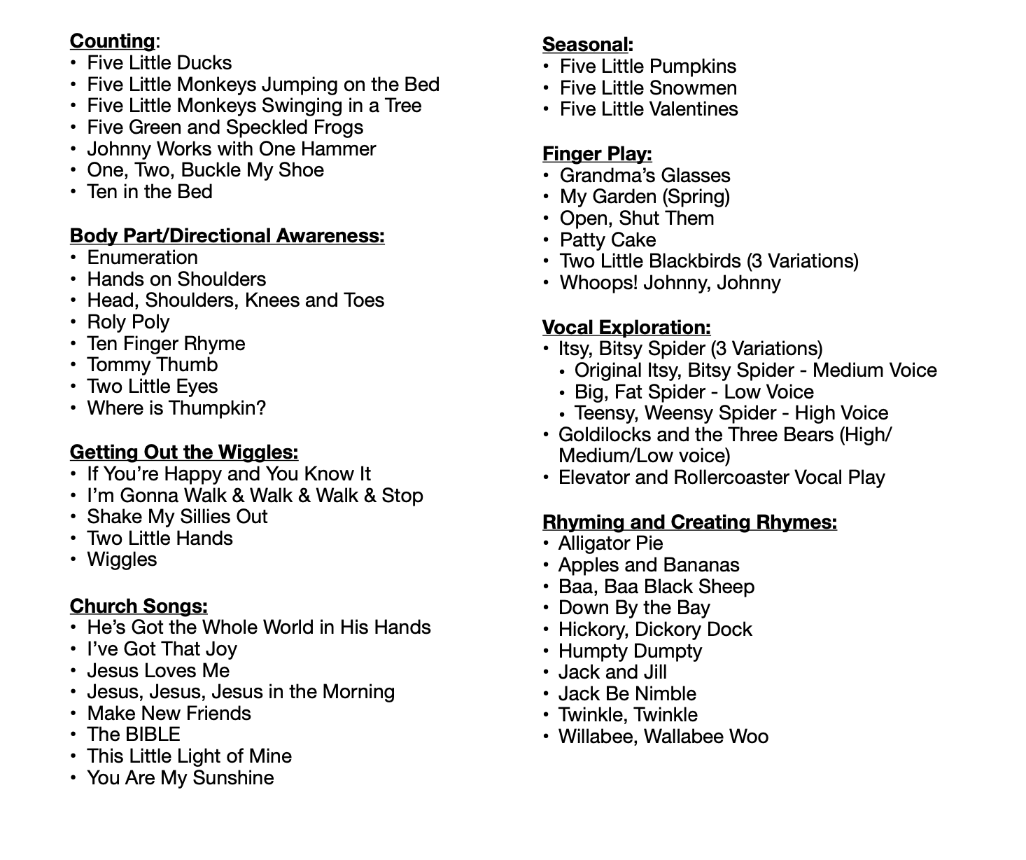
Songs & Rhymes for the Classroom Teacher

Slide 23
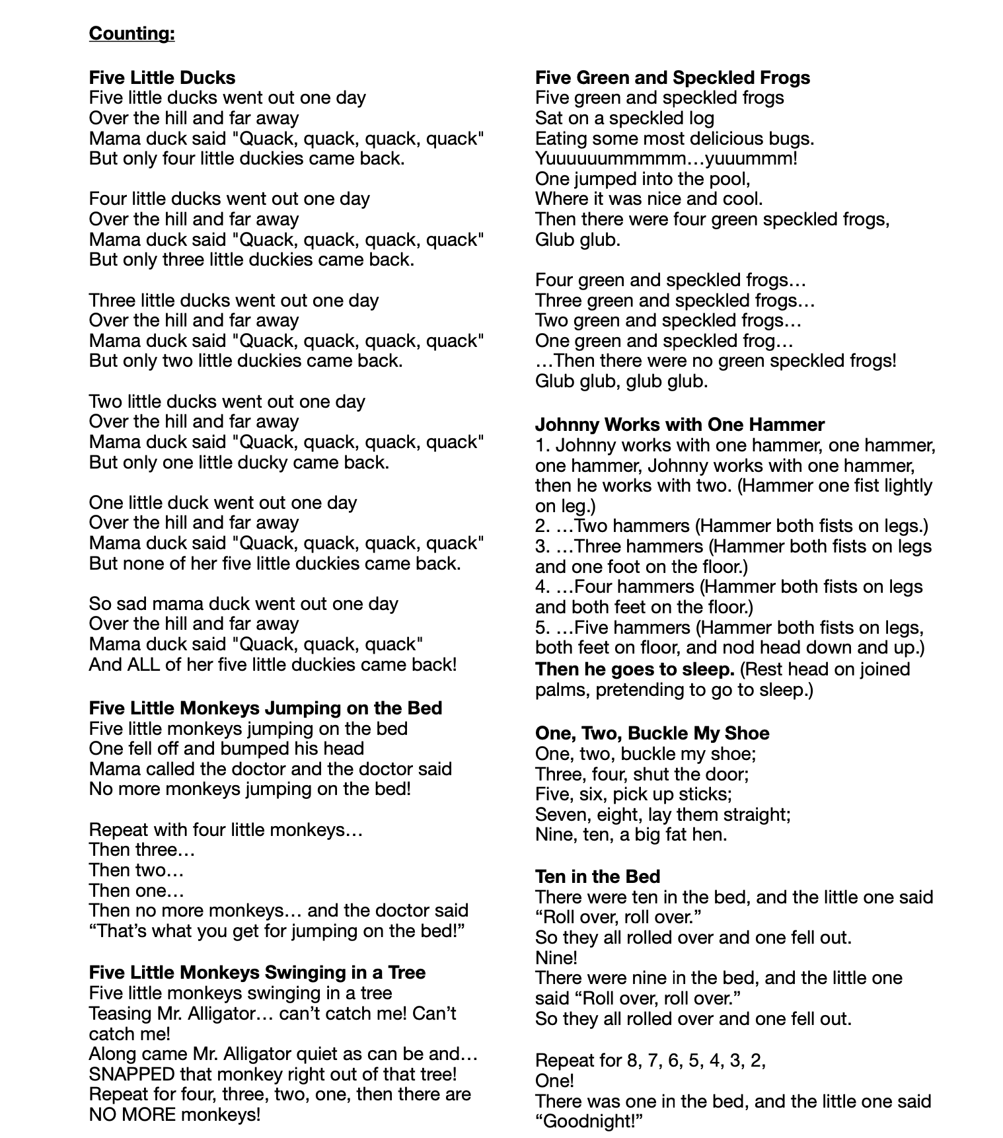
Songs & Rhymes for the Classroom Teacher

Slide 24
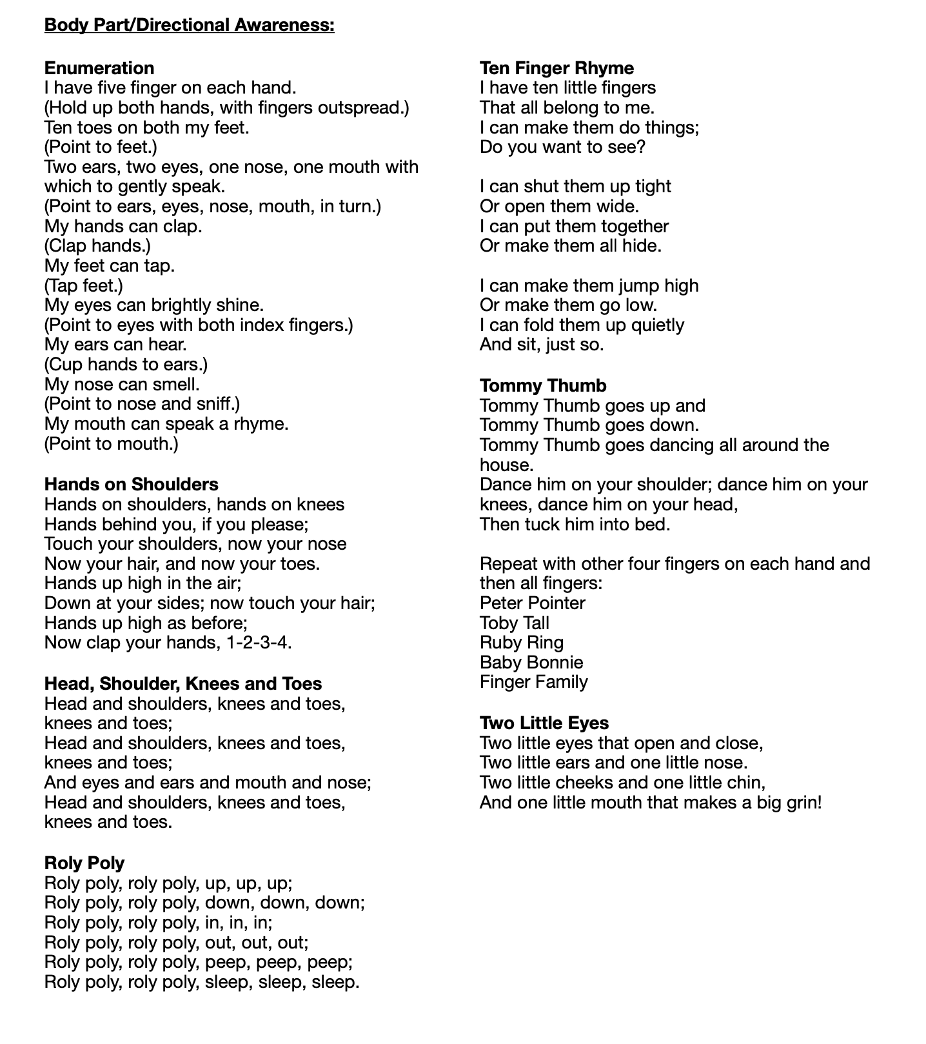
Songs & Rhymes for the Classroom Teacher

Slide 25
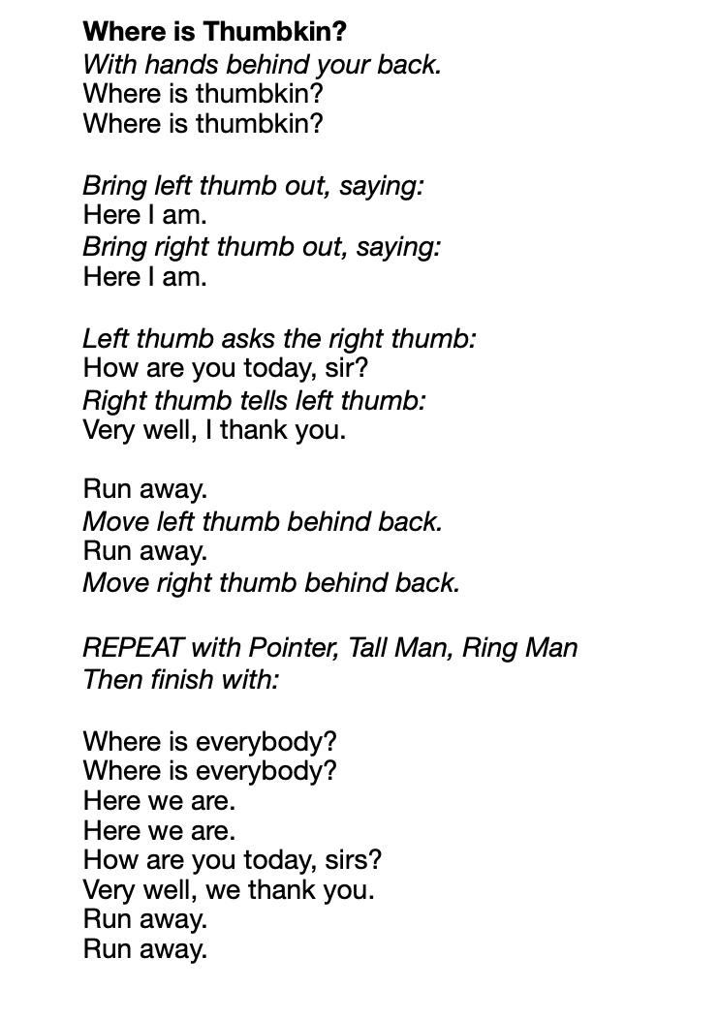
Songs & Rhymes for the Classroom Teacher
Continued…

Slide 26
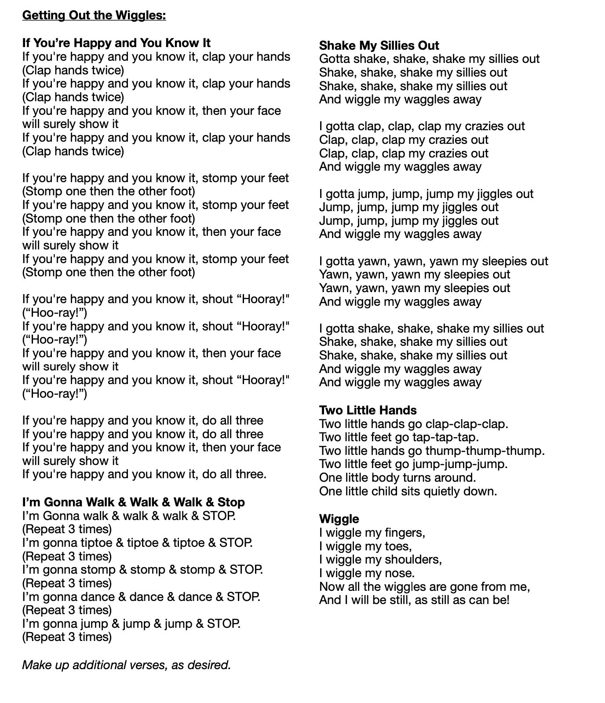
Songs & Rhymes for the Classroom Teacher

Slide 27
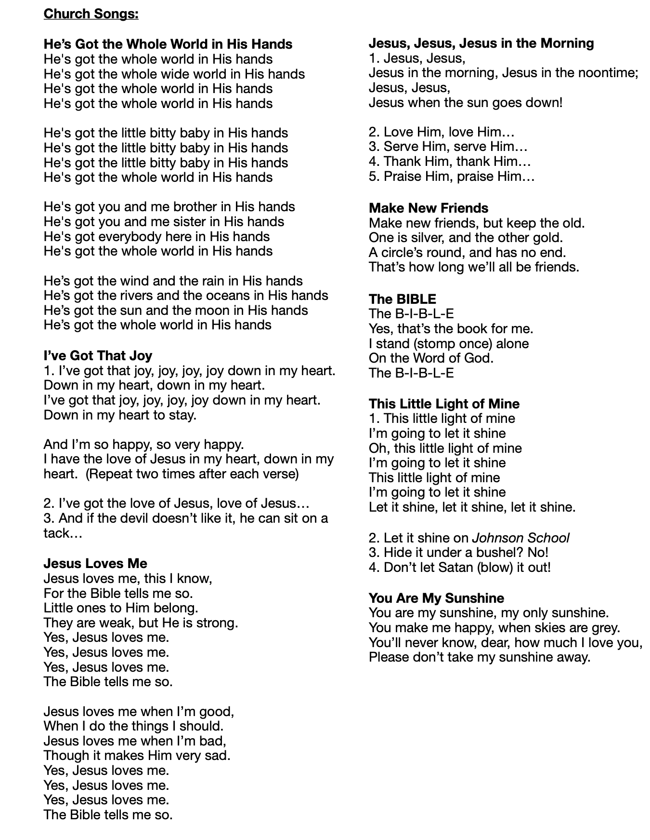
Songs & Rhymes for the Classroom Teacher

Slide 28
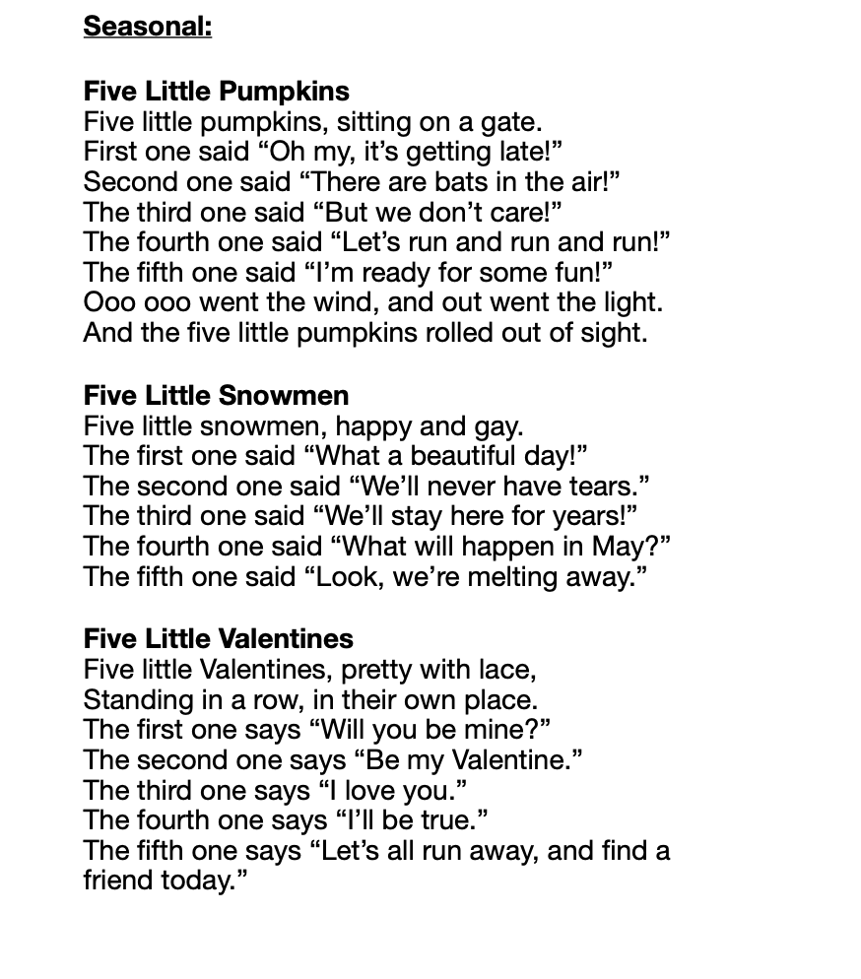
Songs & Rhymes for the Classroom Teacher

Slide 29
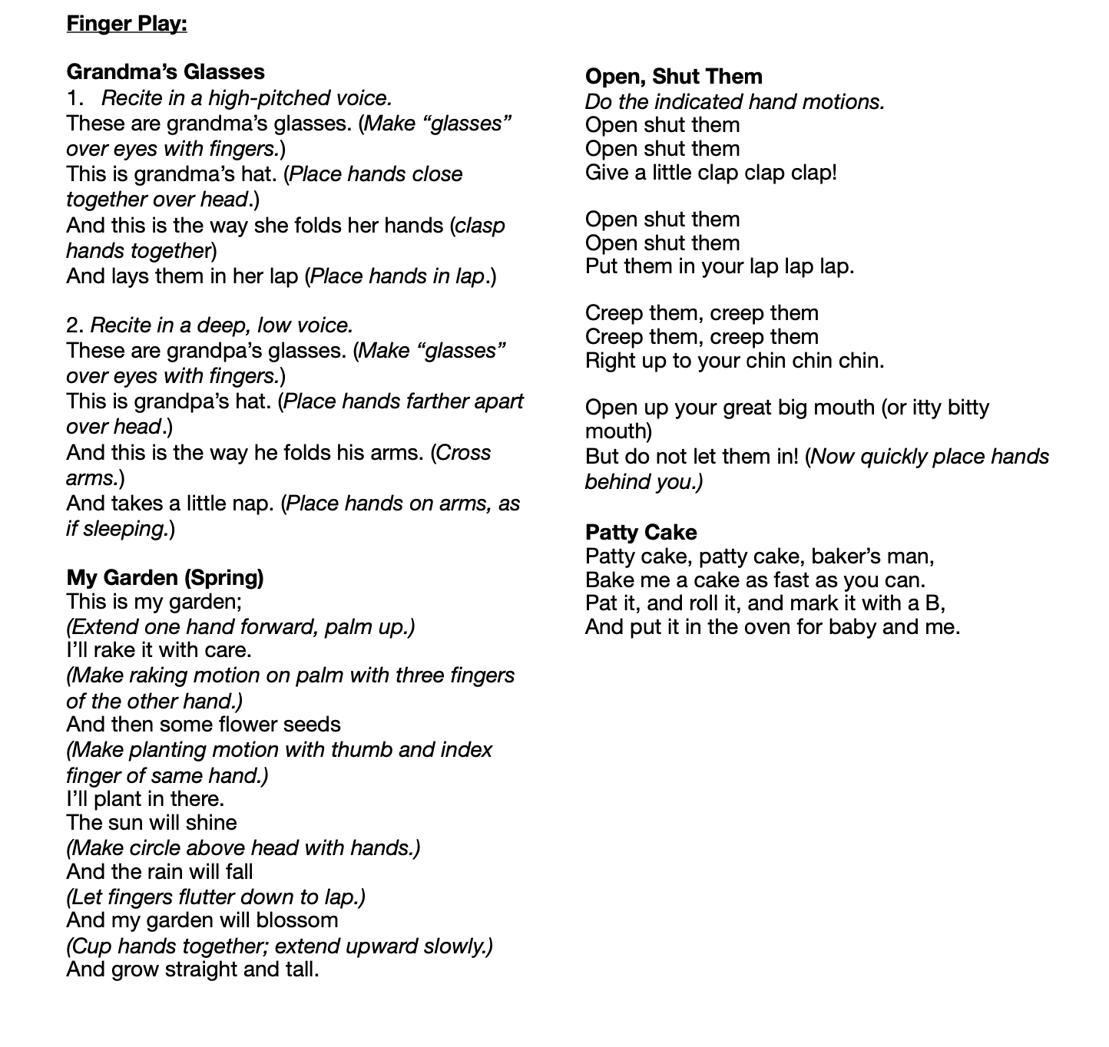
Songs & Rhymes for the Classroom Teacher

Slide 30
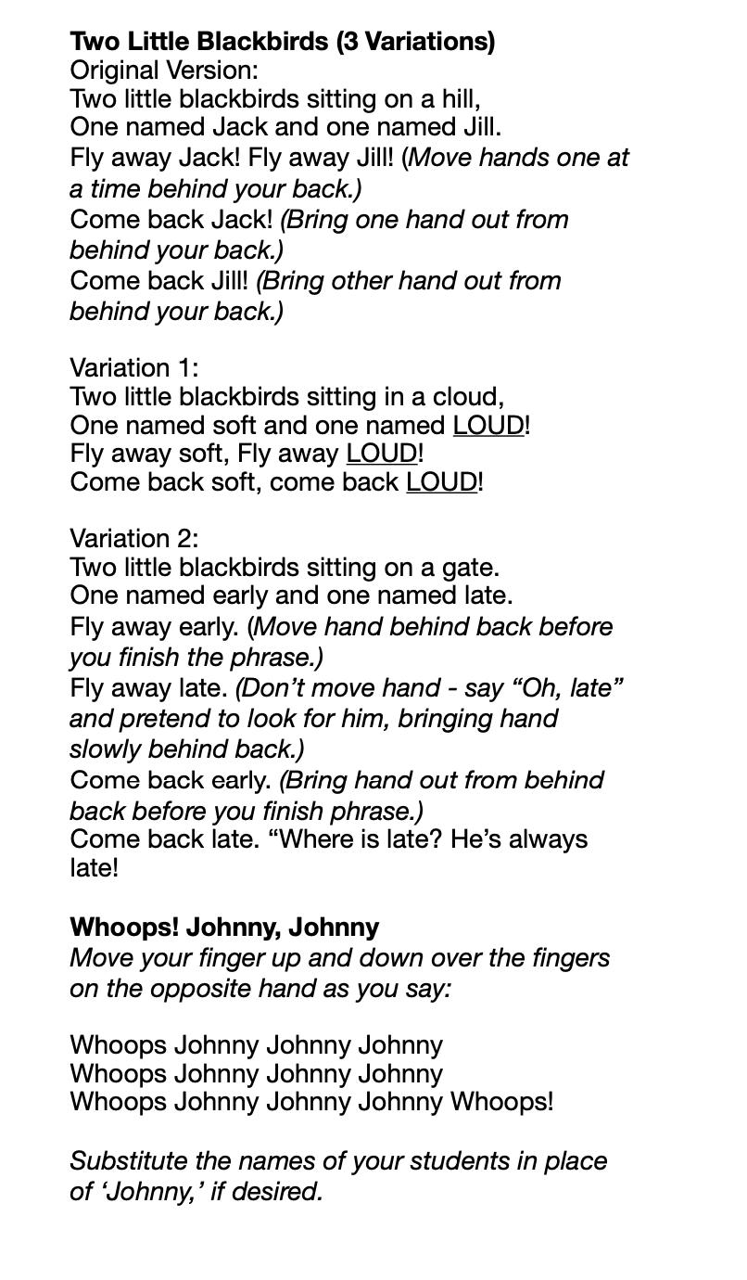
Songs & Rhymes for the Classroom Teacher
Continued…

Slide 31
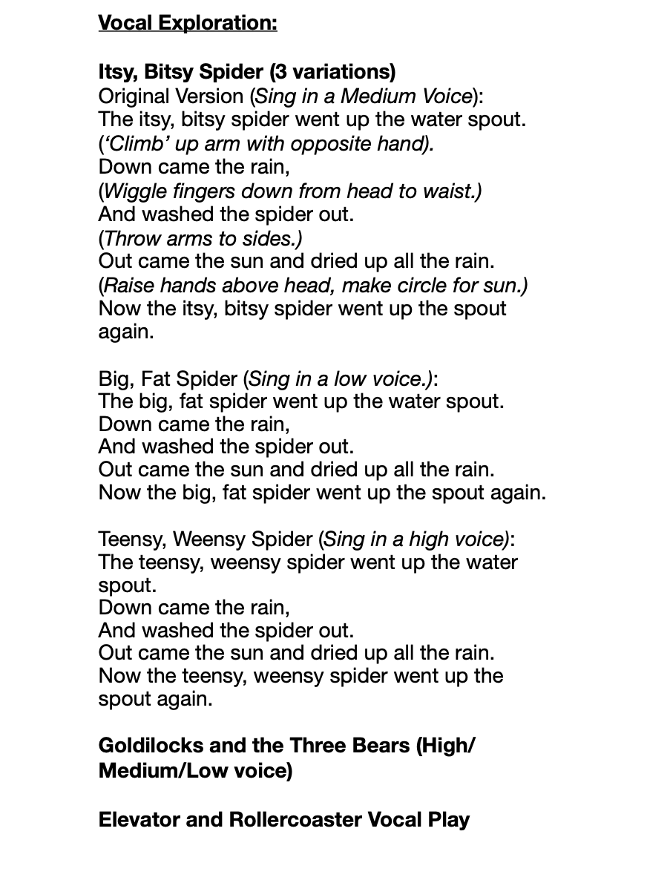
Songs & Rhymes for the Classroom Teacher

Slide 32
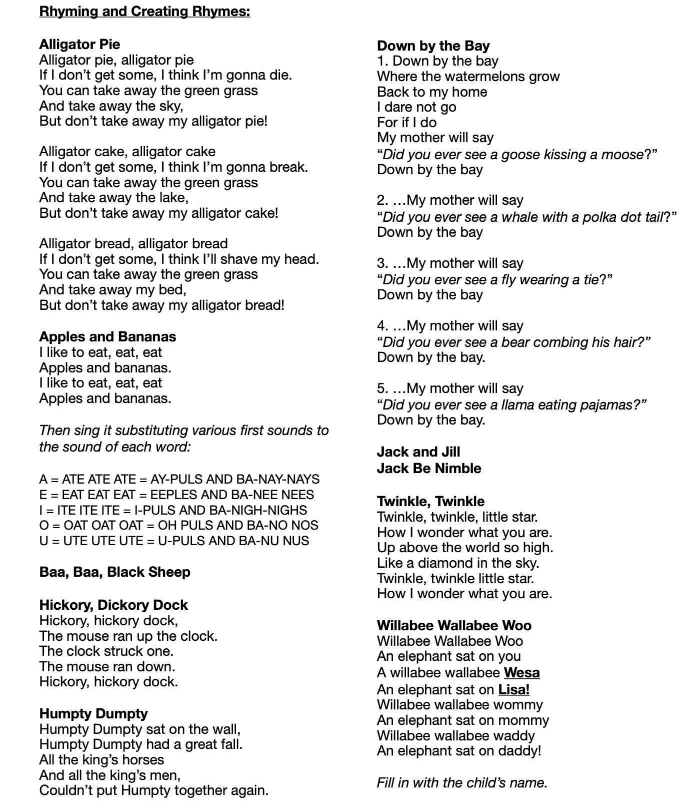
Songs & Rhymes for the Classroom Teacher

Slide 33
Summary
Public Domain
Copyright Laws
Publishing Process
Cognitive Relations
Group Activity

Slide 34
References
https://www.pdinfo.com/pd-info-faq.php
https://www.iipta.com/whats-difference-public-domain-fair-use-definitions-examples/#:~:text=The%20term%20%E2%80%9Cpublic%20domain%E2%80%9D%20refers%20to%20creative%20materials,permission%2C%20but%20no%20one%20can%20ever%20own%20it.
https://cyber.harvard.edu/copyrightforlibrarians/Module_1:_Copyright_and_the_Public_Domain
https://copyright.universityofcalifornia.edu/use/public-domain.html
https://web.law.duke.edu/cspd/
https://web.law.duke.edu/cspd/publicdomainday/2022/

Slide 35
References
https://web.law.duke.edu/cspd/publicdomainday/2022/
https://theartistsjd.com/public-domain/
https://www.washingtonpost.com/news/the-switch/wp/2013/10/25/15-years-ago-congress-kept-mickey-mouse-out-of-the-public-domain-will-they-do-it-again/
https://www.lib.umn.edu/services/copyright/basics#:~:text=The%20classroom%20use%20exemption,perform%20or%20display%20any%20works
https://creativecommons.org/about/
https://www.copyrightuser.org/create/creators-discuss/teachers-students/

