Slide 1
Membership Journey
Recruit, Retain, Reinstate
Where is your Chapter Headed?
93rd TSO Convention, Lubbock
June 15-18, 2022

Slide 2
Where do we start?
Elevator Speech
What does DKG stand for?
What do its members do?
What does DKG mean to me?

Slide 3
What is our destination?
Types of Membership
Active
Collegiate
Reserve
Honorary

Slide 4
Recruit
How do we get there?
Support educational/legislative issues.
Consider women in all areas of education.
Target “key women educators”.
Each one reach one.
Award scholarships.
Increase the visibility of our society.
Present quality programs.
Invite guests to special meetings.
Sponsor educational community event.
Publicize the society.

Slide 5
ROADMAP for RECRUITMENT
Prospect Card
Buddies
Member information form
1
3
5
2
4
6
Letter of Invitation
Orientation
Induction

Slide 7
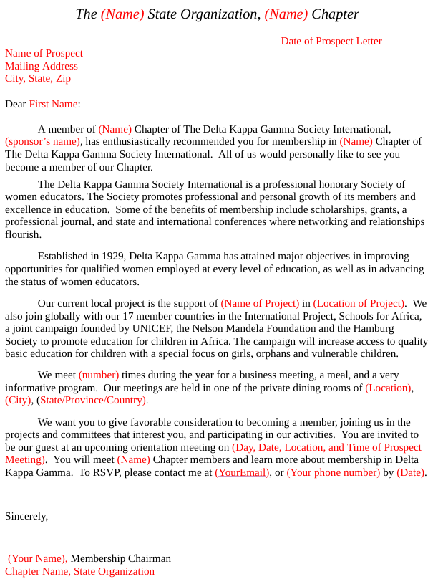

Slide 9
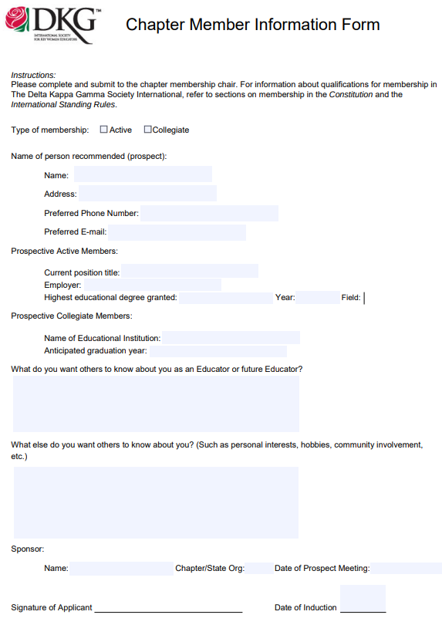

Slide 10
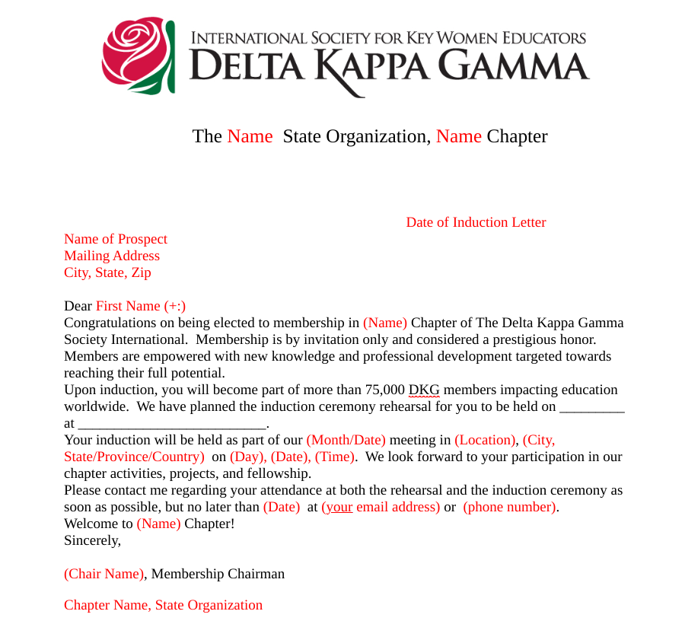

Slide 11
Retain
Stay on course
Meaningful programs
Involve all members
Buddy up

Slide 12
Reinstate
Recalculating
Annie Calling

Slide 13
Let's remember that DKG is more than numbers. Yes, we want to grow but let us look inside each chapter and see what we are doing to keep members and build our chapters. What can you do to build a positive team spirit and continue on with the passion and determination of our founders? What does DKG mean to you?

Slide 14
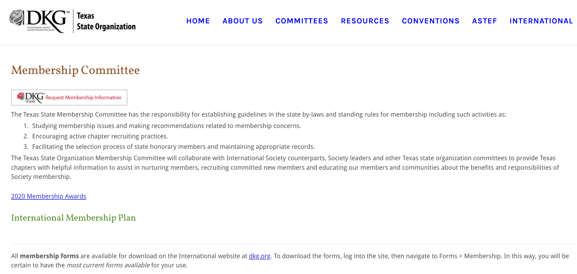
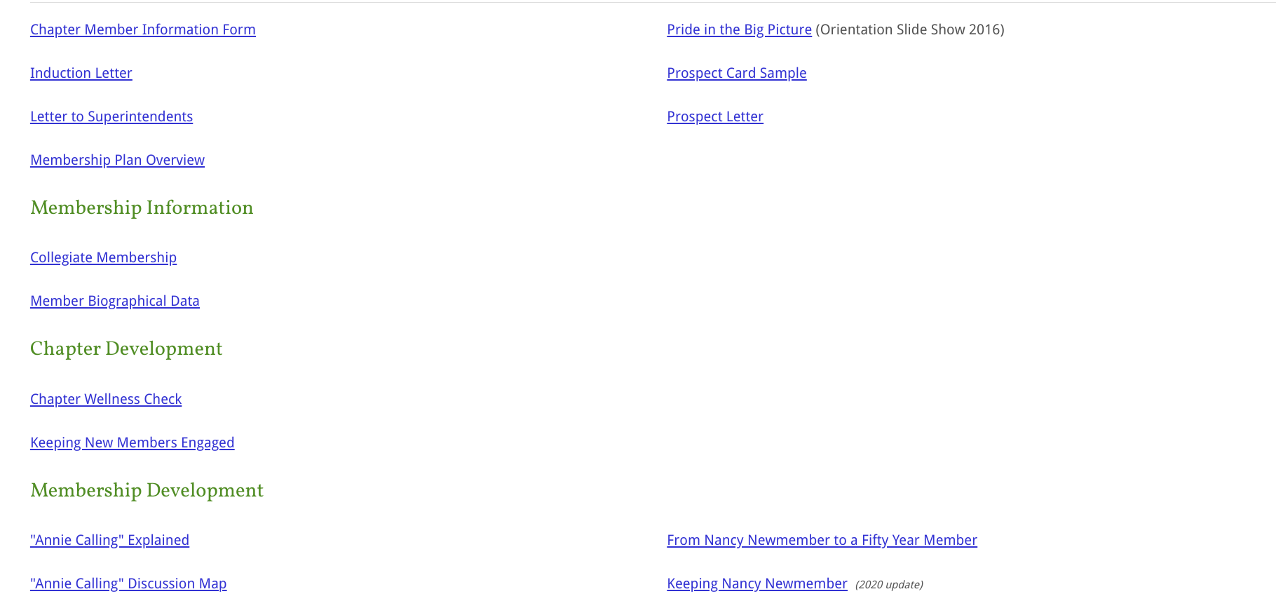
Membership GPS
https://www.dkgtexas.org/membership-committee.html

Slide 15
Slides created by Lori Shontz
Free templates for all your presentation needs

