Slide 1

ACHIEVEMENT AWARD COMMITTEE
Texas State Organization
The Delta Kappa Gamma Society International

Slide 2
2019-2021 TSO
Achievement Award Committee
    Chair Diane Moose - Area 3
    Karolyn Caldwell - Area 5
    Dr. Barbara Hryekewicz – Area 10

Slide 3
2019-2021 TSO
Achievement Award Committee
    Andi Kirby – Area 17
    Sandra Morales - Area 7
    Patti Belknap – Area 9 (Ex Officio)

Slide 4
Committee Website Information
Texas State Organization strives to recognize members who have given outstanding service to DKG at the state level.
Notes:
Barbara Achievement Began: 1948 Golden Rose Began: 1993

Slide 5
The recognition is given in the form of the Texas State Achievement Award, which began in 1948, and the Golden Rose Award that began in 1993.

Slide 6
These awards are presented annually during the Texas State Organization Convention.

Slide 7
Each award has different criteria and a specific nomination form.

Slide 8
It is the responsibility of the Achievement Awards Committee to review completed nominations and to select the recipients for each award.

Slide 9
In order to qualify for the Texas State Achievement Award, a member must have served as a chapter president and completed two or more leadership roles at the state level.
Notes:
Barbara

Slide 10

State Level Leadership Roles
State officer
State Convention chair or co-chair
ASTEF officer or ASTEF board director
State committee chair
Area coordinator

Slide 11
Additionally, the member should have been a workshop leader and have good attendance at area, state, regional and international meetings.

Slide 12
The Golden Rose Award is designated for those members who are not eligible for the Texas State Organization Award; but, have given years of service at the state level through workshop participation, committee work, and attendance at Delta Kappa Gamma conventions.

Slide 13
Completed nomination forms for both awards should be electronically submitted to the State Achievement Awards Chair by February 1st of each year.

Slide 14
The award nominations forms are actually outlines for the person making the nomination to follow.
The award nominations forms are actually outlines for the person making the nomination to follow.

Slide 15
Location of Nomination Outlines
Texas State Organization Website at dkgtexas.org
Deadlines/Forms page
Achievement Award Committee page

Slide 16
To Access the Committee Page:
Type dkgtexas.org into the address line of your web browser.
Find the “hamburger” menu and click it.
Click on Committees.
Click on Achievement Award.

Slide 17
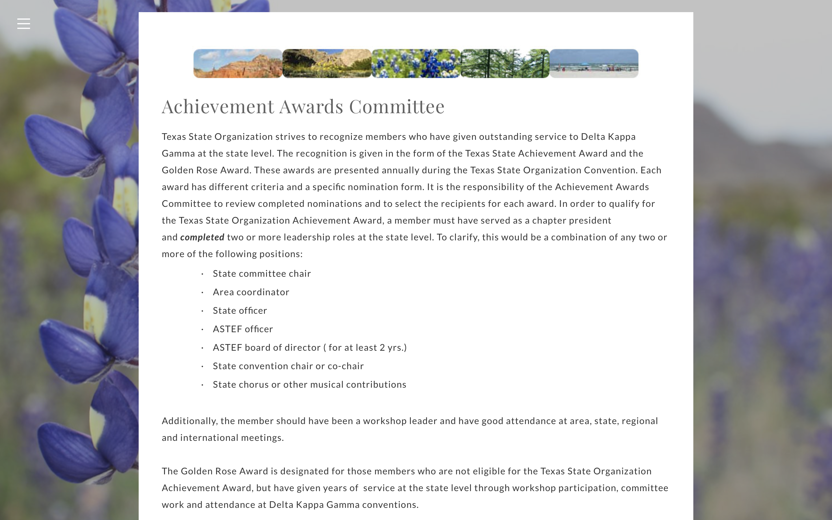

Slide 19


Pins
Golden Rose Award
State Achievement Award
Notes:
Carolyn

Slide 20
Ways to Honor Chapter Members’ Achievements
Chapter Achievement Award rose guard pin or alternative
Certificate of appreciation
Donation to ASTEF in member’s honor
Small gift in recognition of service

Slide 21
Lists of previous Achievement Award and Golden Rose recipients can be found on the Achievement Award committee webpage.

Slide 22
Additional Information
You may visit the webpage for the TSO Achievement Award Committee to read more about the requirements for the State Achievement and Golden Rose Awards and print outlines to follow when making a nomination.

