Slide 1
Your Chapter’s Financial Journey:
Returning Treasurers – Next Part of the Journey
Graphic used are from TSO Website

Slide 2
Do you know the number one form that Treasurers forget to send with their order and pay?

Slide 3
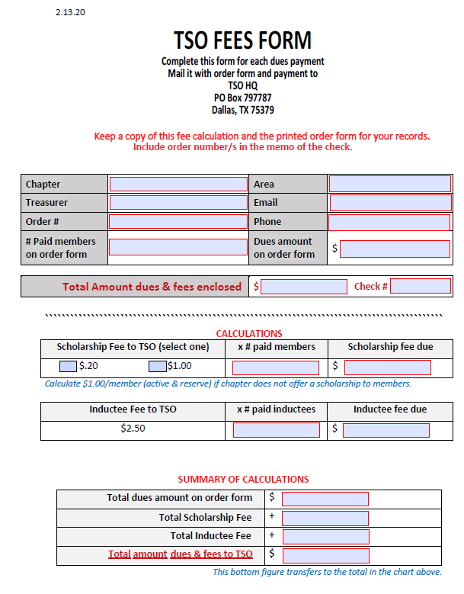

Slide 4
TSO Website Resources:
www.dkgtexas.org
Do you use these helpful sheets and slideshows?

Slide 5
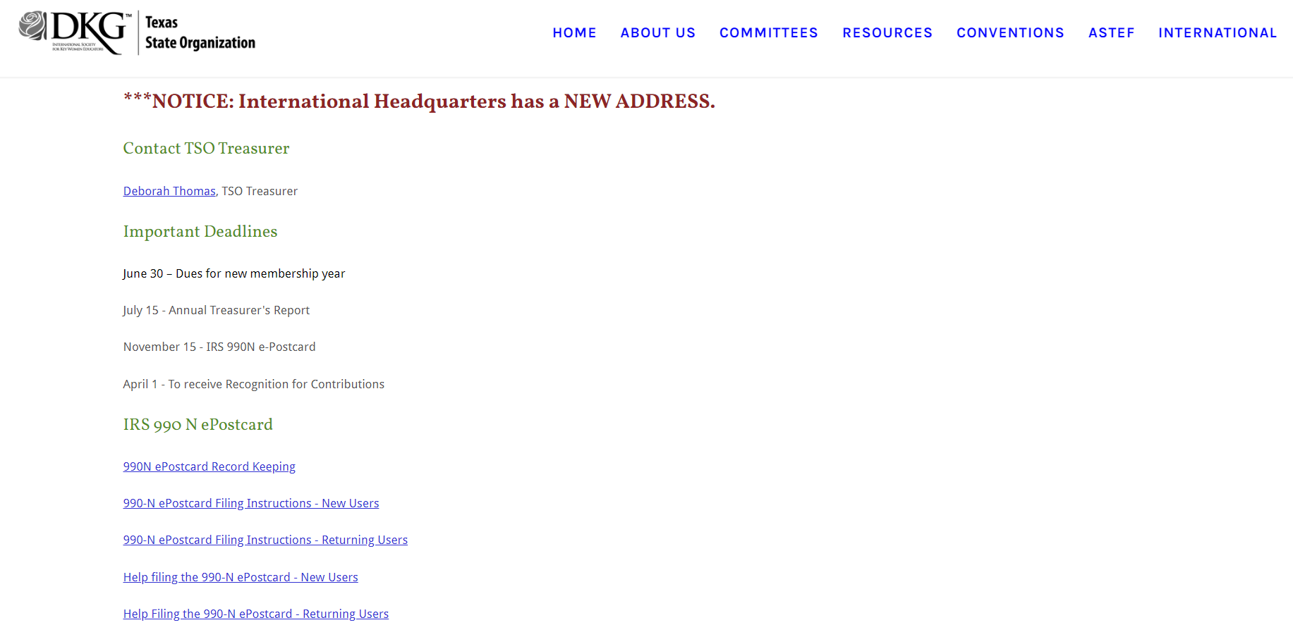

Slide 6
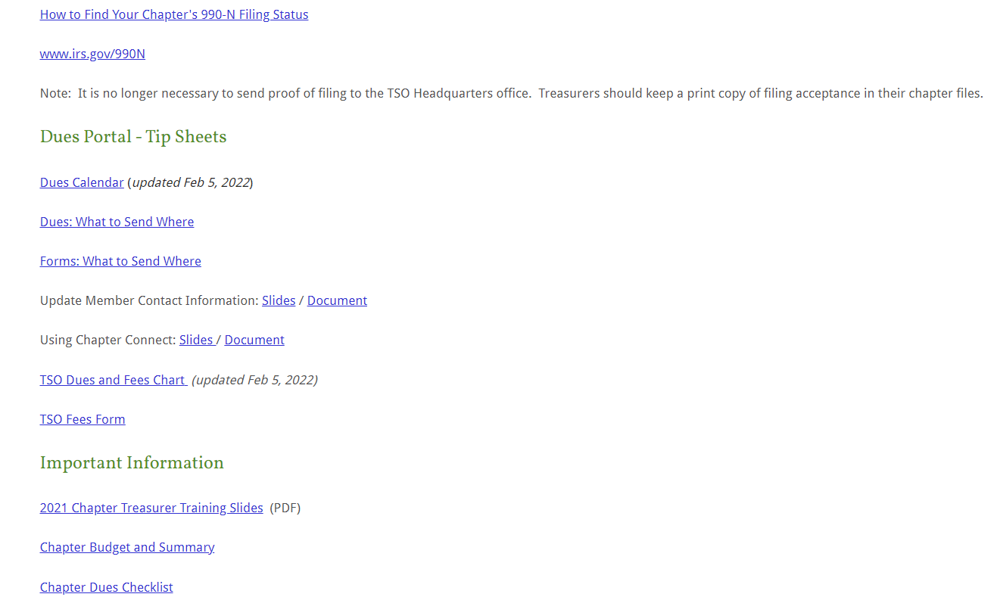

Slide 7
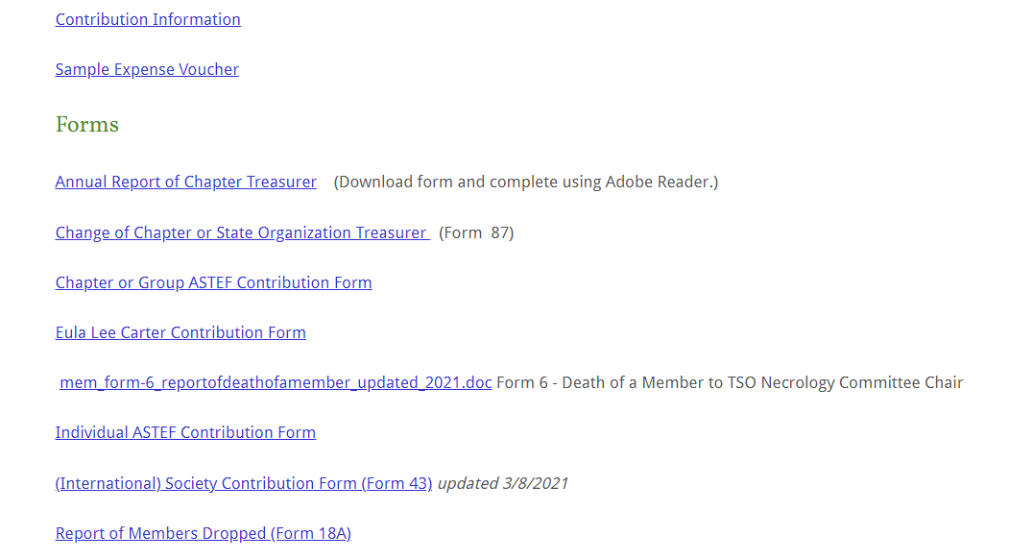

Slide 8
DKG International Website Resources
www.dkg.org
Have you discovered what you find to use in your account under Chapter Connect?

Slide 9
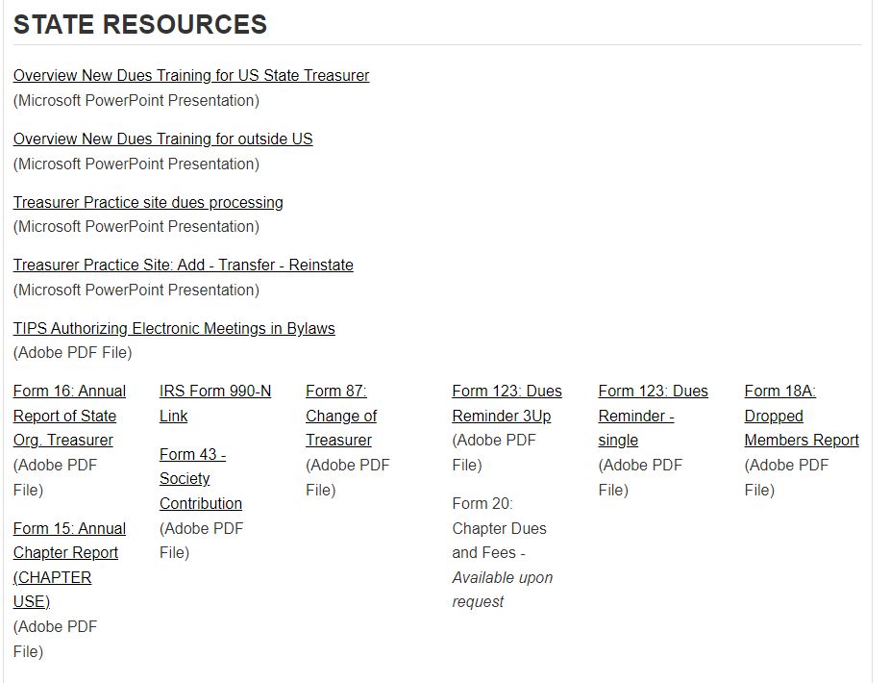
State Resources are found below your chapter information.

Slide 10
Another resource to sign up and join is the Treasurer’s Community.
Here you can ask other treasurer’s questions or see questions others are
asking. Recently they held a round table discussion with State Treasurers
and Chapter Treasurers.
Once you are in your account on the red ribbon you will see
My Communities. Here is where you can sign up to join the Treasurer’s
Community.

Slide 11
Reminders:
You and your Executive Board should be working as a team.
You should not be doing everything by yourself.
Assign or ask one of the officers to help make sure each member’s information is up to date and updated in the portal. Every member can update their own information or someone can help the members that don’t use a computer.
Ask another officer to call the members that haven’t paid yet.

Slide 12
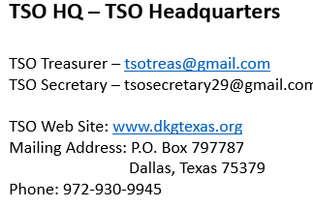
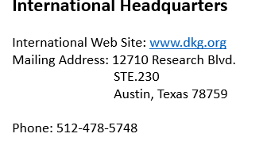
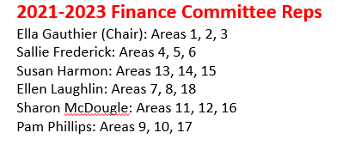
Where to go for help…
President’s Kit on dkgtexas.org
Each President has the password to get into the protected site.
Here you will find other President’s and Treasurer’s you can visit with and ask questions. You can find your Finance Committee Reps Information also.

Slide 13
Thanks so much for coming to our
Treasurer Training
TSO State Treasurer – Deborah Thomas
Email – tsotreas@gmail.com
Headquarters phone number – 972- 930-9945
TSO Executive Secretary – Leesa Cole
Email – tsosecretary29@gmail.com
Headquarters phone number – 972-930-9945
And the wonderful TSO Finance Committee

