Slide 1
WELCOME TO LDCP
Please sit with your Area
Save an empty seat next to you each day for your chapter leadership who will join you later.

Slide 2
Texas State Organization
President’s Road Map 2022-2024
President’s Kit:
Journey21&23
Shalan Inmon, President
Janet Helmcamp, LDCP Chair
TEXAS STATE ORGANIZATION
THE DELTA KAPPA GAMMA SOCIETY INTERNATIONAL
Notes:
JANET: Welcome and introductions.

Slide 3
LDCP Sessions
Thursday, June 17th - 2:00 - 2:45 PM
Session 1: I’m the President, Now What?
Thursday, June 17th - 3:00 - 3:45 PM
Session 2: Membership (with your membership chair)
Friday, June 18th - 8:30 - 8:50 AM & 9:00 - 9:45 AM
Session 3: Parliamentary Procedure/Finance (with your treasurer)
Friday, June 18th - 10:00 - 10:45 AM
Session 4: Resources/Programs/Projects (with your programs chair)
Notes:
JANET: Welcome and introductions.

Slide 4
Presenters
I’m the President, Now What?
Janet Helmcamp, Shalan Inmon, Patti Belknap, & Janie Stone
Membership
Michelle Grandenetti, Phyllis McPherson, & Janet Pipkin
Parliamentary Procedure
Dr. Helen Popovich, International Representative
Finance
Charlotte Nyman, Nelle Gentry, Leesa Cole, Ella Gauthier, & Deborah Thomas
Resources/Programs/Projects
Bonne Moore, Mandy Story, Stacey Arnold, & Janet Helmcamp
Notes:
JANET: Welcome and introductions.

Slide 5
LDCP Session 1
I’m the President…NOW WHAT?
Notes:
JANET:

Slide 6
TSO 2021 - 2023 Goals
Nurture - Develop relationships with current and new members
Serve - Give of your time to others
Educate - Promote the purposes and mission of DKG to others
Wonder - Dream, Ask, Reflect
Notes:
SHALAN:

Slide 7
Dates to Remember on the Journey
July 2022
1 - Chapter Officers 22-24 begin
1-2 - DKG Ignite, Austin
3 - TSO Dues Processing
12 -15 - Int’l Convention, New Orleans
14 - TX Event, New Orleans
15 - Form 15: Chapter Treas. Annual Report Due
August 2022
6 - AW 6, 8
13 - AW 15
20 - AW 1 4, 7, 14
27 - AW 5, 11, 16
September 2022
10 - AW 2, 9, 10, 12, 18
17 -AW 3, 13, 17
23-24 - ASTEF Board Zoom
October 2022
1-2 - TSO Exec. Comm.
15 - Leadership Seminar Apps. Due
31 - Chapter Website Compliance Fm. 72 Due
November 2022
1 - LSN Article
1 - Fall Mini-Grant Applications Due
15 - IRS Chapter Filing 990N, ePostcard Due
December 2022
January 2023
13-15 - STAR Retreat
31 - ASTEF Proj. Mid-Year Report Due
February 2023
1 - LSN Article
1 - Nomination for TSO Achievement and Golden Rose Due
1 - Annual Necrology Report Fm. 2 Due
1 - Chapter President Report to State President Due
1 - Nomination Forms for TSO Committees Due
1-28 - ASTEF Giving Month
15 - Convention Breakout Session Applications Due
17-19 - Leadership 2023 Event ?????
March 2023
1 - ASTEF Aspiring Educator Applications Due
1 - TSO State Scholarship and Spring Mini-Grant Applications Due
April 2023
1 - LSN Article
1 - ASTEF Project Stipend Applications Due
1 - ASTEF Advocate for Education Applications Due
1 - Chapter Spotlight Program/Project Submission Due
1 - Member in Print and Media Recognition Forms Due
1 - Contributions to TSO Funds Due (for convention recognition)
15 - TSO McAllen Convention Visual Arts Applications Due
May 2023
11 - Founder’s Day
15 - TSO Convention Early Registration Due
June 2023
15-17 - TSO Convention McAllen
Notes:
SHALAN: Refer them to the interactive calendar in the President’s Kit

Slide 8
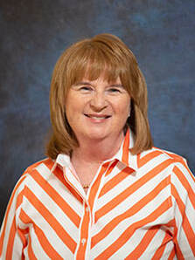
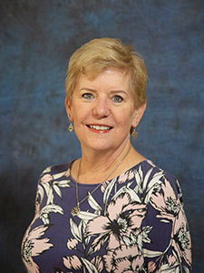
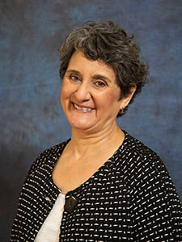
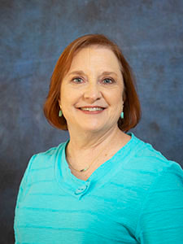
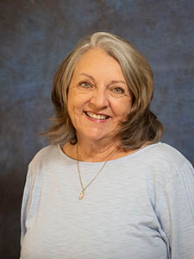
Texas State Organization Executive Committee
Second Vice President
Michelle Grandinetti
​Theta Alpha,
Area 9
Recording Secretary
Dr. Stacey Arnold
​Kappa Lambda, Area 7
Corresponding Secretary
Charlotte Nyman
Alpha Pi,
Area 17
President
​Shalan Inmon
Alpha Sigma,
Area 12
First Vice President
Bonnie Moore
Eta Delta,
Area 3
Notes:
PATTI: Elected officers - Tell what EC is - explain each position - refer to the directory pages in President’s Kit.

Slide 9
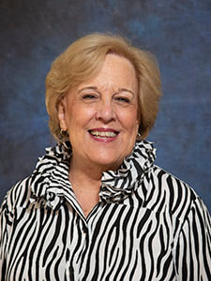
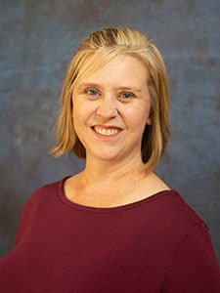
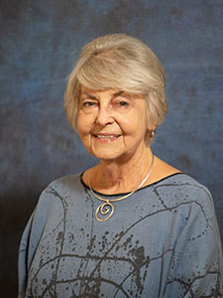
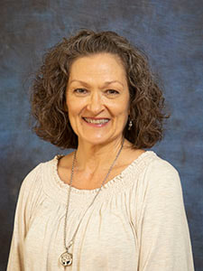
Ex-Officio Executive Committee Members
Immediate Past President
Patti Belknap
Theta Alpha,
Area 9
Parliamentarian
​Mandy Story
​Iota Omicron,
Area 16
ASTEF President
Dr. Rosemary Morrow
Alpha,
Area 7
TSO Executive Secretary
Leesa Cole
Delta Omicron, Area 9
Notes:
PATTI: Explain Ex Officio and PSP and ASTEF

Slide 10
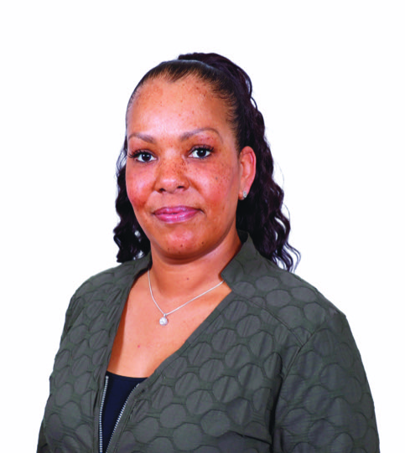
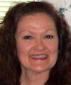
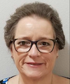
TSO Headquarters Staff
Executive Secretary
Leesa Cole
Treasurer
Deborah Thomas
Business Assistant
Vanessa Diggens
tsosecretary29@gmail.com
tsotreas@gmail.com
Notes:
SHALAN:

Slide 11
TSO Committees
Society Business
Archives
Bylaws and Rules
Ceremonies
Communications & Publicity
Expansion
Finance
Headquarters
LDCP
LOSP
Membership
Necrology
Nominations
Personnel
Technology
Yearbook
Society Mission & Purposes
Achievement Award
Educational Excellence
Global Awareness
Legislation
Music
Personal/Professional Enrichment
Programs/Service Projects
Research
Women in the Arts
E.L. Carter Fund
Leadership Seminar
Scholarship
Strategic Plan of Action (SPA)
**Chapters choose which committees they include
based on their need and size.
Notes:
SHALAN: Refer chapter presidents to the directory pages - Explain Necrology, Educational Excellence, SPA in another session
Peruse committees...any committees need further explanation?
Your chapter is NOT required to have all these committees - you may have the chapter committees YOUR CHAPTER NEEDS - check in your chapter rules for what they are currently in your chapter

Slide 12
TSO Mentors 2021-2023
Bonnie Moore | Areas 2, 8, 15
Michelle Grandinetti | Areas 3, 4, 18
Stacey Arnold | Areas 5, 6, 7
Charlotte Nyman | Areas 1, 9, 17
Mandy Story | Areas 10, 13, 16
Patti Belknap | Areas 11, 12,14
*Contact information is located in your President’s Kit.
Notes:
PATTI: Explain mentors and the value of this relationship.

Slide 13
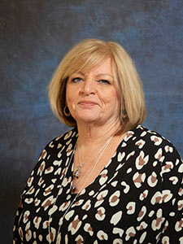
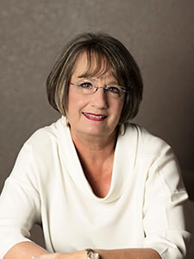
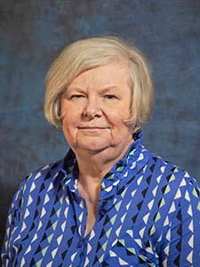
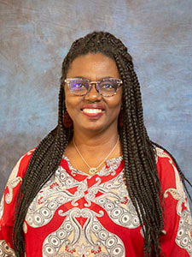
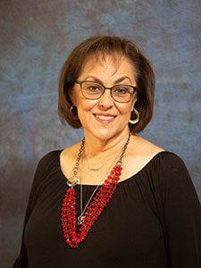
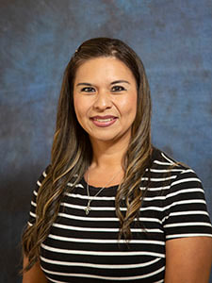
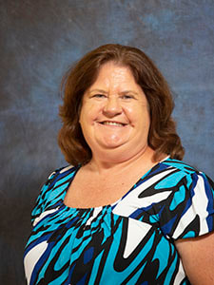
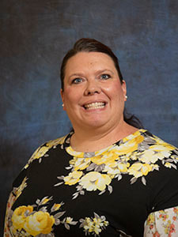
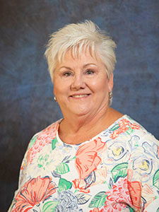
Area Coordinators 2021-2023
Area 1 Coordinator
Marsha Edney
​Phi
Area 2 Coordinator
Susan Daigle
​Delta Theta
Area 3 Coordinator
Barbara Coon
​Theta Sigma
Area 4 Coordinator
​Salethia Morris
Lambda Sigma
Area 5 Coordinator
Mellie Smithwick
​Beta Pi, Area 5
Area 6 Coordinator
Jennifer Garcia
Zeta Beta
Area 7 Coordinator
Nancy Varljen
​Kappa Lambda
Area 8 Coordinator
Shanna Denson
​Zeta
Area 9
Elizabeth "Liz" Garrett
​Nu Gamma
Notes:
JANET: Describe what an Area Coordinator can do for the chapter.

Slide 14
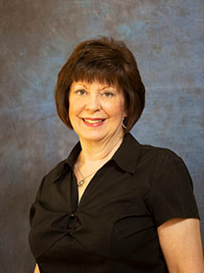
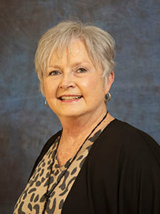
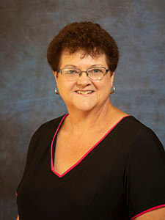
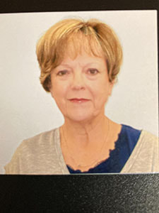
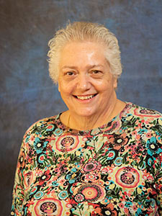
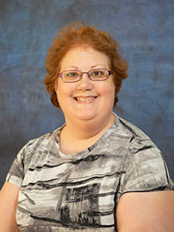
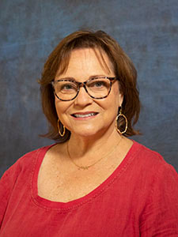
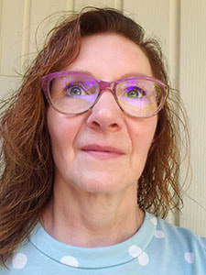
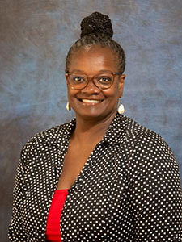
Area Coordinators 2021-2023 (continued)
Area 10
Toni McCutchen
Kappa Delta
Area 11
Cecelia Cates
​Eta Alpha
Area 12
Sonja Hanks
​Beta Epsilon
Area 13
​Nancy Lowry
​Omega
Area 14
Melody Drinkard
​Theta Mu
Area 15
Melissa Mathews
Mu Kappa
Area 16
Lezli Collins
​Iota
Area 17
Debora Shidemantle
​Alpha Pi
Area 18
Teresa Toliver
​Kappa Kappa
Notes:
JANET: More AC info.

Slide 15
Eight Chapter Mandates
Members are elected to membership based on particular qualifications.
Members complete financial responsibility.
Chapters must have Rules that are consistent with the Constitution and its state organization bylaws.
Chapters must elect and appoint particular officers who must be members. Chapter officers are elected in even-numbered years.
Chapters must have an Executive Board, with defined duties, that meets at least twice per year
Chapters adhere to the Purposes and Mission Statement. They are responsible for Society duties and may created committees to complete that work.
Chapters must submit annual and biennial reports.
Chapters must have at least four (4) regular meetings per year.
Source: Go-To Guide for Chapter Members 2019
Guidelines for Chapter Leaders 2019
Notes:
PATTI:

Slide 16
Successful Chapter Practices - Meetings
Holds 4-6 well-planned, relatively informal, quick moving business meetings per year (Only 4 business meetings are required)
Meets at varied times, days, and places convenient for working members
Meets for approximately 1 ½ hours in length, excluding meals
Has more refreshment-only meetings than meetings with meals
Plans fellowship time as part of each meeting
Focuses on meeting members’ social needs (fellowship/camaraderie)
Has open meetings and activities that welcome non-members
Has a wide variety of high-quality, interesting programs and speakers, including programs that highlight community initiatives and those that use members’ talents/expertise
Supports a variety of one-time and ongoing projects that actively engage members
Notes:
PATTI:

Slide 17
Successful Chapter Practices (continued)
Supports projects in the areas of mentoring/Collaborative Connections; fundraising and volunteer efforts; scholarships and grants-in-aid; community initiatives, especially for women and children; literacy; the legislative process; and others, including international projects
Communicates with members in multiple ways: newsletter (print, website or email 4+ times a year), phone, email, snail mail, website
Publicizes the Society through projects and activities that receive newspaper coverage as well as school and community recognition
Has specific strategies in place for attracting new members, retaining members, engaging retired and employed members, and developing/nurturing new chapter leaders
Implements formal and traditional induction and installation ceremonies
Notes:
JANIE:

Slide 18
Successful Chapter Practices (continued)
Emphasizes the Society’s mission, purposes, and history
Offers benefits and services that members cannot get elsewhere, including chapter scholarships, grants, interaction among a diverse group of educators, friendship/camaraderie, and service to the community
Keep Hard Copies of the following:
Biennium History - written by the president
Newsletters
Yearbook
Minutes of business meetings
Treasurer’s report
Send all historical documents to archives
Keep most current only
TSO HQ - archives committee
Notes:
JANIE:

Slide 19
Healthy Routines for your Journey
1st of every month - check your calendar
Keep a folder or a binder organized month-by-month
Push out communication from TSO & Area Coordinators immediately and respond to the communication with “Got It”
Plan an agenda 1 week before your meeting; share with 1st VP Secretary, & Treasurer prior to the meeting.
Assign greeters to help people get acclimated at each meeting
Plan your year or two years of programs/meetings at your executive board meeting. Don’t forget to include your committee chairs.
Program names & business or nonbusiness
Times
Dates
Locations
Survey members about their choice of times and days to meet regularly
Pick an accountability partner NOW and find one in your chapter also
Use past chapter presidents
Call on them to fulfill roles at meetings and ask them for advice
Assign them to help the new president, secretary, treasurer, membership & program chairs
Use your Area Coordinator and Area Mentor
Notes:
JANIE: Talk about your binder here

Slide 20
Reference Guide
President’s Kit:
Journey21&23
Topic |  | Guidelines for Chapter Leaders | Go-To Guide 2019 | TSO/LDCP “Keys to Success” 2020-2022 | TSO Website
Eight Chapter Mandates |  | p. 6 | p. 64
Duties of Chapter President |  | pp. 7, 8 |  | Chapter Goals Chapter Wellness Chapter Self Assessment
Chapter Executive Board |  | p. 9 | p. 7
Chapter Structure, Culture and Inclusion |  | p. 10 | pp. 39-41 | Successful Chapter Practices
Communications |  | p. 11 | p. 11
Chapter Meetings |  | pp. 14-17 | p. 7
Chapter Finances and Treasurer Duties |  | pp. 19-25 | pp. 13-16 |  | TSO Treasurer’s Page www.dkgtexas.org
Membership |  | pp. 34-37 | pp. 16-19 | Recruitment Plan | www.dkgtexas.org
ASTEF |  |  |  | ASTEF | www.astef.org
Notes:
JANET:

Slide 21
As a Chapter President remember, it’s your…
Notes:
JANET:

