Slide 1
Global Awareness Committee
Trudy Matus, Chair
matustd25@gmail.com

Slide 2
WHAT IS THE GLOBAL AWARENESS COMMITTEE
The primary purpose of the TSO Global Awareness Committee is to promote the global projects, initiatives, and goals of DKG International. Those include Schools for Africa, World Fellowship, the United Nations involvement, and the Conference for Teaching About the United Nations (CTAUN). The Global Awareness Committee also strives to provide members with activities, programs, and projects that advance global awareness both in the chapter and in the classroom.

Slide 3
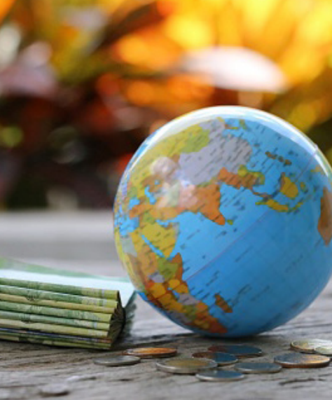
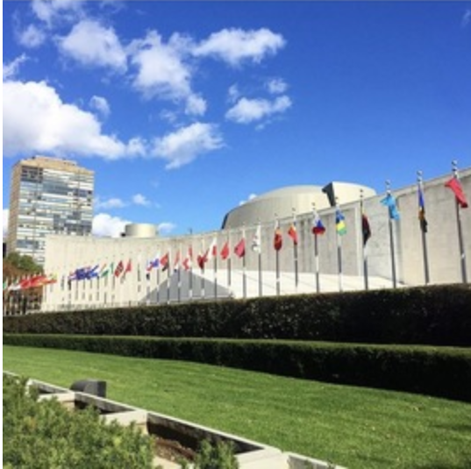
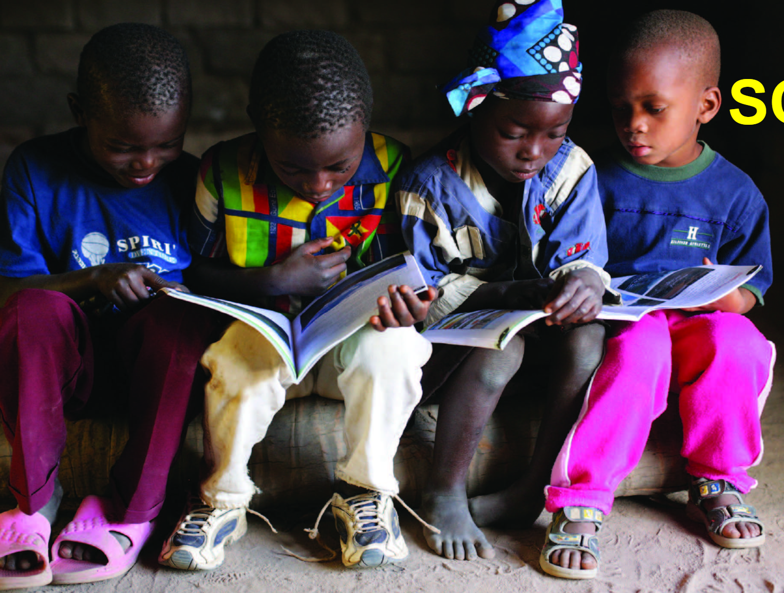
Global Awareness Committee Four (4) Components
World Fellowship
Schools for Africa
Delta Kappa Gamma/United Nations Connection
Committee on Teaching about the United Nations

Slide 4
Global Awareness Committee Four (4) Responsibilities
To educate members about the four components
To encourage members to support the international projects and programs
To encourage members to be informed global citizens
To encourage educators to be informed, active global educators

Slide 6
CULTURAL COMPETENCIES
Cultural Awareness
Cultural Understanding
Cultural Knowledge
Cultural Interaction
Cultural Understanding

Slide 7
BE A GLOBAL CHAPTER
Consider including a fun and interactive program that gives members opportunities to share activities that incorporate global education in each content area, and that are simple and easy to prepare.
Have a discussion in your chapter around the topic “What it means to be a global citizen.”
Invite members or guests of diverse cultural backgrounds to share their unique histories, practices, celebrations, and educational systems.
Contribute to World Fellowship so that women who are eager to study in the United States may have the opportunity to attend in one of our great schools.
Support the Schools for Africa project which provides educational opportunities to children in 21 African countries.

Slide 8
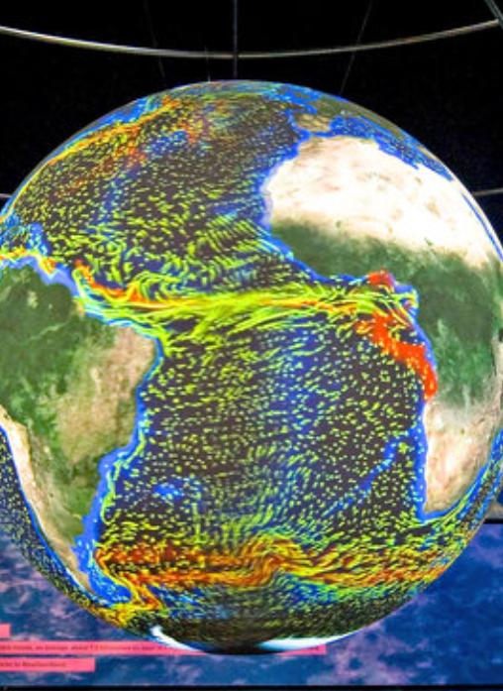
Resources for the Global Awareness Committee
TSO Website www.dkgtexas.org under the committees tab, Global Awareness
DKG Website www.dkg.org
To request a program for your chapter or get more information, contact Trudy Matus, committee chair at matustd25@gmail.com or your area Global Awareness committee member (found on the TSO website)

